Slide 1
Internal Consistency Reliability Analysis
Cronbach’s Alpha

Slide 2
It is very common in psychological research to collect multiple measures of the same construct.
For example, in a questionnaire designed to measure task goals, there are typically many items that collectively measure the construct of task goals. To have confidence in a measure such as this, we need to test its reliability, the degree to which it is error-free.
The type of reliability we'll be examining here is called internal consistency reliability. the degree to which multiple measures of the same thing agree with one another.

Slide 3
What is reliability?
A reliable measure is reproducible and precise: each time it is used it produces the same results, all else being equal.
Internal consistency reliability analysis is a parametric procedure used to evaluate the consistency of results across items within a single scale (i.e., instrument) or subscale that is composed of multiple items.
All items in an internally consistent scale assess the same construct.
The most fundamental problem with single item measures is not merely that they tend to be less valid, less accurate, and less reliable than their multi-item equivalents.
It is rather, that the social scientist rarely has sufficient information to estimate their measurement properties. Thus their degree of validity, accuracy, and reliability is often unknowable (McIver and Carmines, 1981, p. 15).
IMPORTANT!! THE SCALE SHOULD INCLUDE AT LEAST 2 ITEMS!!!

Slide 4
Procedures for estimating reliability produce a reliability coefficient, which is a correlation coefficient that ranges in value from zero to + 1.0. When a reliability coefficient is zero, all variability in obtained test scores is due to measurement error. Conversely, when a reliability coefficient is 1.0, all variability in scores reflects true score variability.
Reliability coefficients can be interpreted as follows:
George and Mallery (2003) provide the following rules of thumb: “> .9 – Excellent, > .8 – Good, > .7 – Acceptable, > .6 – Questionable, > .5 – Poor, and
< .5 – Unacceptable” (p. 231).
While increasing the value of alpha is partially dependent upon the number of items in the scale, it should be noted that this has diminishing returns. It should also be noted that an alpha of .8 is probably a reasonable goal. It should also be noted that while a high value for Cronbach’s alpha indicates good internal consistency of the items in the scale, it does not mean that the scale is unidimensional.

Slide 5
Conclusion
When using Likert-type scales it is imperative to calculate and report Cronbach’s alpha coefficient for internal consistency reliability for any scales or subscales one may be using. The analysis of the data then must use these summated scales or subscales and not individual items. If one does otherwise, the reliability of the items is at best probably low and at worst unknown.
Cronbach’s alpha does not provide reliability estimates for single items

Slide 6
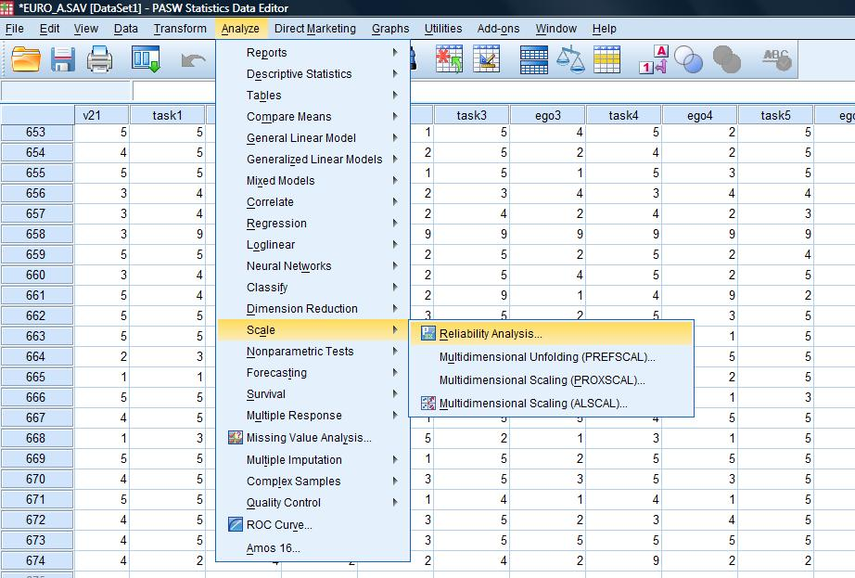
EXAMPLE Reliability of task goals
1) Analyze- Scale -Reliability Analysis

Slide 7
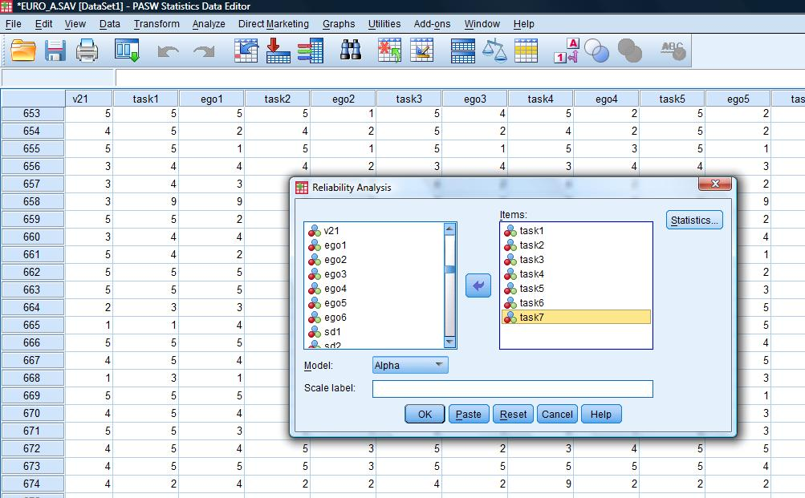
2) Select variables from task1 to task7 and with the arrow insert them to Items: Then click Statistics

Slide 8
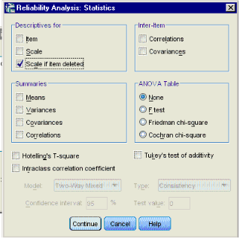
Click on the box labelled Statistics and select Scale if item deleted (explained below).

Slide 9
Click on the box labelled Statistics and select Scale if item deleted (explained below).
Press 'Continue' and then 'OK.' You should get the following output.

Slide 10
OUTPUT

Slide 11
Improving Reliability
If you are using an accepted scale obtained from a published source, you do not need to worry about improving reliability. You should use the whole scale, even if it has problems, because if you start changing the scale you will be unable to compare your results to the results of others who have used the scale. You only want to improve the reliability of a scale if it is a scale you are developing. IN OUR EXAPMPLE THE ALPHA IS .78 AND IF YOU DELETE ANY OF THE ITEMS (SEE COLUMN CRONBACH’S ALPHA IF ITEM DELETED) IT WILL DECREASE…

Slide 12
Improving Reliability
If one of the “Alpha if item deleted” values is greater than the overall alpha, you should re run Analyze > Scale > Reliability Analysis after moving the offending item from the “Items” box back over to the unused items box.
Repeat this process until there are no values in the “Alpha if item deleted” column that are greater than the alpha for the overall scale.

Slide 13
Computing a mean score for a questionnaire
The goal of this whole procedure is to produce a single score for your questionnaire. Once you've used reliability analysis to identify the items that will produce the most reliable measure, you can use those items to create an average score for your questionnaire, as described below.

Slide 14
Computing a mean score for a questionnaire
To compute a mean score, select Transform > Compute. In the Target Variable box, type in the name of your scale, TASK.
In the Numeric Expression box, type the word MEAN, followed by “(” and then a list of the variables (TASK1, TASK2, TASK3, ETC) you want to average together, separated by commas. Make sure you only put in the variables that you decided were the best for the scale. At the end, close the expression with a “)”. Press OK to compute the new variable.

Slide 15
NOTICE - Reverse Scoring
Most of the items are phrased so that strong agreement indicates a belief that the athletes are using task goals.
However, in some scales some items can be phrased in the reverse.
In order to make those items comparable to the other items, we will need to reverse score them.

Slide 16
For example in a questionnaire, participants responded to the items using a 5 point Likert scale ranging from 1 (“Strongly Disagree”) to 5(“Strongly Agree”). When we reverse score an item, we want 1's to turn into 5's, 5's to turn into 1's, and all the scores in between to become their appropriate opposite (4's into 2’s, etc.).

Slide 17
Fortunately, there is a simple mathematical rule for reverse scoring.
reverse score(x) = max(x) + 1 – x
Where max(x) is the maximum possible value for x. In our case, max(x) is 5 because the Likert scale only went up to 7. To reverse score, we take 5 + 1 = 6, and subtract our scores from that
6 - 5 = 1, 6 - 1 = 5.

Slide 18
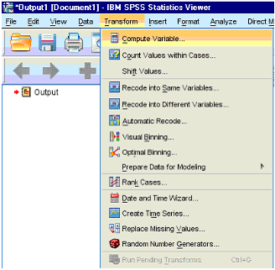
To get SPSS to reverse score.
Transform > Compute Variable
Please see Ntoumanis, 2001 on how you reverse scores using SPSS

Slide 19
CONCLUSION – USUAL STEPS BEFORE YOU CONDUCT ANY ANALYSIS
CHECK FOR ERRORS IN YOUR DATA SET
THEN REVERSE ITEMS IF IT IS NEEDED
THEN RUN RELIABILITY ANALYSIS (DELETE ITEMS IF IT IS NEEDED IN ORDER TO INCREASE ALPHA LEVEL
COMPUTE THE MEAN
RUN NORMALITY TEST IN ORDER TO SEE IF YOU WILL FOLLOW A PARAMETRIC OR NON-PARAMETRIC PROCEDURE…

