Slide 1
Brief Vivado Tutorial CE333, Fall 2021
Stavros Simoglou, Dimitris Valiantzas, Christos Sotiriou

Slide 2
Overview
FPGA Flow
Xilinx Vivado 2021
Create Project
Create Design Constraints (XDC)
Import Xilinx Soft IP
Behavioral Simulation
Synthesis
Gate Level Simulation
Implementation
Post P&R Simulation
Generate Bit Stream
Program

Slide 3
Overview
FPGA Flow
Xilinx Vivado 2021
Create Project
Create Design Constraints (XDC)
Import Xilinx Soft IP
Behavioral Simulation
Synthesis
Gate Level Simulation
Implementation
Post P&R Simulation
Generate Bit Stream
Program

Slide 4
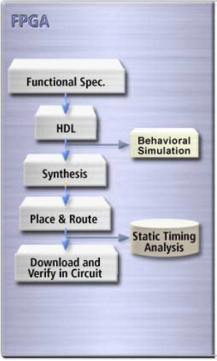
FPGA Flow

Slide 5
Overview
FPGA Flow
Xilinx Vivado 2021
Create Project
Create Design Constraints (XDC)
Import Xilinx Soft IP
Behavioral Simulation
Synthesis
Gate Level Simulation
Implementation
Post P&R Simulation
Generate Bit Stream
Program

Slide 6
Xilinx Vivado 2021
Xilinx Embedded Systems Development Kit

Slide 7
Xilinx Vivado 2021
Xilinx Embedded Systems Development Kit
RTL to FPGA Integrated Solution

Slide 8
Xilinx Vivado 2021
Xilinx Embedded Systems Development Kit
RTL to FPGA Integrated Solution
Latest Version

Slide 9
Xilinx Vivado 2021
How to start Vivado:
Vivado directory contains settings32.sh and settings64.sh scripts
Use command source <Vivado Path>/settings64.sh
Where <Vivado Path> is the installation directory path
Start using the command vivado

Slide 10
Xilinx Vivado 2021

Slide 11
Overview
FPGA Flow
Xilinx Vivado 2021
Create Project
Create Design Constraints (XDC)
Import Xilinx Soft IP
Behavioral Simulation
Synthesis
Gate Level Simulation
Implementation
Post P&R Simulation
Generate Bit Stream
Program

Slide 12
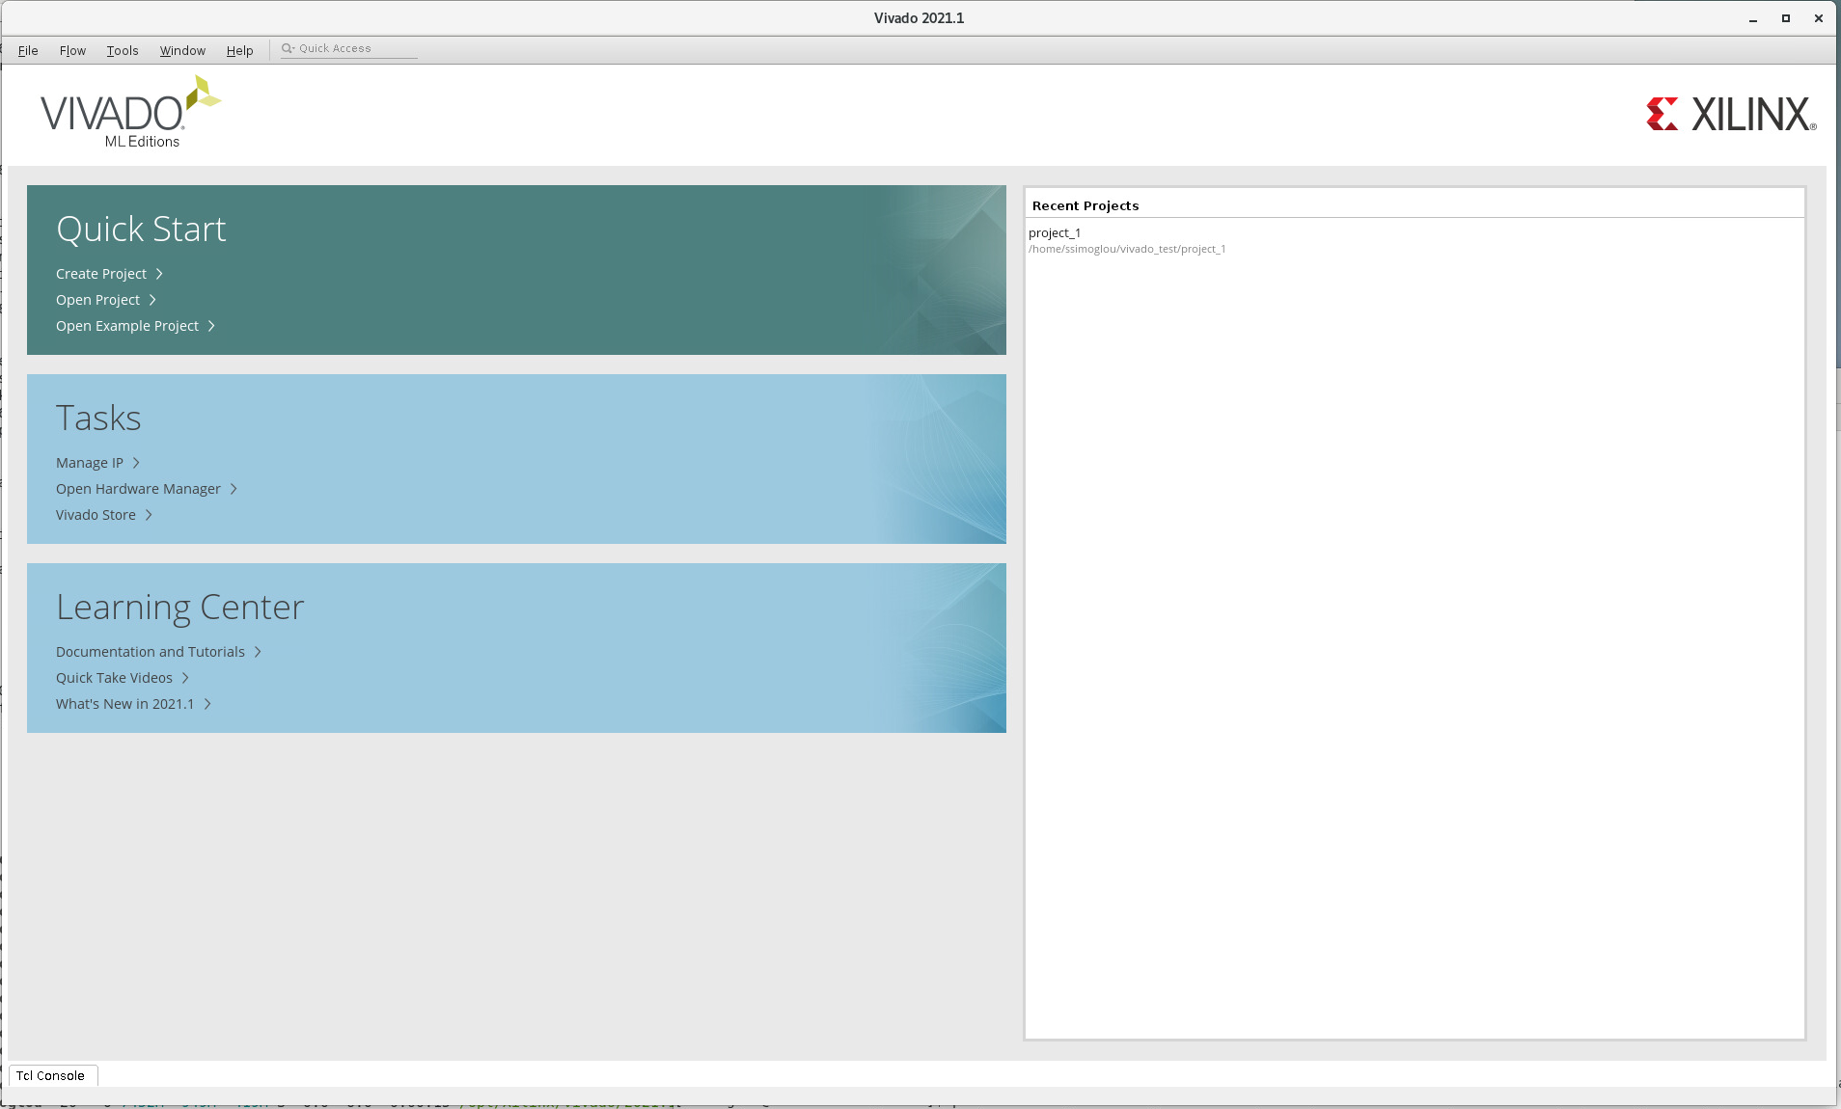
Create Project

Slide 13
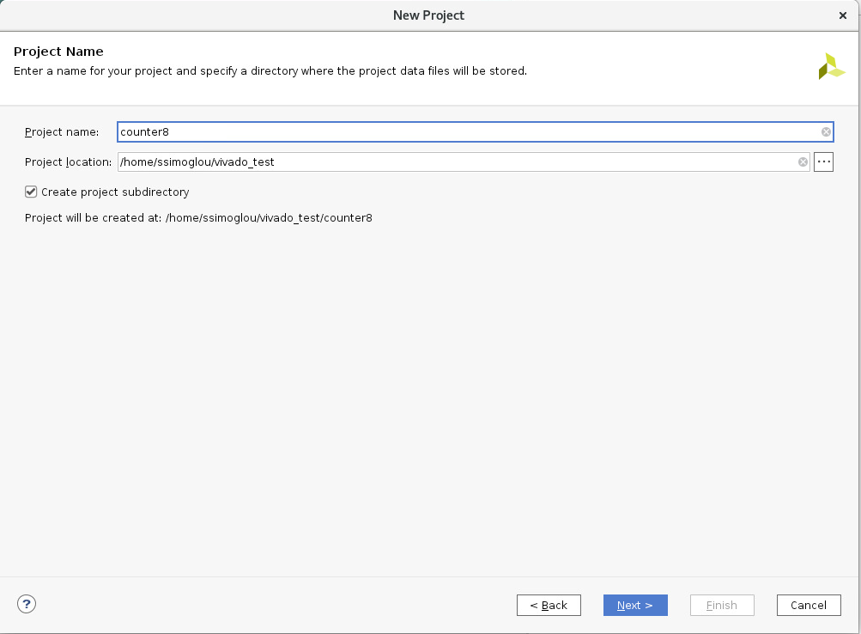
Create Project
8

Slide 14
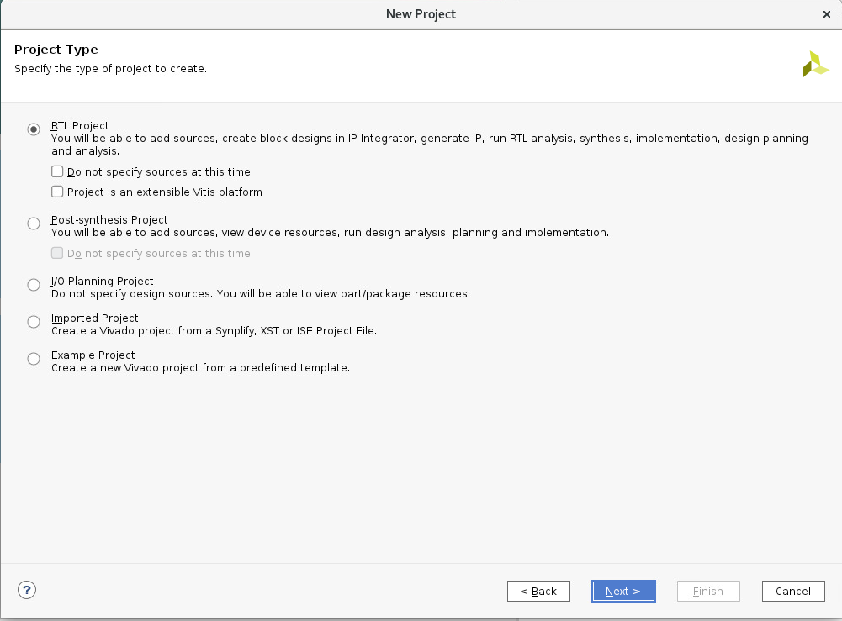
Create Project
8

Slide 15
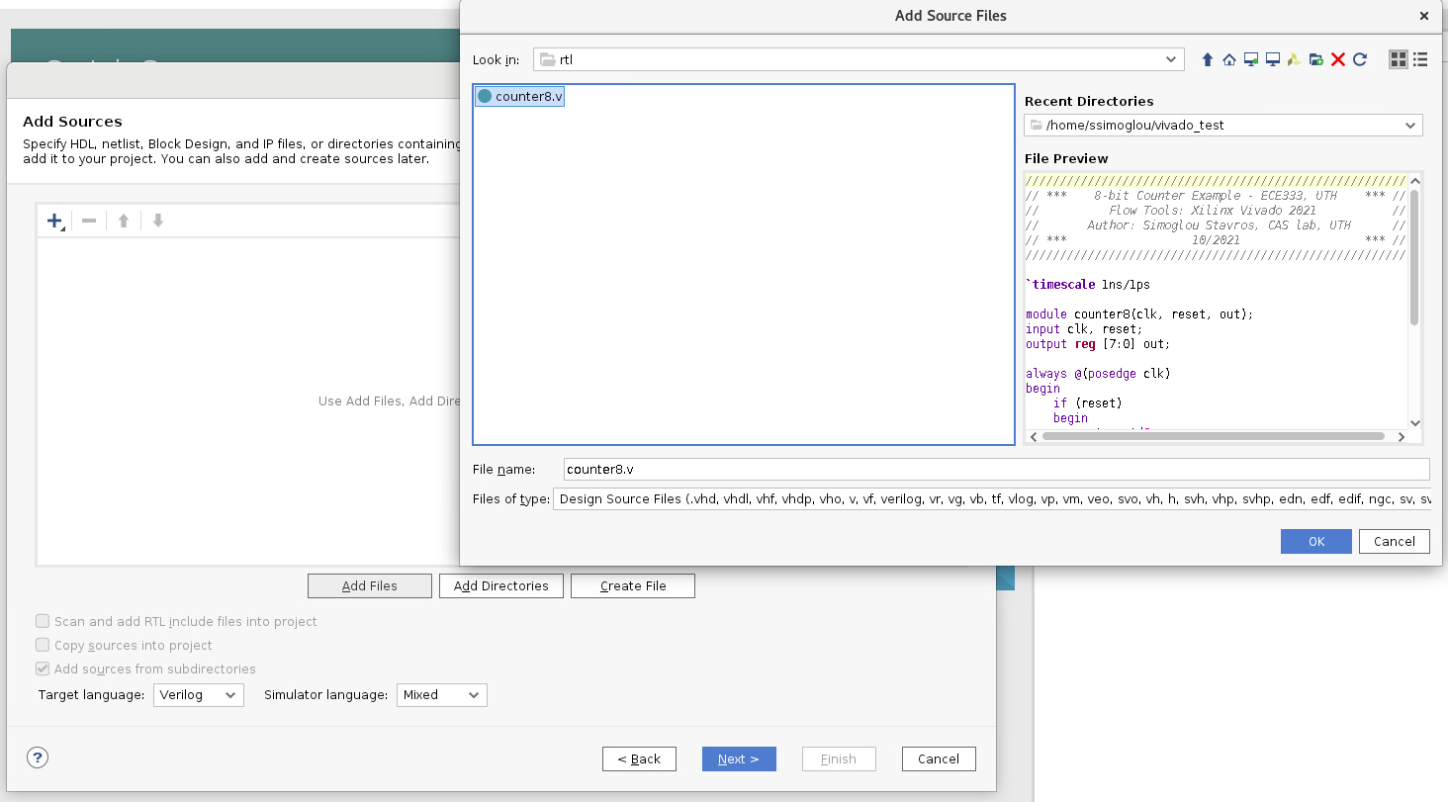
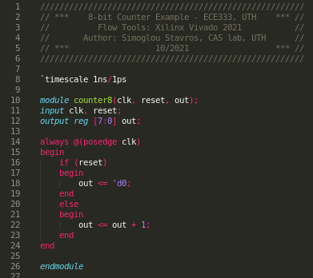
Create Project
8

Slide 16
Create Project
8
Prefer using an external editor of your choice!
Usually more capable than Vivado text editor

Slide 17
Create Project
8
Some suggestions:
Sublime Text, VS Code, Atom, Vim, Emacs

Slide 18
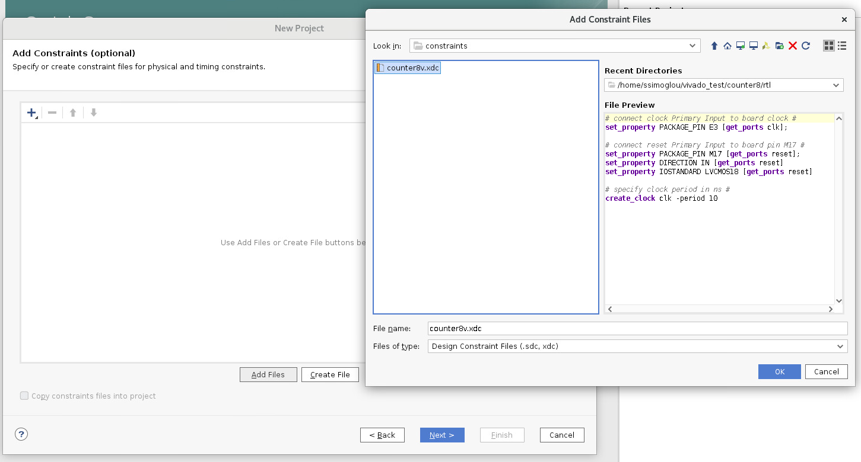
Create Project
8

Slide 19
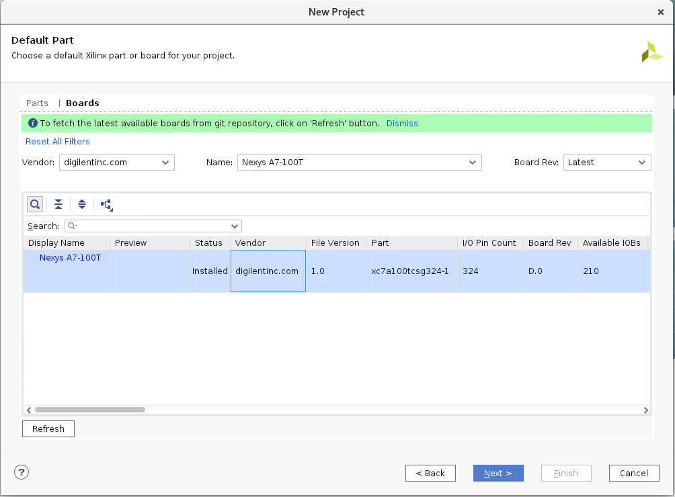
Create Project
8

Slide 20
Create Project
Select Digilent Nexys A7-100T Board
8

Slide 21
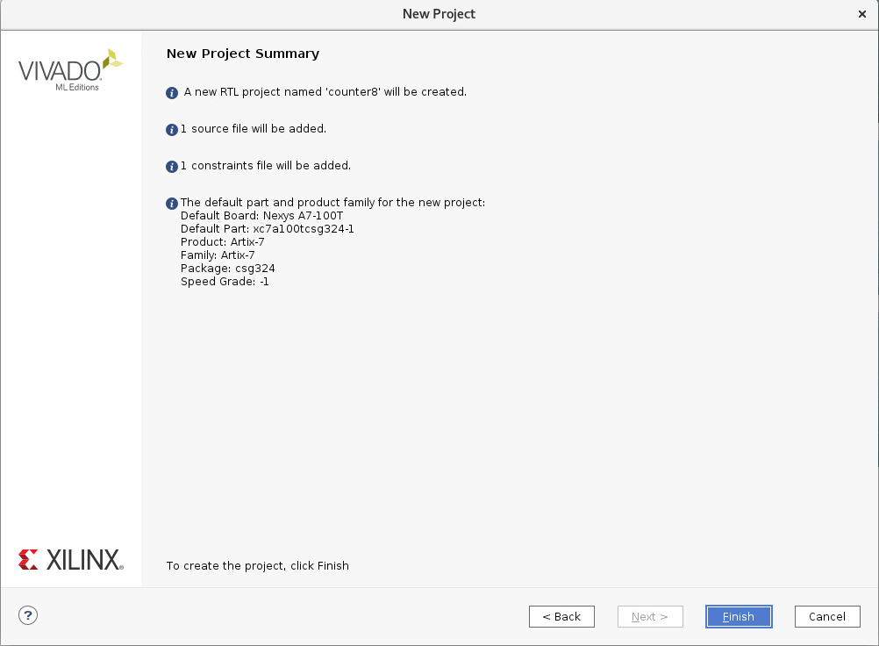
Create Project
8

Slide 22
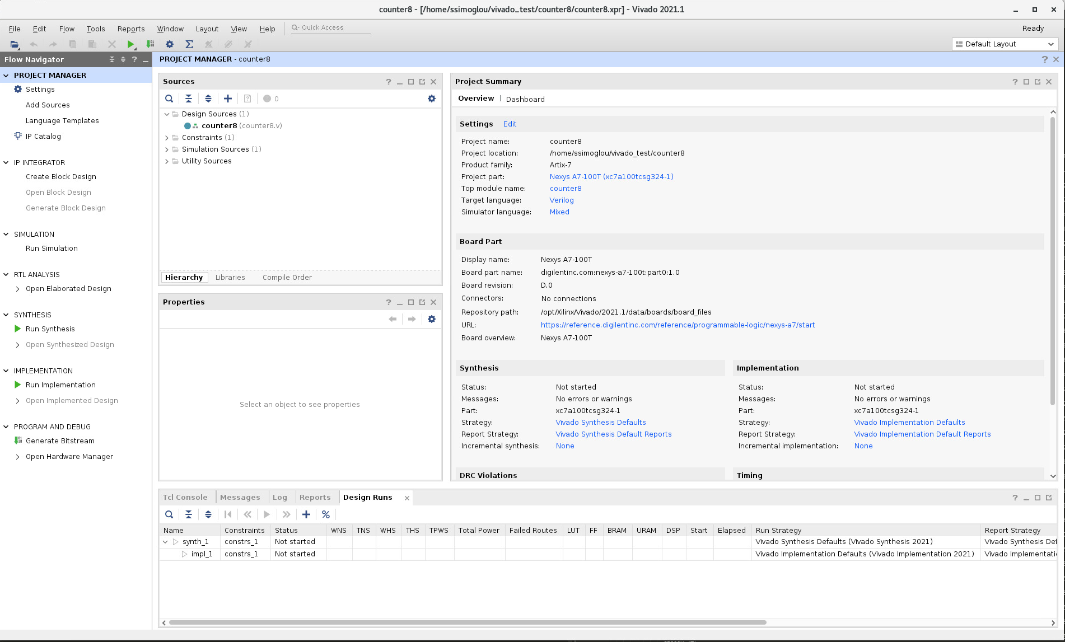
Create Project

Slide 23
Overview
FPGA Flow
Xilinx Vivado 2021
Create Project
Create Design Constraints (XDC)
Import Xilinx Soft IP
Behavioral Simulation
Synthesis
Gate Level Simulation
Implementation
Post P&R Simulation
Generate Bit Stream
Program

Slide 24
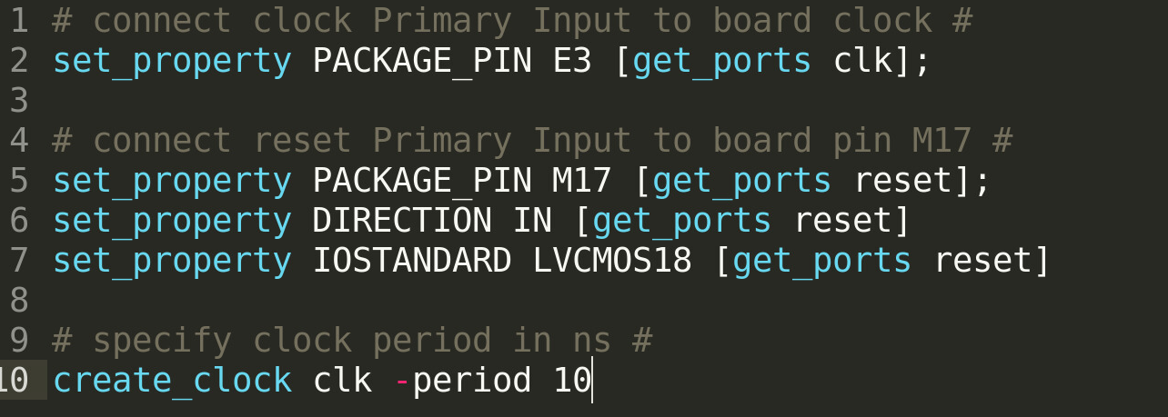
Create Design Constraints (XDC)
8

Slide 25
Overview
FPGA Flow
Xilinx Vivado 2021
Create Project
Create Design Constraints (XDC)
Import Xilinx Soft IP
Behavioral Simulation
Synthesis
Gate Level Simulation
Implementation
Post P&R Simulation
Generate Bit Stream
Program

Slide 26
Import Xilinx Soft IP

Slide 27
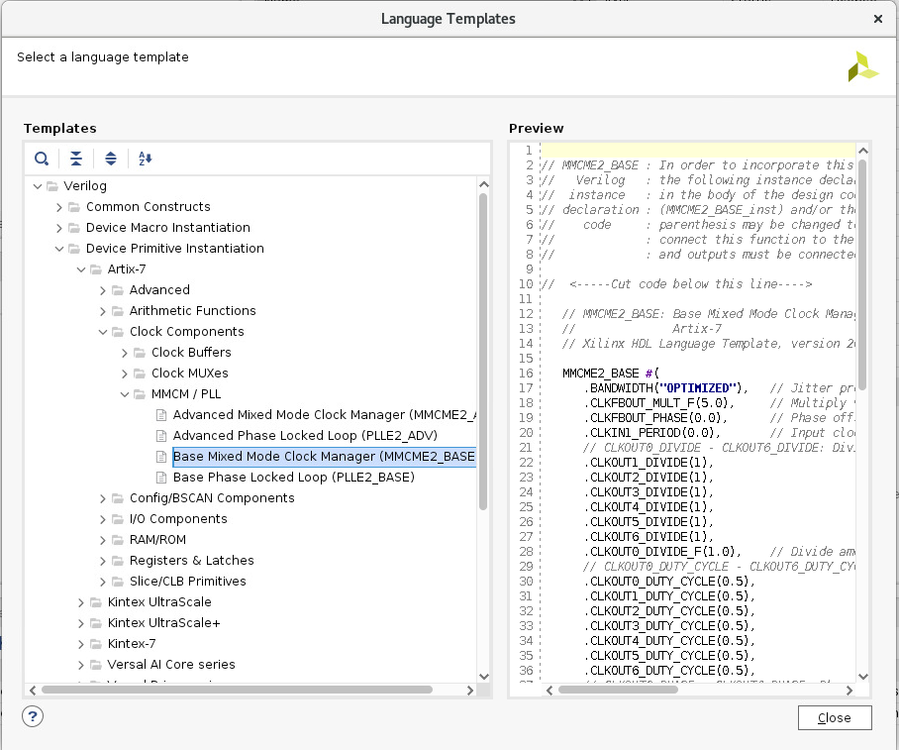
Import Xilinx Soft IP

Slide 28
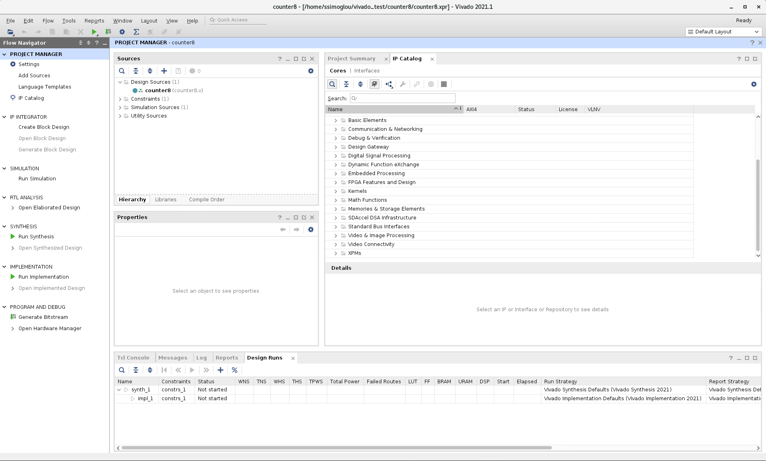
Import Xilinx Soft IP

Slide 29
Overview
FPGA Flow
Xilinx Vivado 2021
Create Project
Create Design Constraints (XDC)
Import Xilinx Soft IP
Behavioral Simulation
Synthesis
Gate Level Simulation
Implementation
Post P&R Simulation
Generate Bit Stream
Program

Slide 30
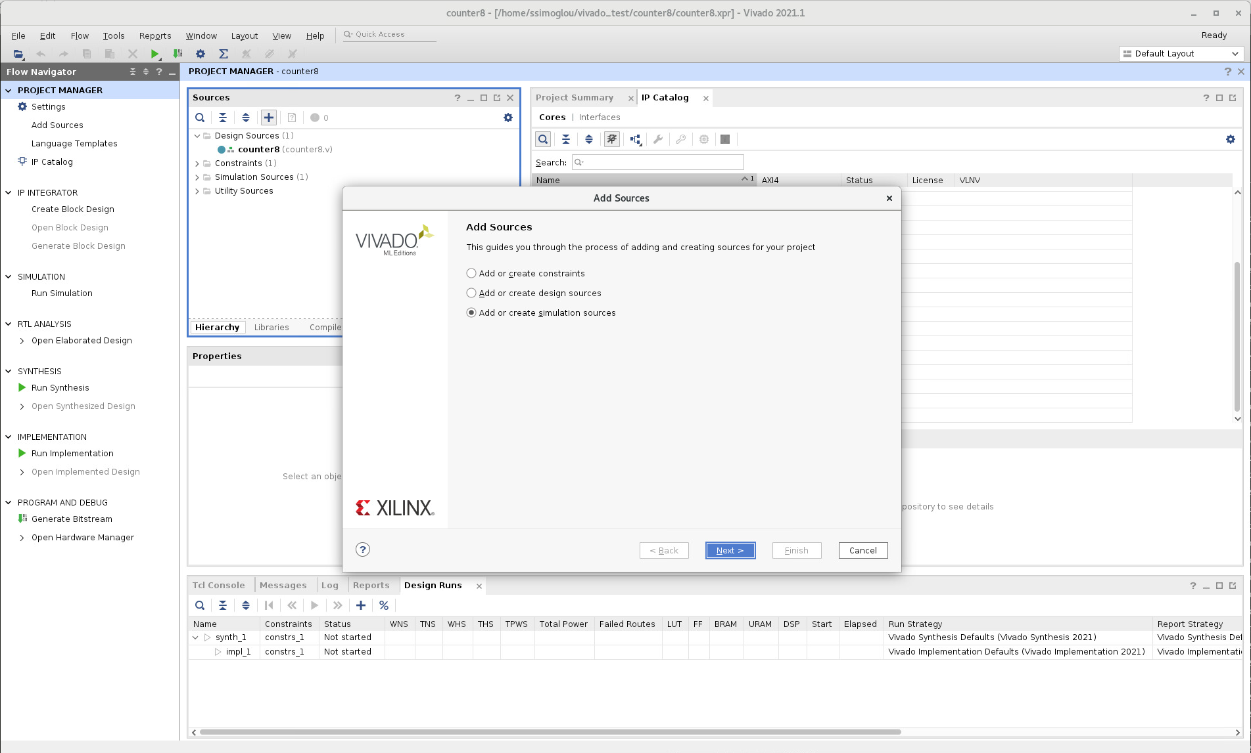
Behavioral Simulation
Include testbench!

Slide 31
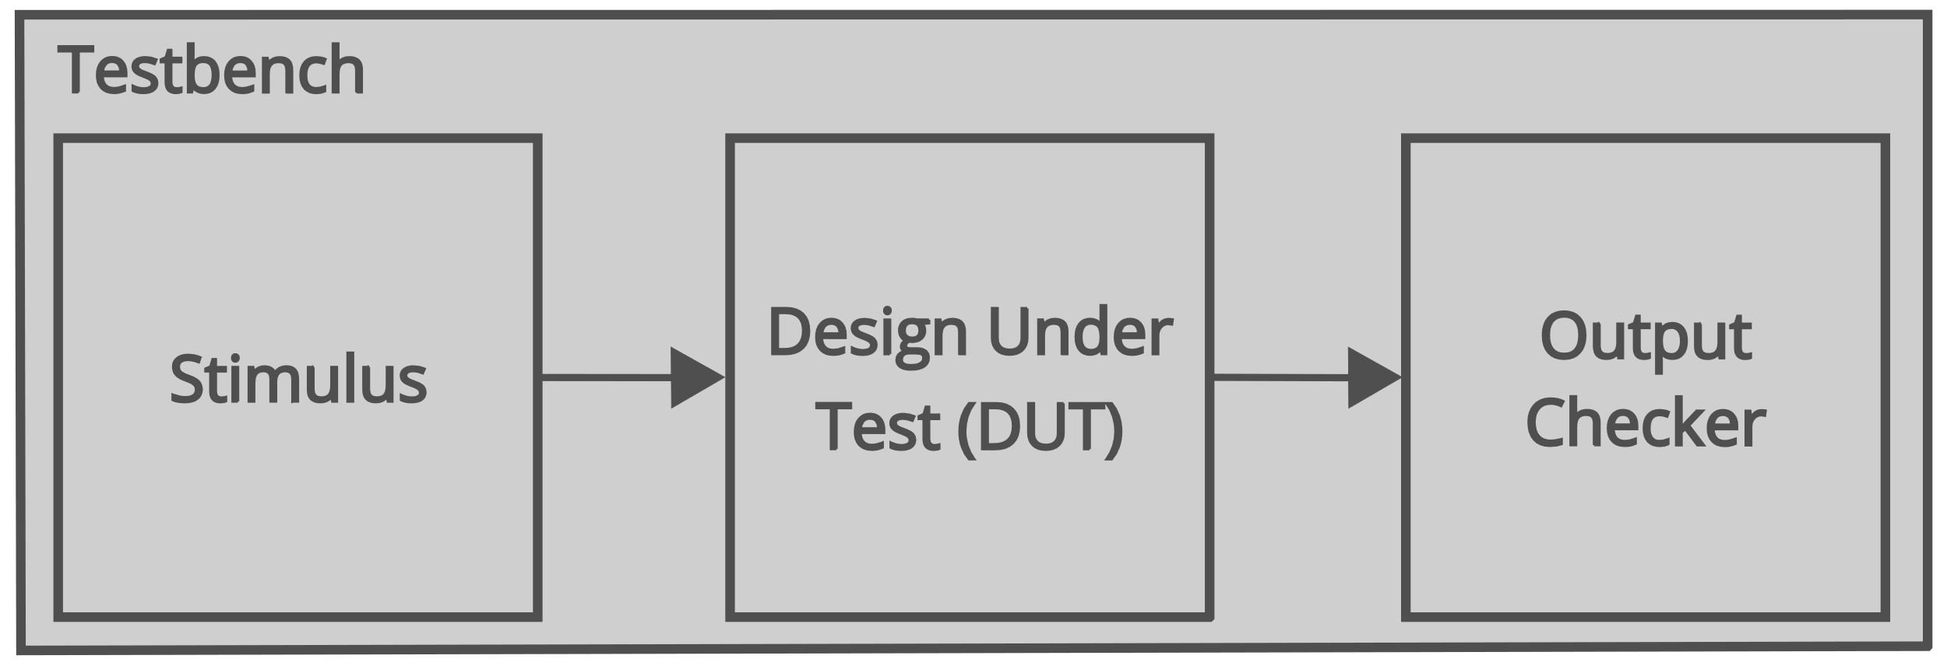
Behavioral Simulation
Include testbench!

Slide 32
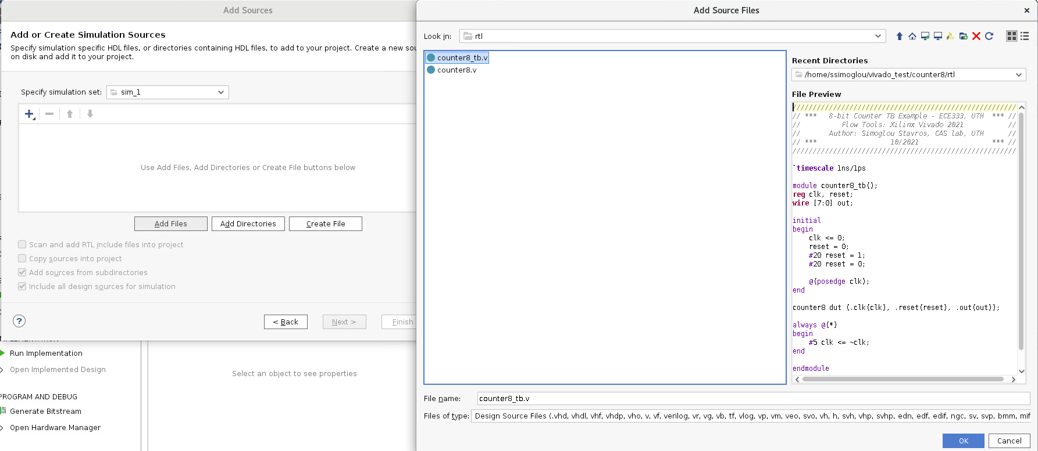
Behavioral Simulation

Slide 33
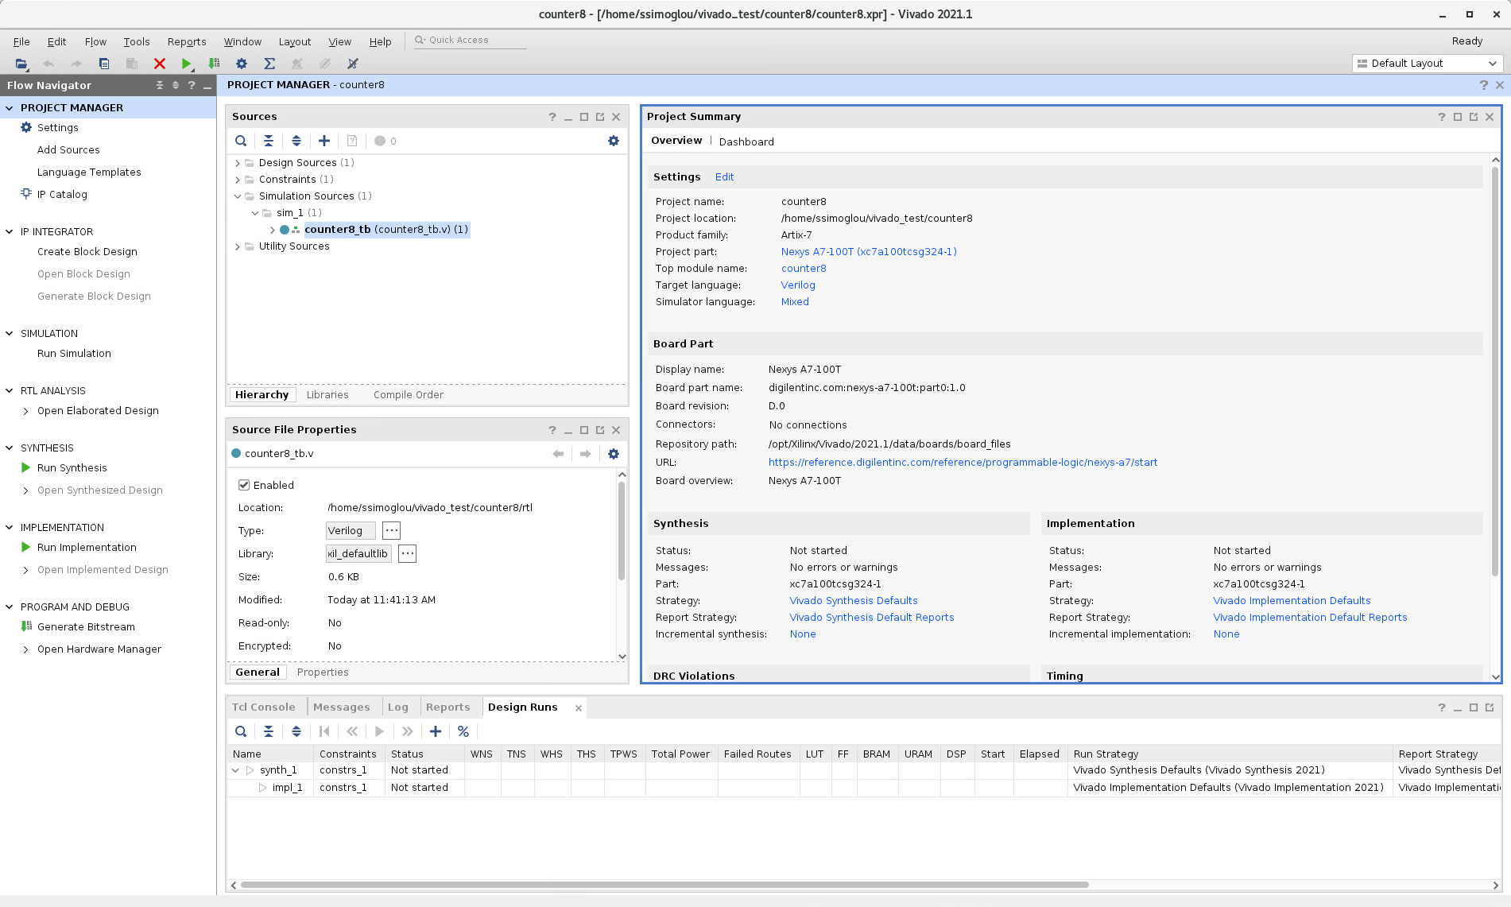
Behavioral Simulation

Slide 34
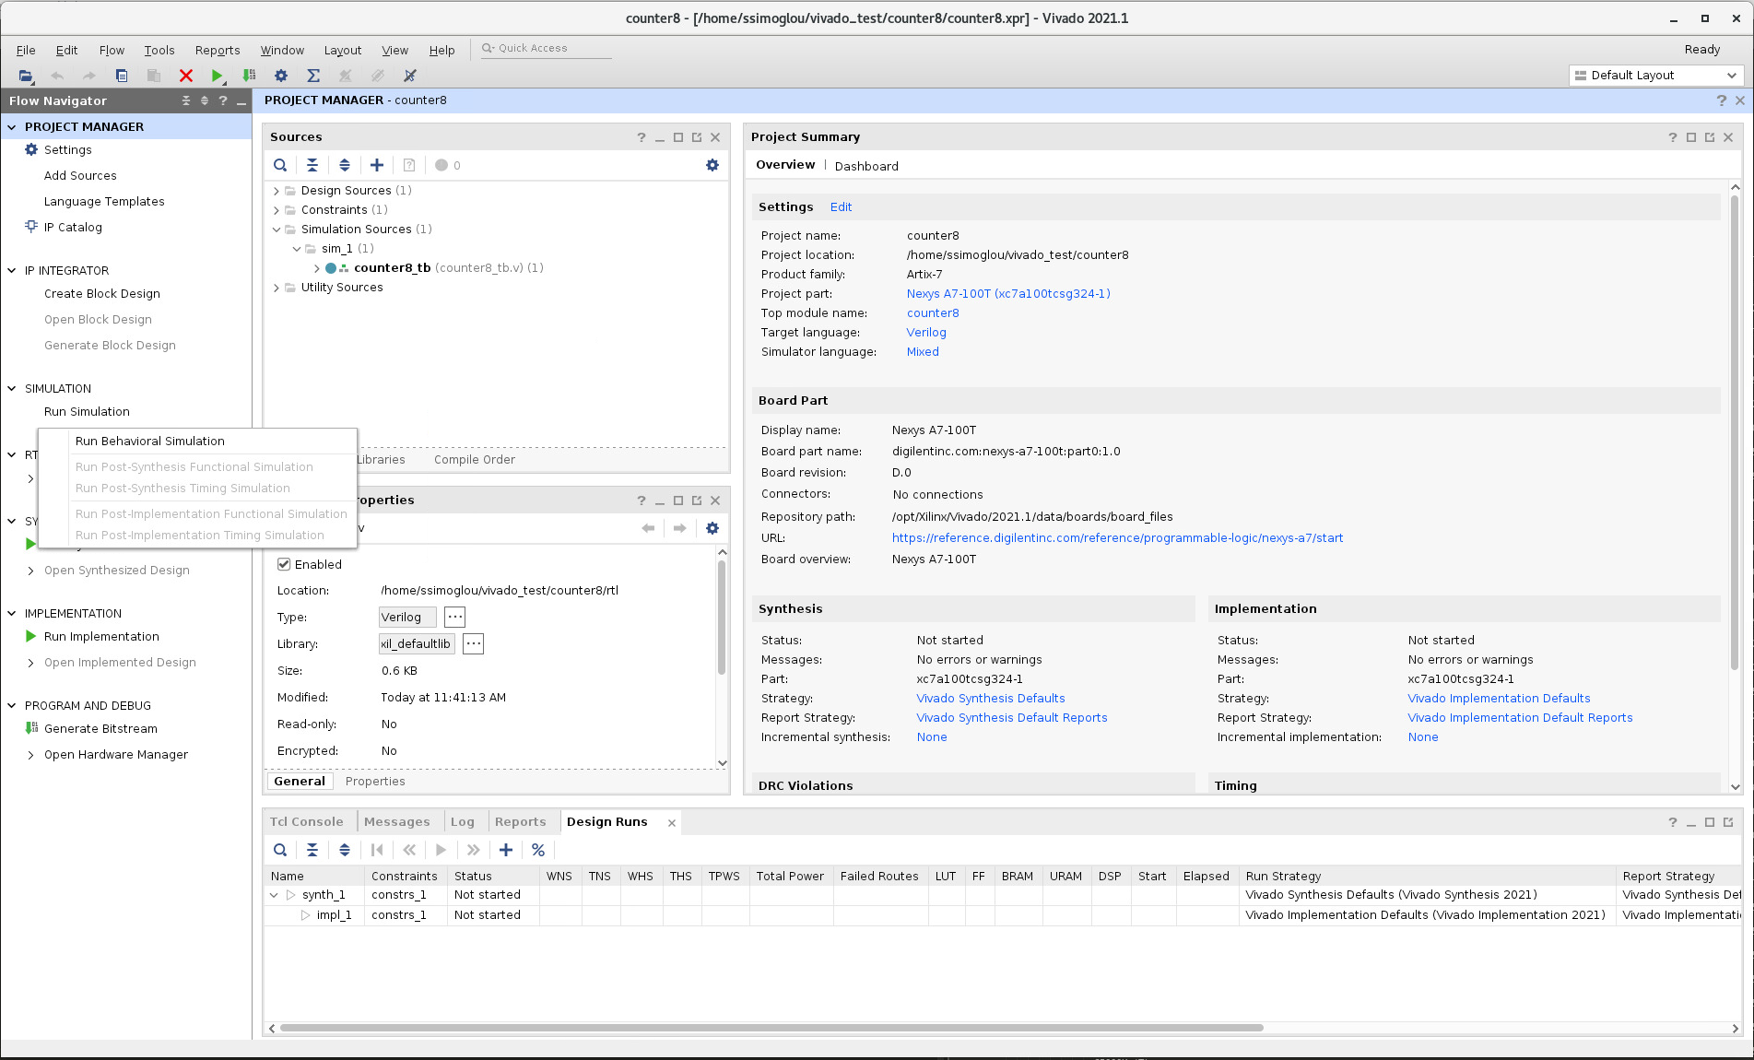
Behavioral Simulation

Slide 35
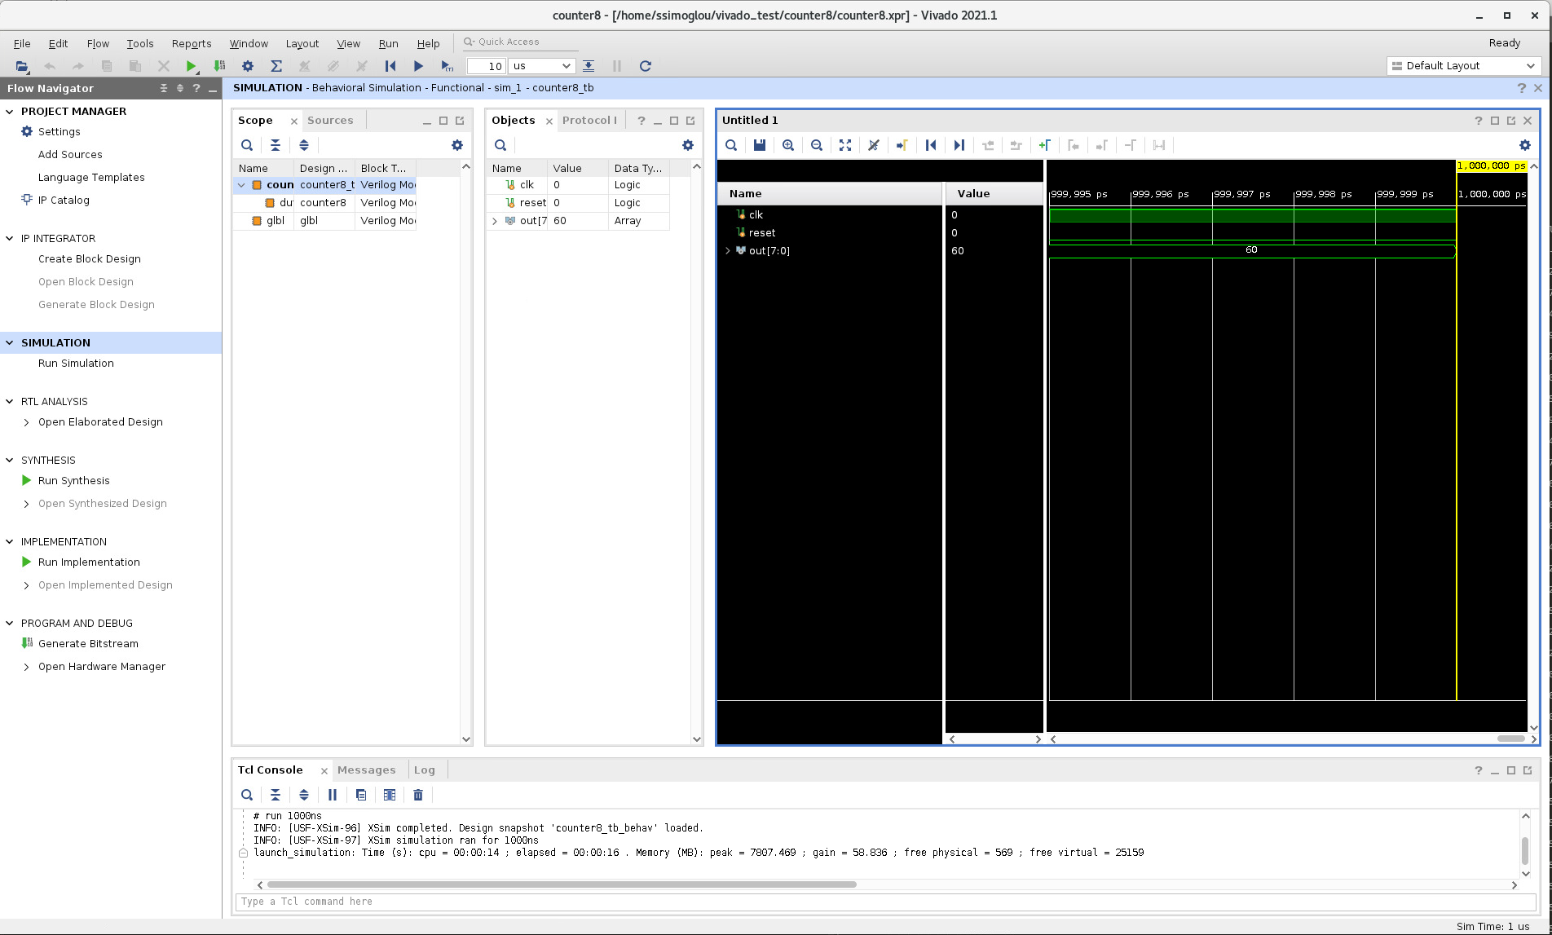
Behavioral Simulation

Slide 36
Behavioral Simulation
Simulation Control Buttons

Slide 37
Overview
FPGA Flow
Xilinx Vivado 2021
Create Project
Create Design Constraints (XDC)
Import Xilinx Soft IP
Behavioral Simulation
Synthesis
Gate Level Simulation
Implementation
Post P&R Simulation
Generate Bit Stream
Program

Slide 38
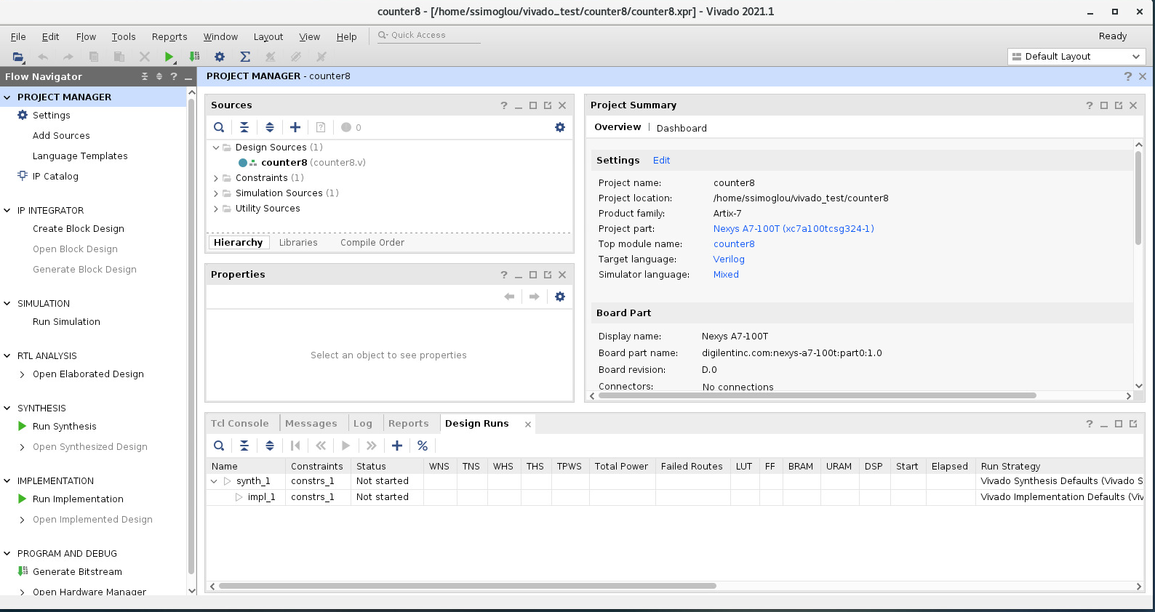
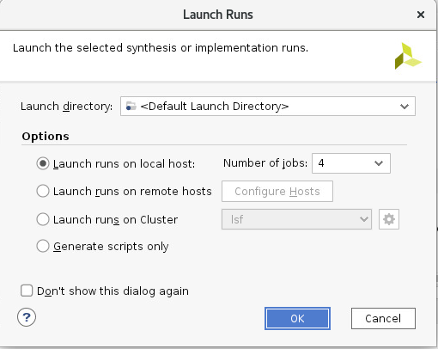
Synthesis

Slide 39
Overview
FPGA Flow
Xilinx Vivado 2021
Create Project
Create Design Constraints (XDC)
Import Xilinx Soft IP
Behavioral Simulation
Synthesis
Gate Level Simulation
Implementation
Post P&R Simulation
Generate Bit Stream
Program

Slide 40
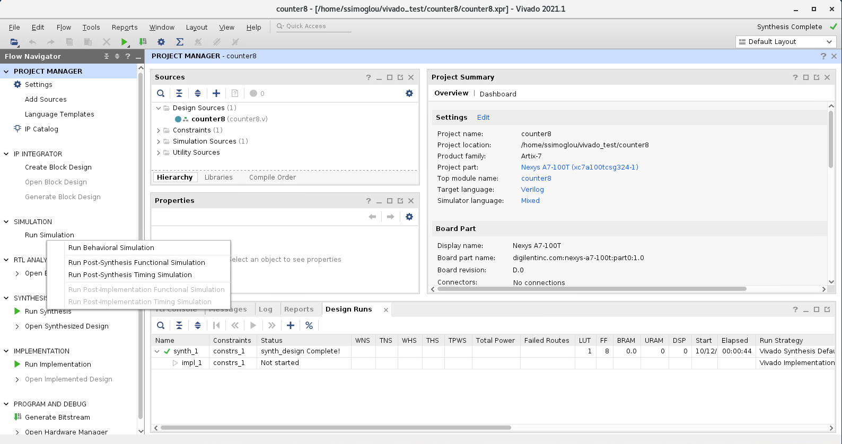
Gate Level Simulation

Slide 41
Gate Level Simulation
What’s the difference?

Slide 42
Overview
FPGA Flow
Xilinx Vivado 2021
Create Project
Create Design Constraints (XDC)
Import Xilinx Soft IP
Behavioral Simulation
Synthesis
Gate Level Simulation
Implementation
Post P&R Simulation
Generate Bit Stream
Program

Slide 43
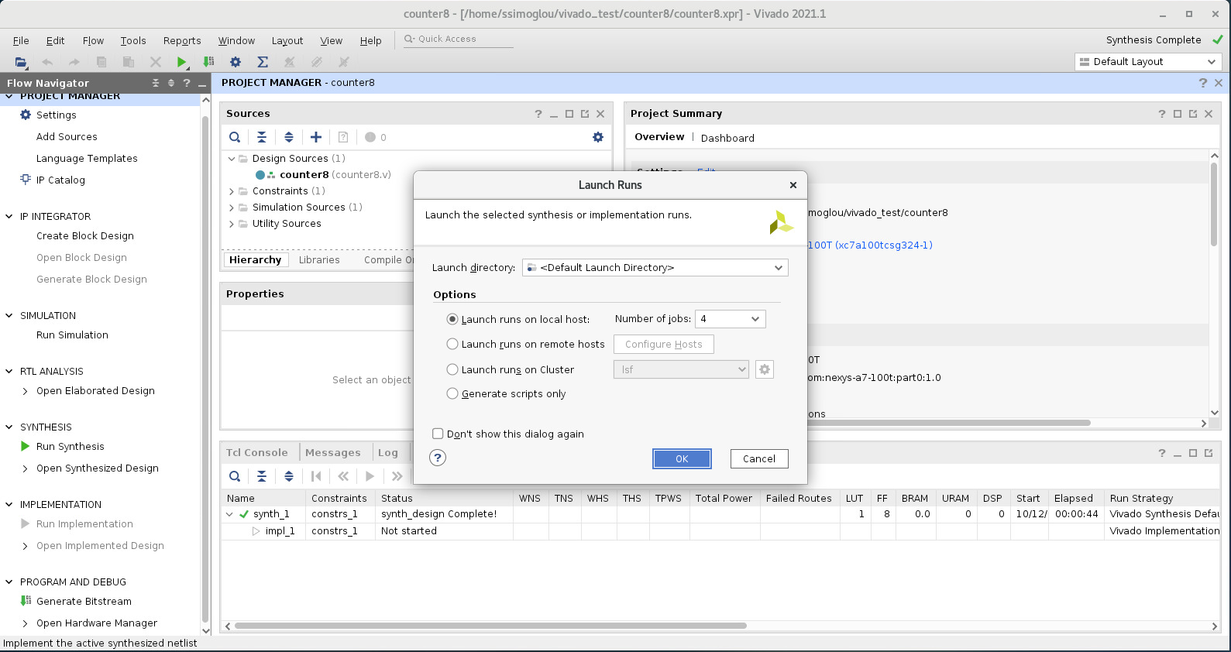
Implementation

Slide 44
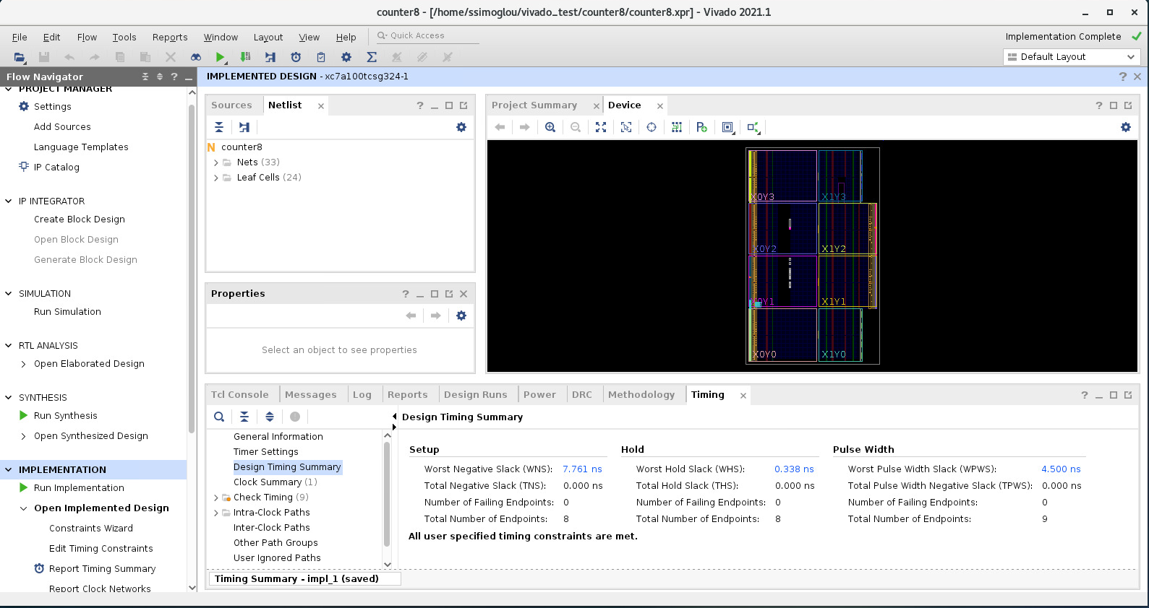
Implementation

Slide 45
Overview
FPGA Flow
Xilinx Vivado 2021
Create Project
Create Design Constraints (XDC)
Import Xilinx Soft IP
Behavioral Simulation
Synthesis
Gate Level Simulation
Implementation
Post P&R Simulation
Generate Bit Stream
Program

Slide 46
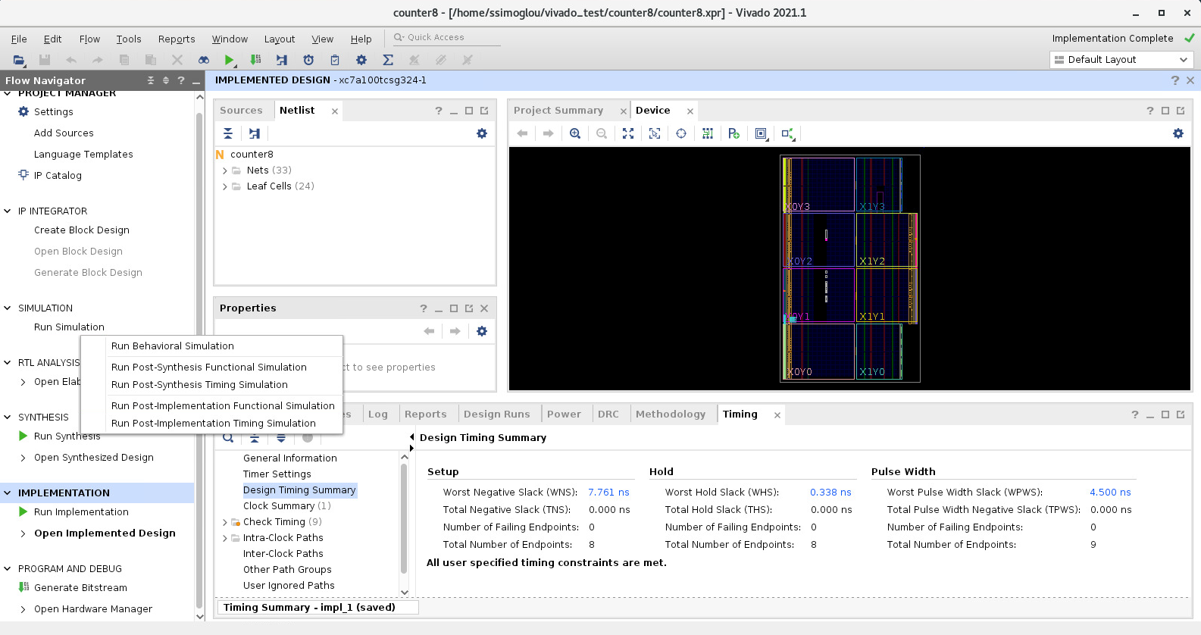
Post P&R Simulation

Slide 47
Overview
FPGA Flow
Xilinx Vivado 2021
Create Project
Create Design Constraints (XDC)
Import Xilinx Soft IP
Behavioral Simulation
Synthesis
Gate Level Simulation
Implementation
Post P&R Simulation
Generate Bit Stream
Program

Slide 48
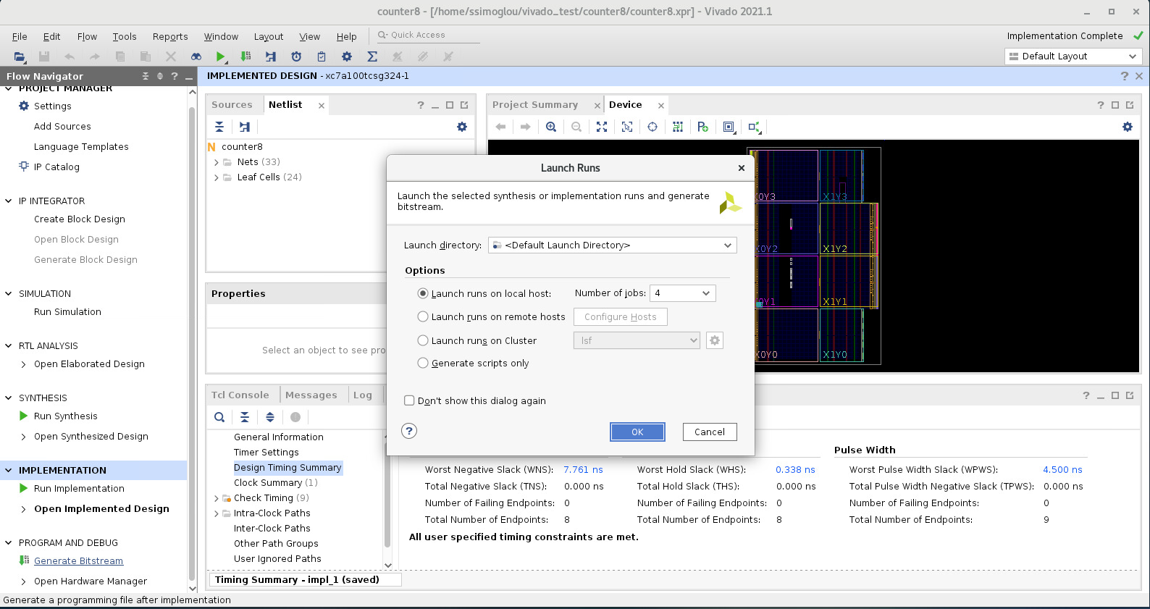
Generate Bit Stream

Slide 49
Generate Bit Stream
Will it work?

