Slide 1
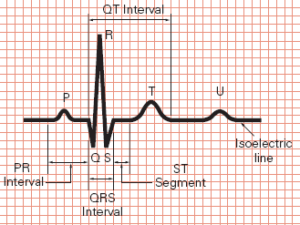
Practical Electrocardiography
Myocardial Ischemia – Myocardial infarction
Grigorios Giamouzis
Ass. Professor of Cardiology
University of Thessaly

Slide 2
Case presentation #1
74 year-old male
Current smoker, Obese (BMI=32)
HTN, Dyslipidemia?
Presents to the ER with chest pain radiating to the back

Slide 3
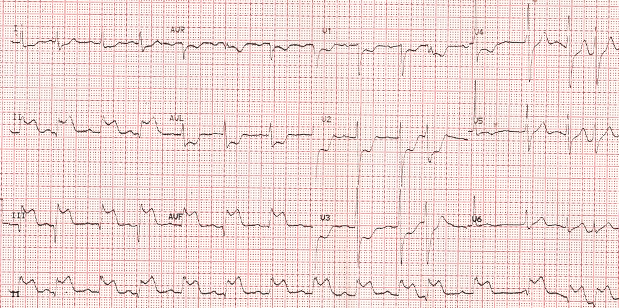
ECG

Slide 5
Primary PCI in RCA and abciximab administration

Slide 6
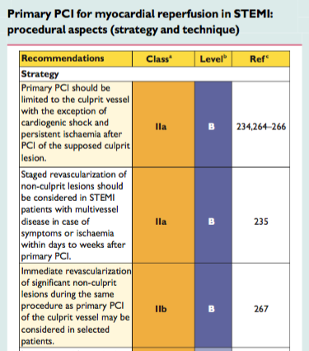

Slide 7
Admission Lipid Profile
TC=223 mg/dl,
LDL=149 mg/dl,
HDL=55 mg/dl,
Tg=155

Slide 8
Discharge exams - Therapy
ECG: SR, 65 bmp, q waves inferior wall
Echo: LVEF=45-50%, moderate hypokinesis LV inferior wall
Aspirin 80 mg od,
ticagrelor 90 mg bid,
perindopril 5 mg od,
metoprolol 100 mg bid,
atorvastatin 40 od

Slide 9
3 months later…
Presents for scheduled PTCA in LCx+LAD. Pt reports chest pain in moderate-to-severe exertion.
Aspirin, ticagrelor 90 mg bid, perindopril 5 mg od, metoprolol 100 mg bid, atorvastatin 40 od
TC=152 mg/dl, LDL 89 mg/dl, HDL=49 mg/dl, Tg=123
ECG: SR, 65 bmp, q waves inferior wall
BP=130/80 mmHg
Echo: LVEF=50-55%, mild hypokinesis LV inferior wall

Slide 10
3 months later

Slide 11
Background
Myocardial infarction (MI) represents the most important subject in electrocardiography, because of the high prevalence and severity of the disease
40-50% of acute and previous MIs can be recognized in ECG
Since the introduction of urgent percutaneous transluminal coronary angioplasty (PTCA) and fibrinolysis, accurate diagnosis of acute MI (AMI) has become more important than ever
“Time is myocardium”

Slide 12
Etiology
More than 90% of MIs are attributable to atheromatosis of the coronary arteries with consecutive thrombosis, the latter often provoked by plaque rupture
Coronary artery spasm seems to contribute to necrosis
MI can also occur in:
aortic dissection,
connective tissue diseases,
cardiac trauma,
tumors,
cocaine abuse
Myocardial bridge
Vasospasm
coronary artery anomalies

Slide 13
Acute Stage
Thrombotic occlusion of a coronary artery leads to ischemia, with a central zone of major ischemia, or lesion/injury. The ECG shows transmural lesion or a so-called monophasic deformation: the R wave, ST segment, and T wave are incorporated into a single positive deflection

Slide 14
Subacute Stage
Necrosis develops in the central zone; in the ECG, a Q wave appears. The necrotic zone is surrounded by a lesion zone (minor ST elevation in the ECG), which is itself surrounded by an ischemic zone, with beginning T negativity in the ECG

Slide 15
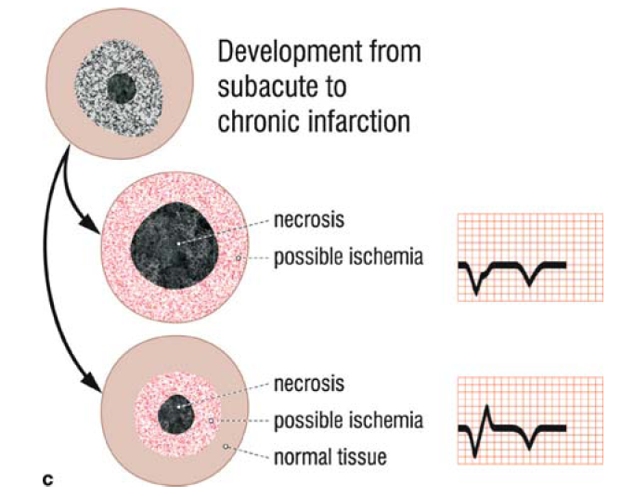

Slide 17
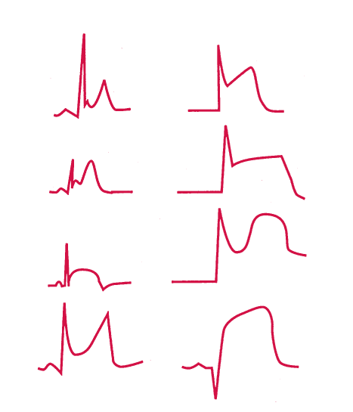
A. Normal variant
B. STEMI

Slide 18
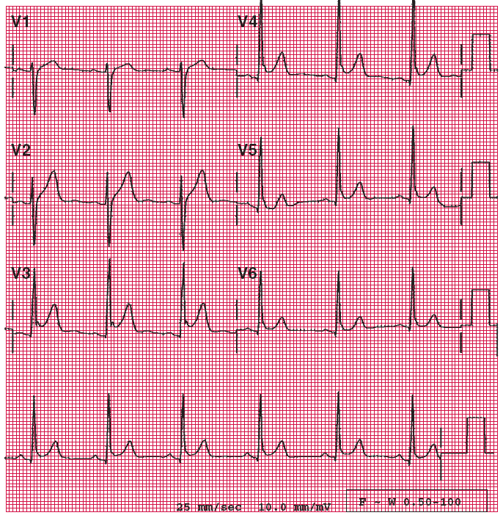

Slide 19
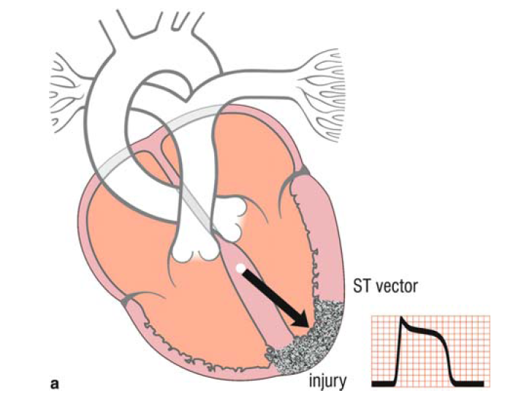

Slide 20
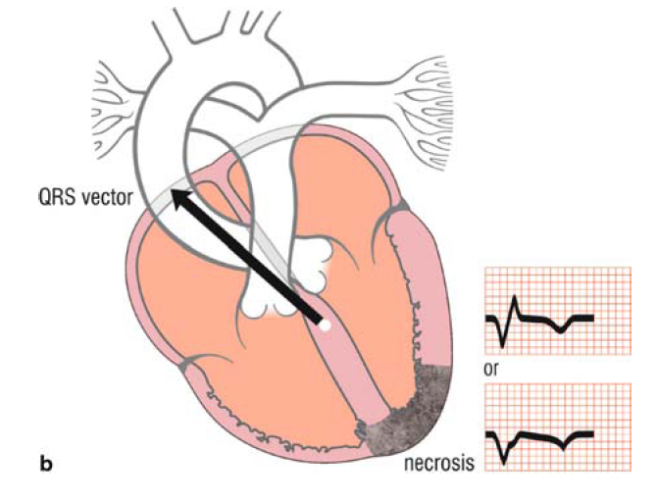

Slide 22
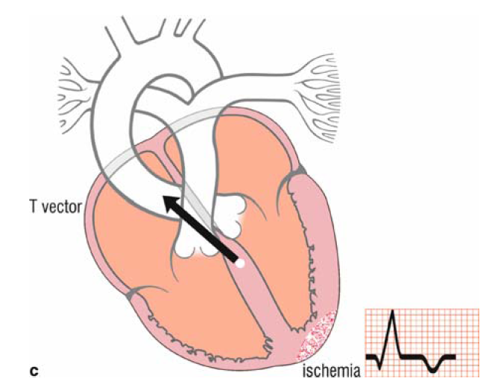

Slide 23
Electropathophysiologic evolution
Acute stage: marked ST elevation (generally >3 mm, up to 12 mm). This represents transmural lesion (also referred to as transmural injury).
Subacute stage: moderate ST elevation plus Q waves or QS waves. This represents minor injury and necrosis. The T wave is generally negative and symmetric, representing ischemia.
Chronic or old stage: “classical” Q waves (duration ≥0.04 s) or QS waves, with isoelectric ST segment. A Q wave or QS wave attributable to infarction represents necrosis. The T wave remains negative or has normalized.

Slide 24
Localization of Q Wave Infarction

Slide 25
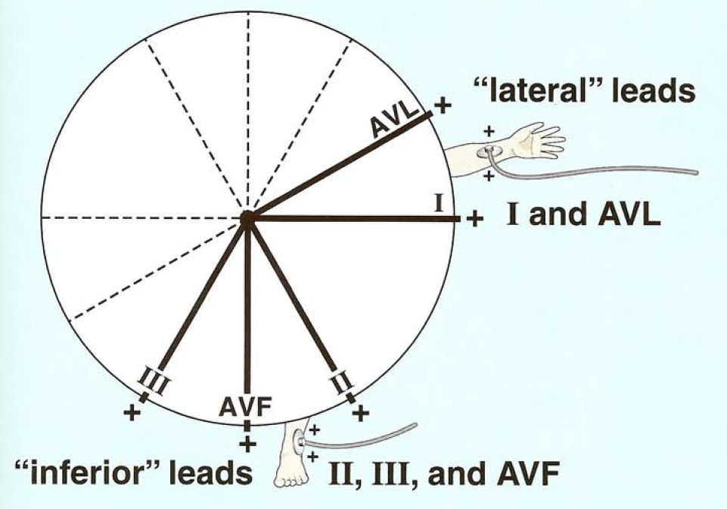

Slide 26
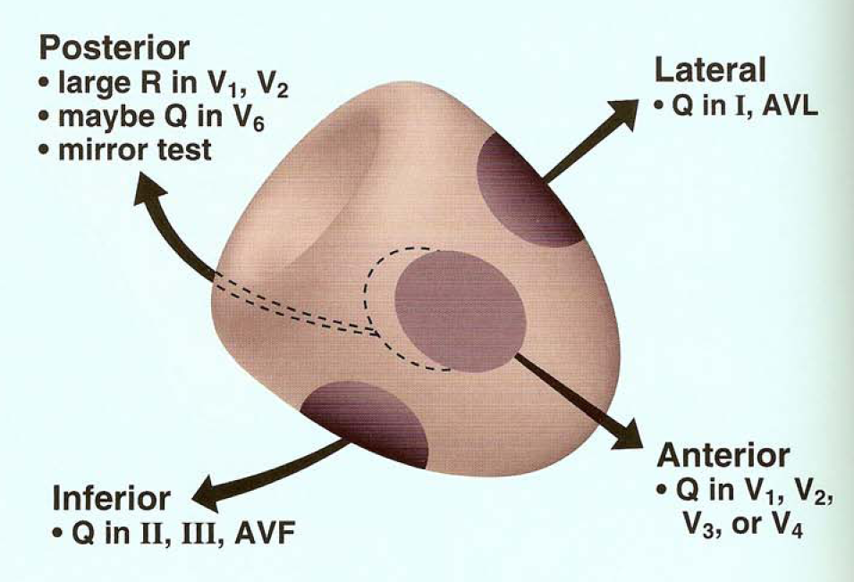

Slide 27
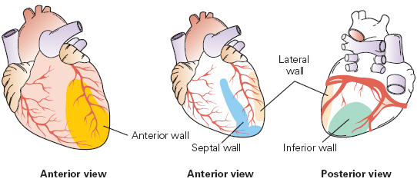
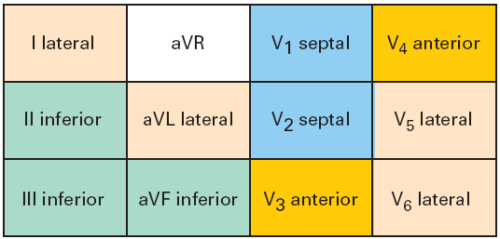

Slide 28
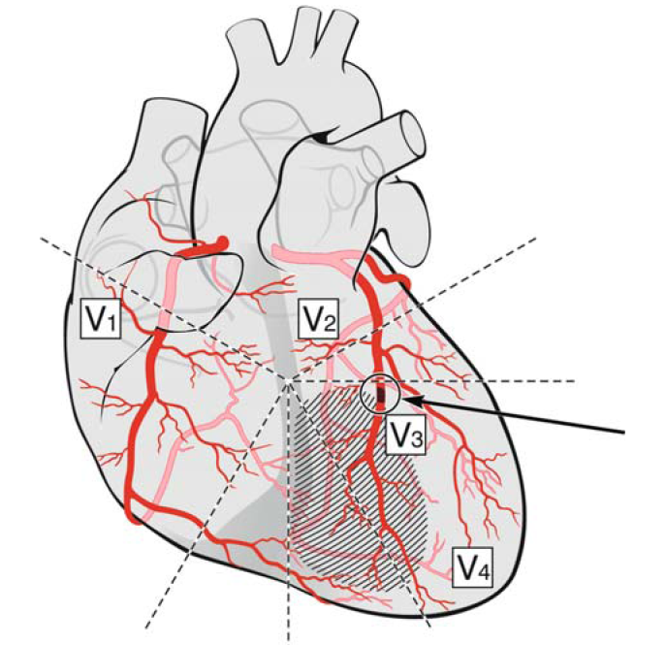
Anteroseptal Infarction

Slide 29
ECG from a 51-year-old man with a 3-hour-old anteroseptal MI.
ECG: ST elevation up to 7 mm in V1 to V3.
Coro: 90% LAD stenosis, distal to the great diagonal branch.
Ventriculography: Moderate anteroseptal hypokinesia. Ejection fraction 60%.
PTCA with stenting. Good
result

Slide 30
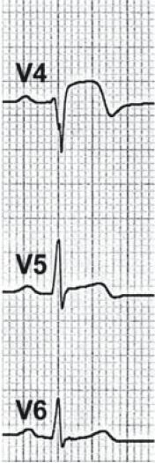
ECG from a 42-year-old man with a 1-day-old acute anteroseptal myocardial infarction. ECG: combination of QS in V₁/V₂ and minimal R wave in V₃/V₄ (with notching) with ST elevation in (V₁) V₂ to V₅, and terminally negative T wave in V₃/V₄. Coro: 99% stenosis of LAD and first diagonal branch. Apical hypokinesia, ejection fraction 70%. PTCA

Slide 31
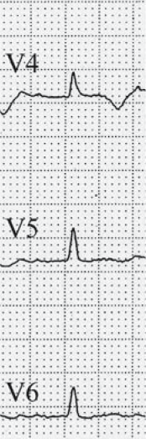
ECG obtained from a 94-year-old man with a 2-day-old acute anteroseptal myocardial infarction.
ECG: Qr in V₂/V₃ (notching in V₄), with slight ST elevation. Negative and symmetric T waves in V₂ to V₄ and aVL.
No Coro

Slide 32
ECG obtained from a 63-year-old man with a 1-year-old anteroseptal MI.
ECG: QS in V₂, Qr in V₃, notched QRS in V₄ (V₃). Minimal ST elevation in anteroseptal leads. Negative symmetric T waves in V₂ to V₆ .
Coro: 50% LAD stenosis (spontaneous recanalization of LAD). Anteroseptal akinesia. Left ventricular ejection fraction 60%

Slide 33
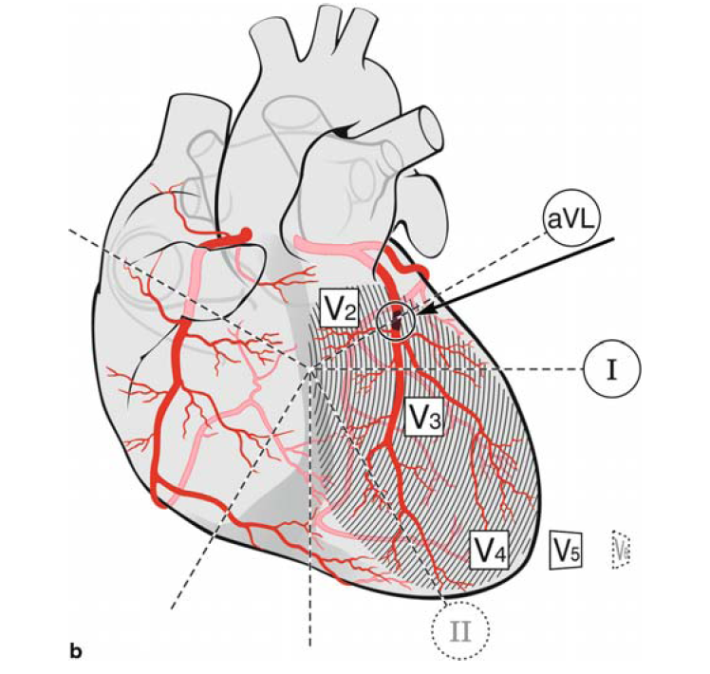
Extensive Anterior Infarction (Anterolateral Infarction)

Slide 34
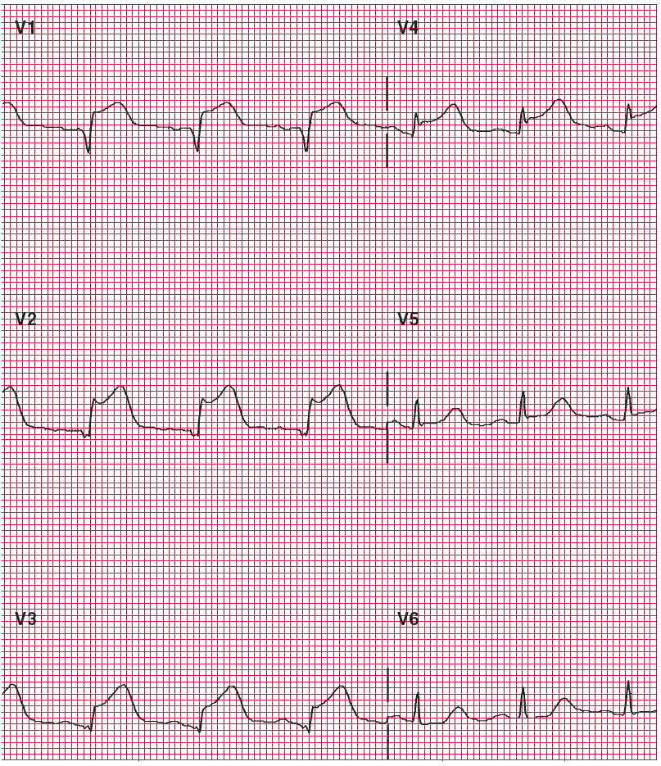

Slide 35
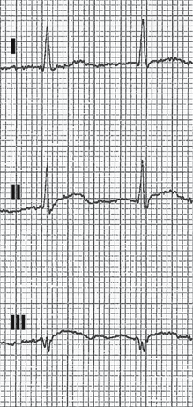
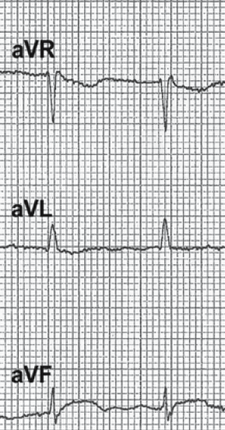
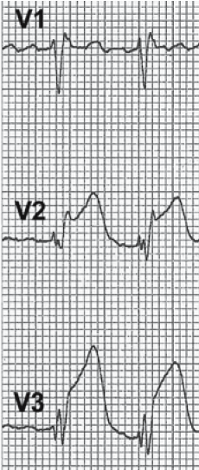
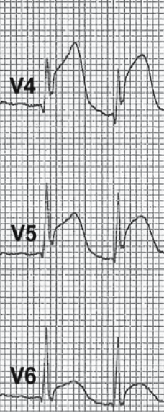
ECG from a 64-year-old man with 1-hour-old acute extensive anterior MI.
ECG: atrial fibrillation, incomplete RBBB. ST elevation up to 7 mm in leads V₂ to V₆, in V₂ (V₃) arising from the S wave, and tall/broad T waves. No pathologic Q waves.
Coro: occlusion of LAD. Anteroapical hypokinesia, ejection fraction 50%.
Percutaneous transluminal coronary angioplasty

Slide 36
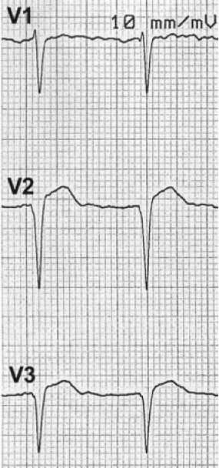
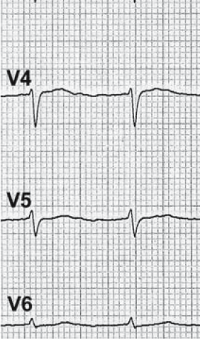
ECG obtained from a 66-year-old man with 4-week-old “acute”
anterolateral MI.
ECG: QS complex in V₂-V₃ and pathologic Q waves in I and aVL. Reduction
of R amplitude in V₄-V₆. Slight ST elevation in V₂-V₃ (V₄, I, aVL).
Coro: 90% stenosis of LAD and CX.
Anterolateral akinesia, diffuse hypokinesia,
ejection fraction 28%. PTCA of LAD and CX

Slide 37
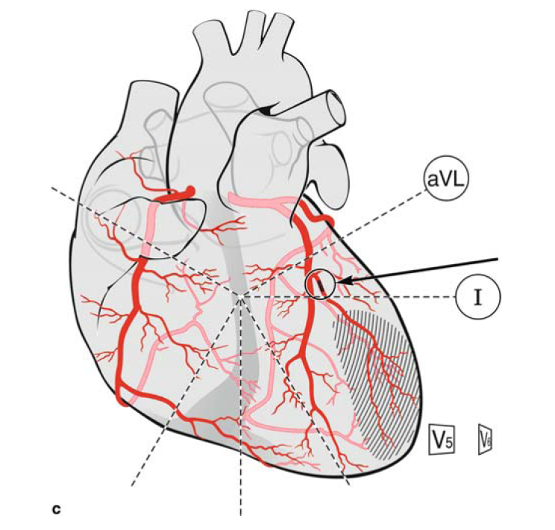
Lateral Infarction (Isolated Myocardial
Infarction of the Lateral Wall)

Slide 38
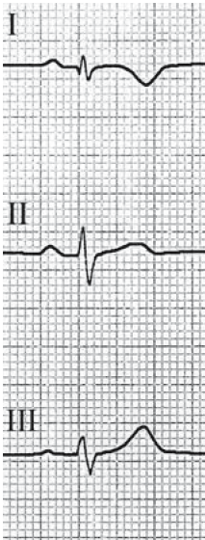
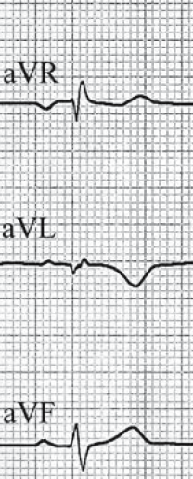
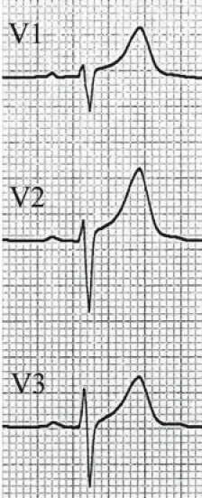
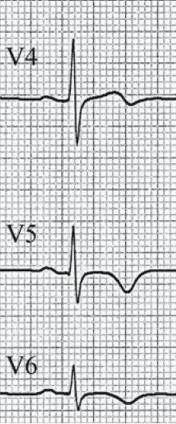
Electrocardiogram (ECG) obtained from a 72-year-old man with 4-day-old high lateral MI. ECG: Qr in aVL, with symmetric T waves in aVL, I, V₅/V₆

Slide 39
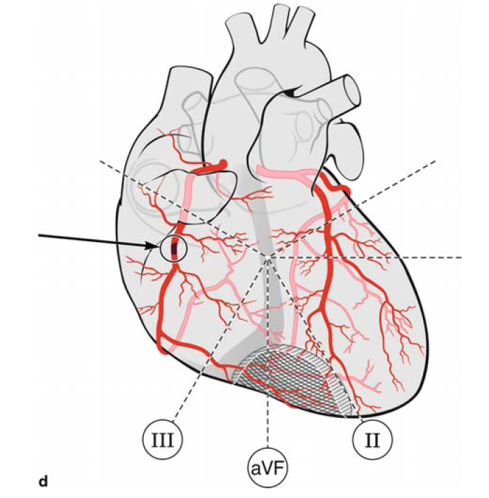
Inferior Infarction

Slide 40
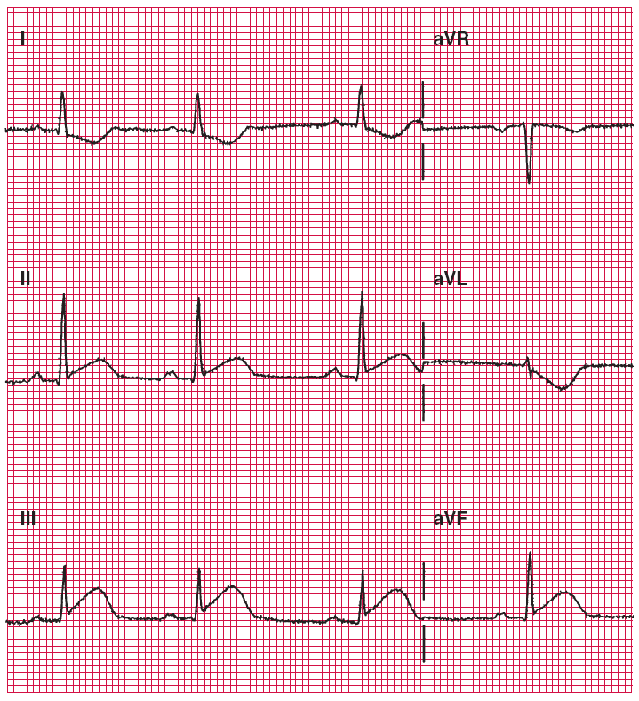

Slide 41
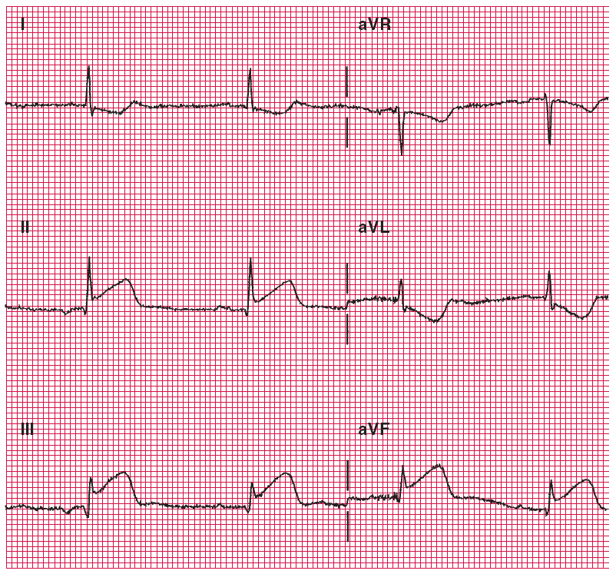

Slide 42
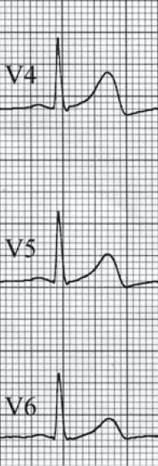
ECG from a 63-year-old woman with acute inferior infarction, chest pain for 2 hours. ECG: ST elevation in III/aVF(II), ST depression in I/aVL as mirror image.
Coro: 90% RCA stenosis. Ejection fraction 62%. Thrombolysis

Slide 43
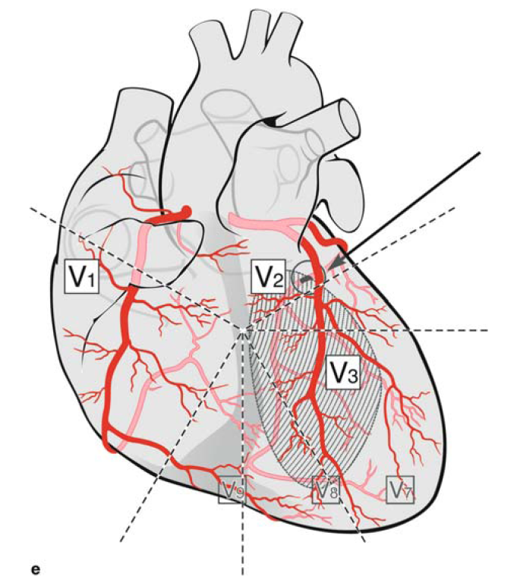
Posterior (“True” Posterior) Infarction

Slide 44
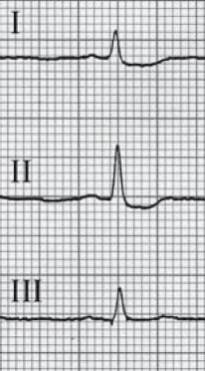
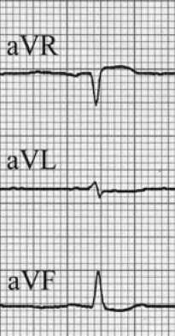
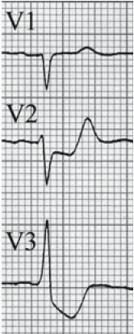
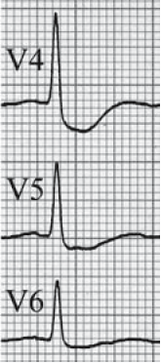
ECG from a 60-year-old man with acute 6-hour-old posterior MI.
ECG (half calibration): enormous ST depression (mirror image of posterior ST elevation) especially in V₂-V₆. High and broad R in V₃.
Coro: three-vessel disease with occlusion of the dominating LCx.
Ejection fraction 36%. Referred for CABG.

Slide 45
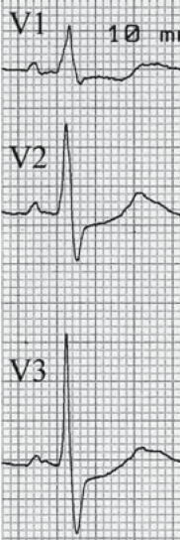
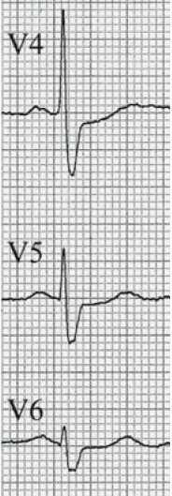
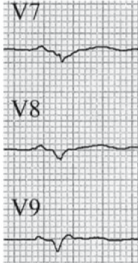
ECG from a 74-year-old man with acute 5-day-old posterior MI.
ECG: tall and broad R wave in V1 and V2 (V3), slight ST depression in V1-V5, both corresponding to mirror image of alterations in the posterior leads.
See: QS in V7/V8, Qr in V9

Slide 46
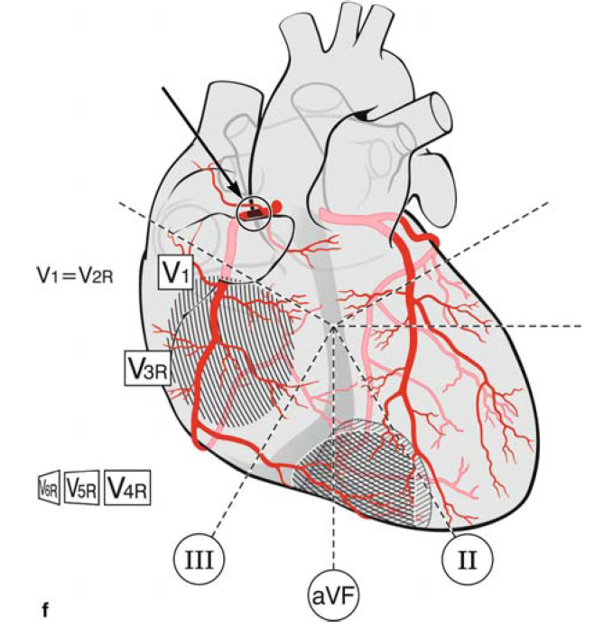
Right Ventricular Infarction

Slide 47
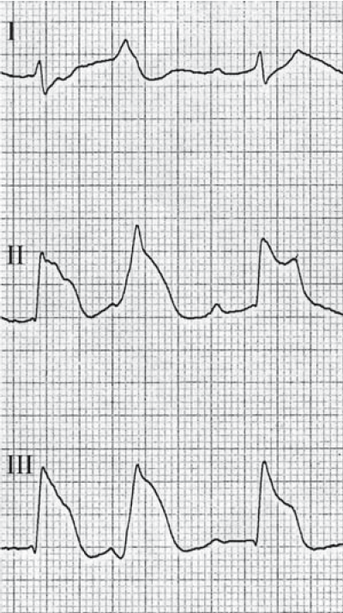
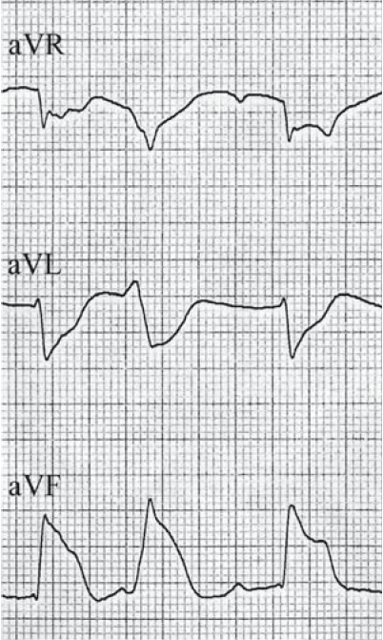
ECGs from a 47-year-old man with acute 12-hour-old inferior MI with RV involvement. Sinus rhythm, atrioventricular block 2° (Wenckebach). Bizarre ST elevation (“monophasic deformation”) in leads II, aVF, and III. Right precordial leads: small q wave and extensive ST elevation in right precordial leads V_{3R}-V_{6R}. The patient refused any intervention and died 3 days later by cardiogenic shock

Slide 48
Complex Infarction Patterns
Infarction in combination with the classical intraventricular conduction disturbances LBBB, RBBB, left anterior fascicular block (LAFB), left posterior fascicular block (LPFB), and bilateral blocks

Slide 49
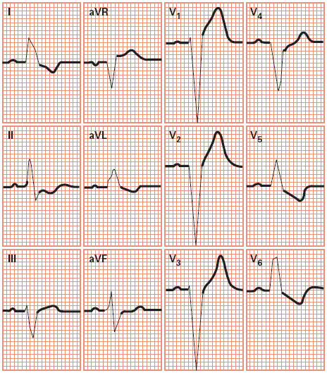
Left Bundle Branch Block
QRS >0.12 sec
QRS predominantly negative in leads V₁ and V₂
QRS predominantly positive in V₅ and V₆ and often notched
Absence of small, normal Q waves in I, aVL, V₅, and V₆
Wide monophasic R waves in I, aVL, V₁, V₅, and V₆

Slide 50
Previous infarction associated with LBBB
A previous infarction associated with LBBB is reliably diagnosable in the presence of some high-specificity criteria such as:
1. A q wave in at least two of these leads: I, aVL, V5, and V6
2. A regression of r wave amplitude from V1 to V4
3. A notching of the S wave in V3 to V5 = “Cabrera sign”
However in the absence of these signs, a previous MI cannot be excluded (low sensitivity). An AMI with LBBB may be suspected or even diagnosed by the unusual behavior of repolarization, for example, ST elevation instead of LBBB-related ST depression.

Slide 51
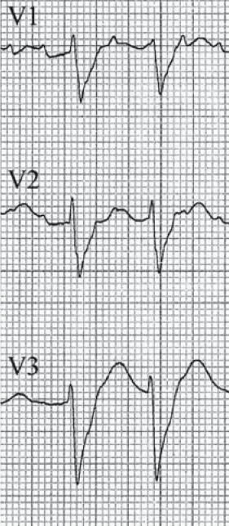
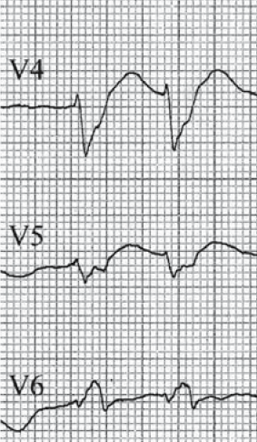
Pathologic Q waves (in LBBB) in I/aVL, reduced R in V5, rsR′s′ in V6. Decreasing R wave from V2 to V5.

Slide 52
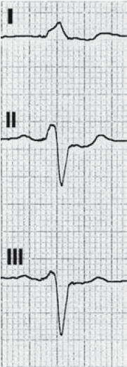
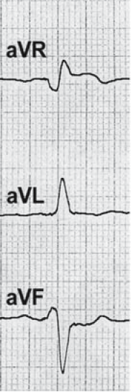
18-year-old extensive anterior. Sinus rhythm, LBBB. Pathologic notching in five precordial leads (V2-V6), indicate anterior MI. Cabrera sign in V2/V3 (notched S upstroke).

Slide 53
Previous infarction associated with RBBB
In contrast to LBBB, an old infarction in RBBB is generally easy to identify, in inferior and anterior localization. Identical pathologic Q waves are present as
without RBBB, because necrosis influences the first 40–60 ms of the QRS complex, whereas RBBB produces alterations of the last 50–60 ms of QRS

Slide 54
Previous inferoposterior MI. Sinus rhythm, RBBB. Q waves inferiorly (only in III ≥40 ms), without T negativity. Tall “primary” R waves in V2/V3 attributed to RBBB or posterior involvement.

Slide 56
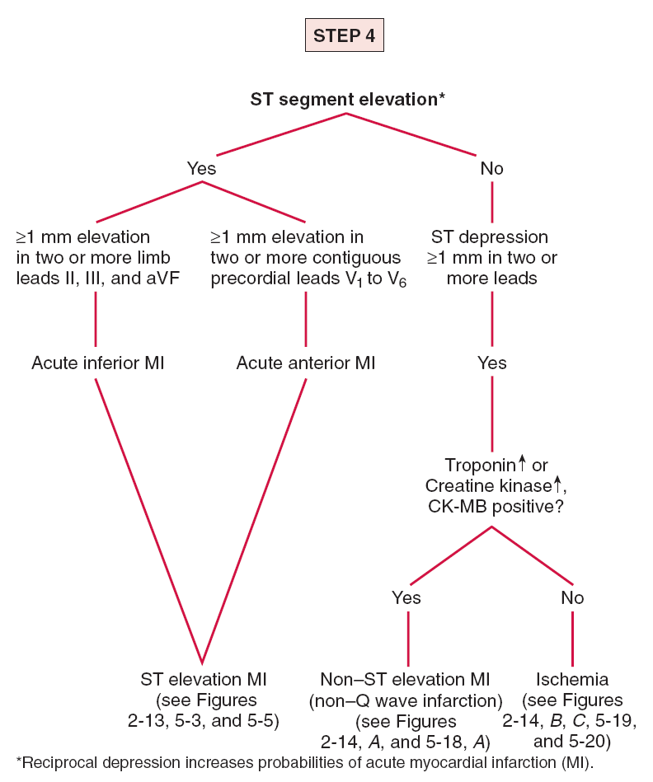

Slide 57
Practical Electrocardiography
Myocardial Ischemia – Myocardial infarction
Grigorios Giamouzis
Ass. Professor of Cardiology
University of Thessaly

