Slide 1
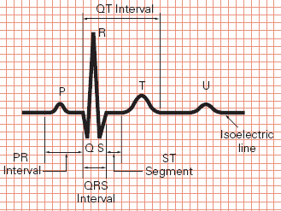
Practical Electrocardiography
Atrial Enlargment – Ventricular Hypertrophy
Grigorios Giamouzis, MD, PhD
Ass. Professor of Cardiology
University of Thessaly
Larissa

Slide 2
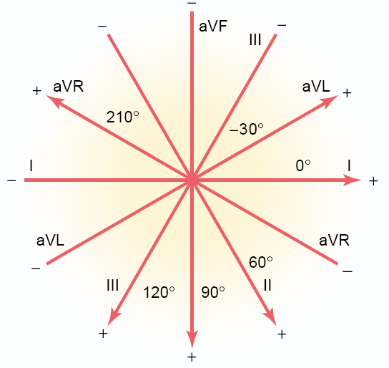

Slide 3
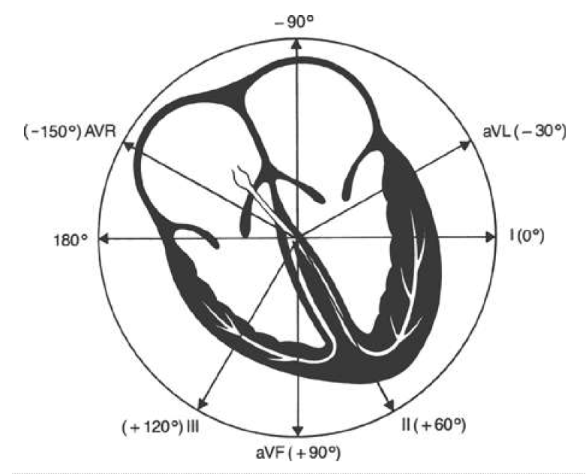

Slide 4
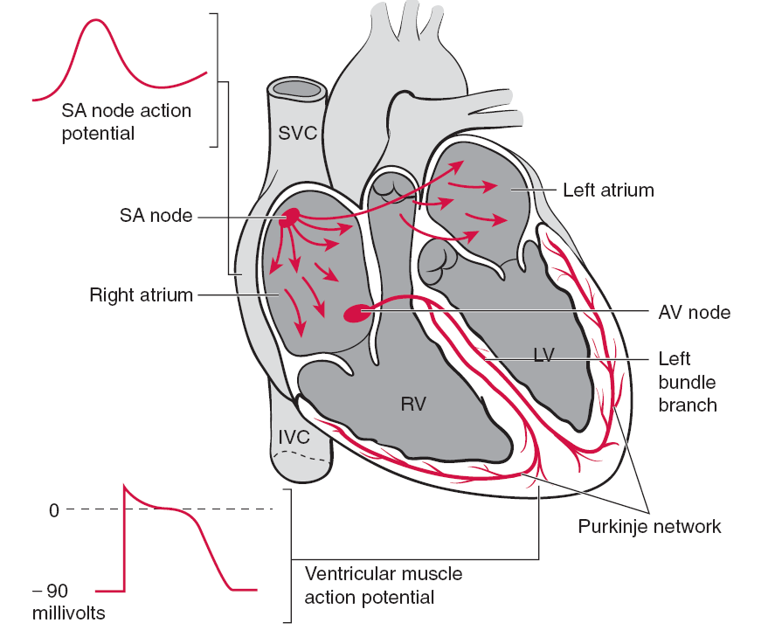
Electrical activation of the heart by the sinoatrial (SA) node

Slide 5
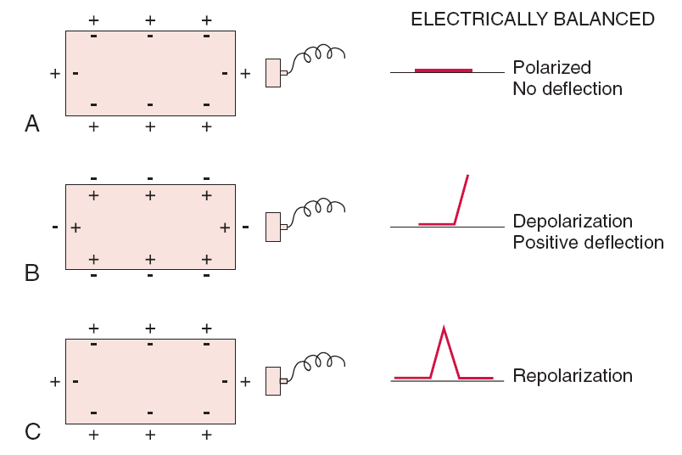
Resting cell - Depolarized cell - Repolarized cell

Slide 6
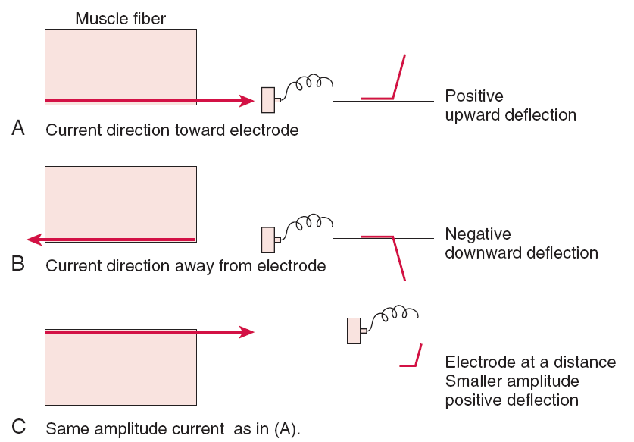
Recording of the effects of electrical activation process

Slide 7
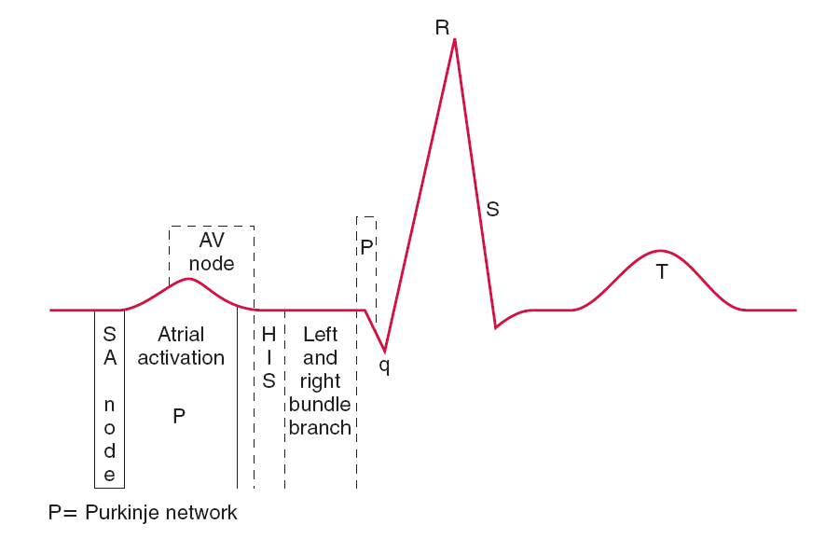

Slide 8
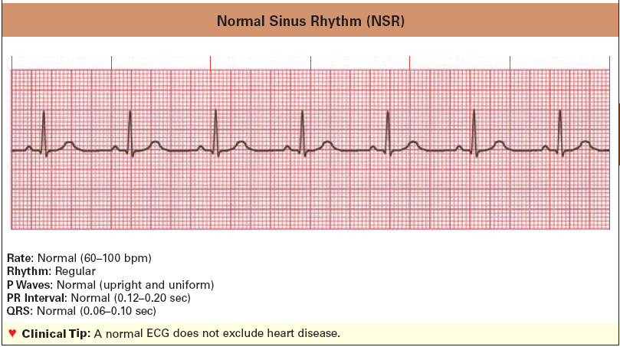

Slide 9
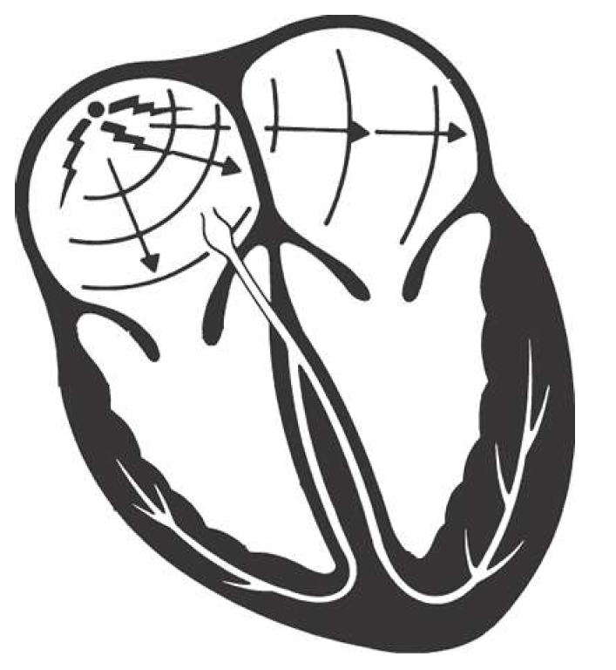
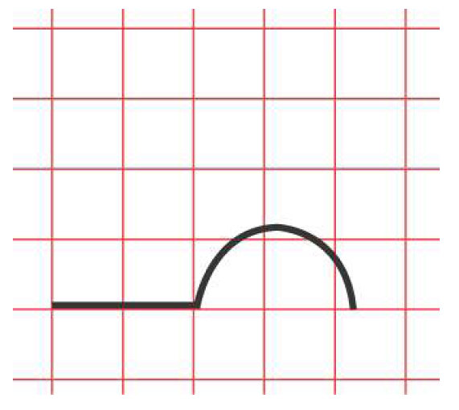
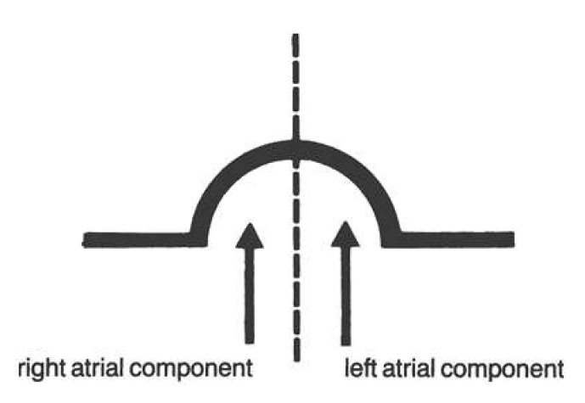
Sinus Node

Slide 10
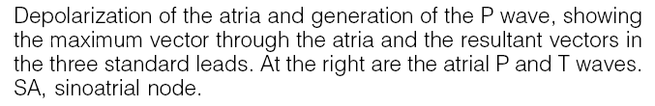
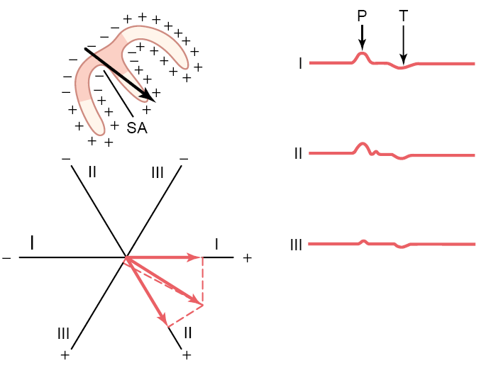

Slide 11
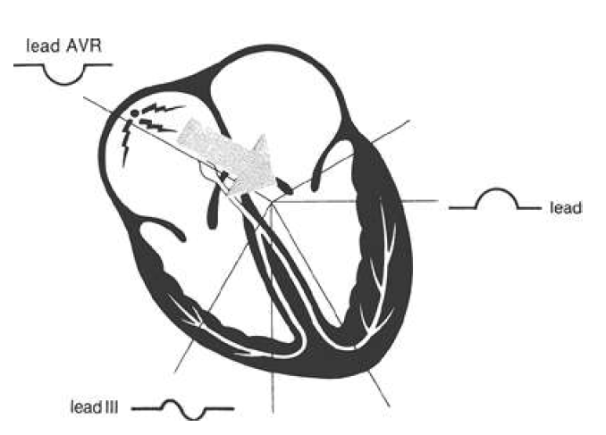
Genesis of the normal P wave: the precordial leads

Slide 12
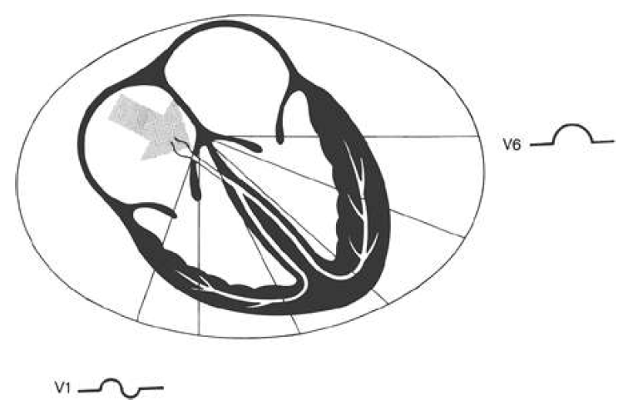
Genesis of the normal P wave: the precordial leads

Slide 13

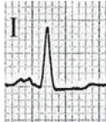
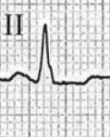
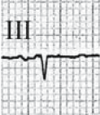
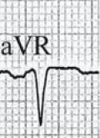
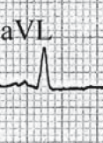
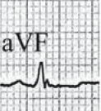
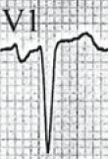
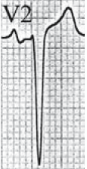
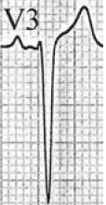
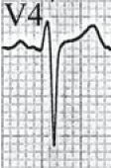
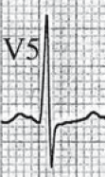
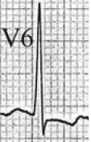
The longer-lasting activation of the dilated left atrium provokes prolongation (≥0.110 ms) and sometimes bifidity of the p wave, especially in leads I or II and V6, with an interpeak distance of >40 ms
The second and negative portion of the p wave in lead V1 (and often V2) is accentuated

Slide 14
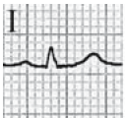
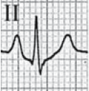
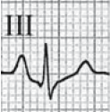
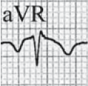
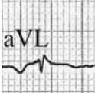
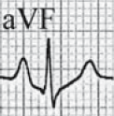
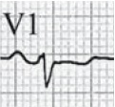
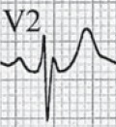
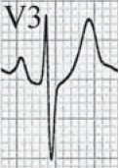
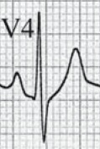
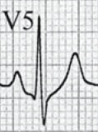
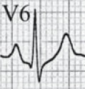
p Pulmonale is characterized by tall and sometimes pointed p waves in leads II, aVF, and III
The amplitude of the p waves is >2.5 mm in at least one of these leads
In the opposite lead aVL, the p wave is completely negative

Slide 15

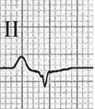
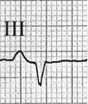
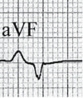
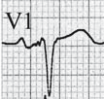
Biatrial enlargement is very rare and combines the criteria of left and right atrial hypertrophy/dilatation :
1. Peaky and high p waves in inferior leads, p ≥2.5 mm in II
2. p Duration 120 ms, accentuated terminal p negativity in V1
Seen in combined severe diseases of heart and lung, and in patients with complex congenital heart disease

Slide 16
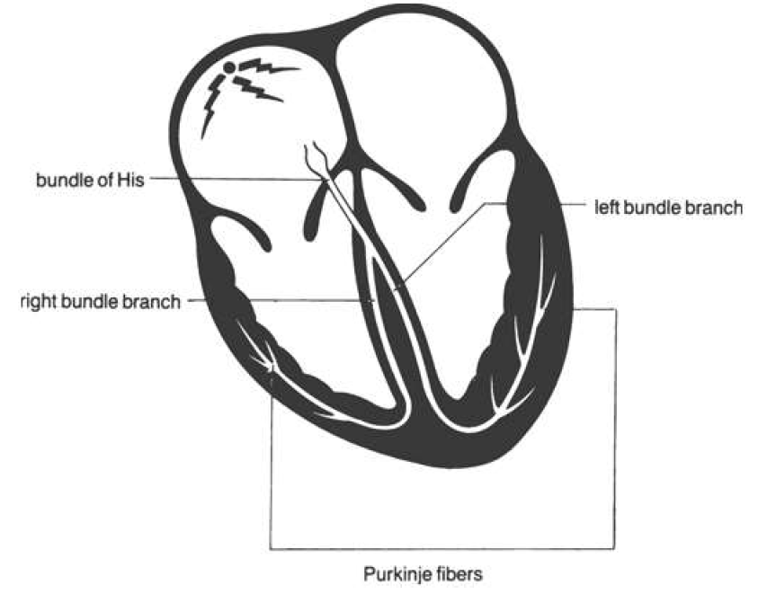
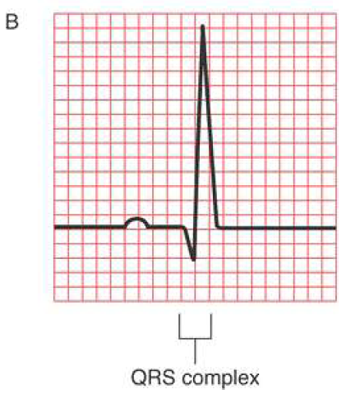
Ventricular Depolarization

Slide 17
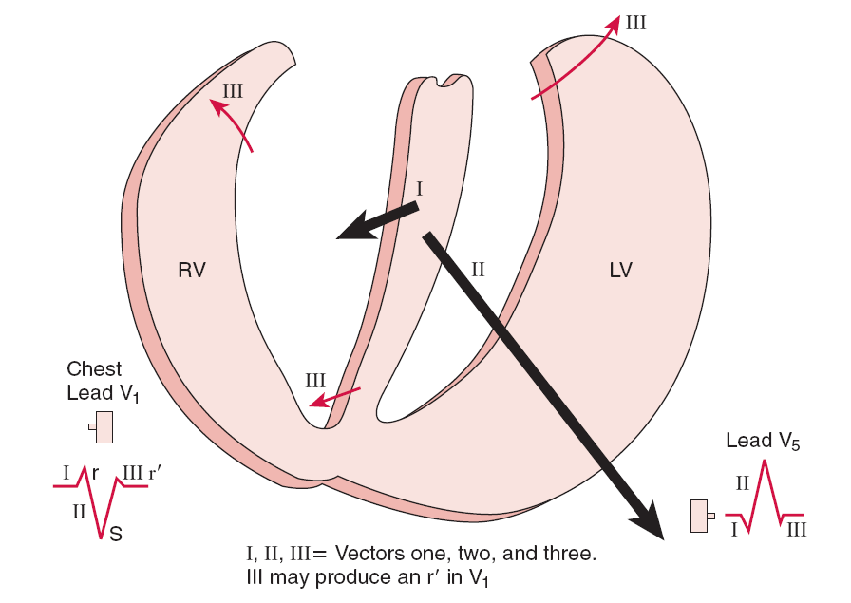
Electrical activation of the heart: resultant vector forces

Slide 18
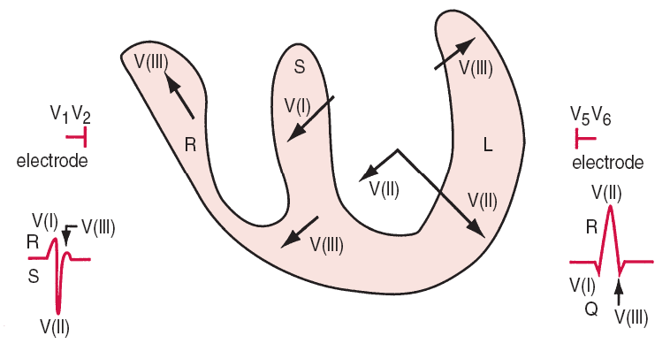
Genesis of the normal QRS complex

Slide 19
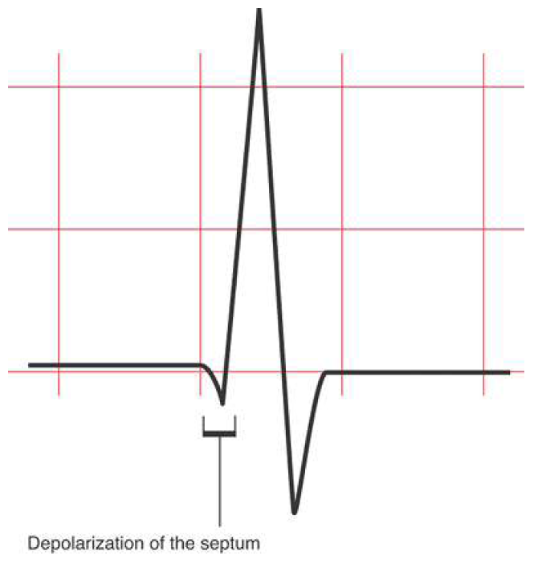

Slide 20
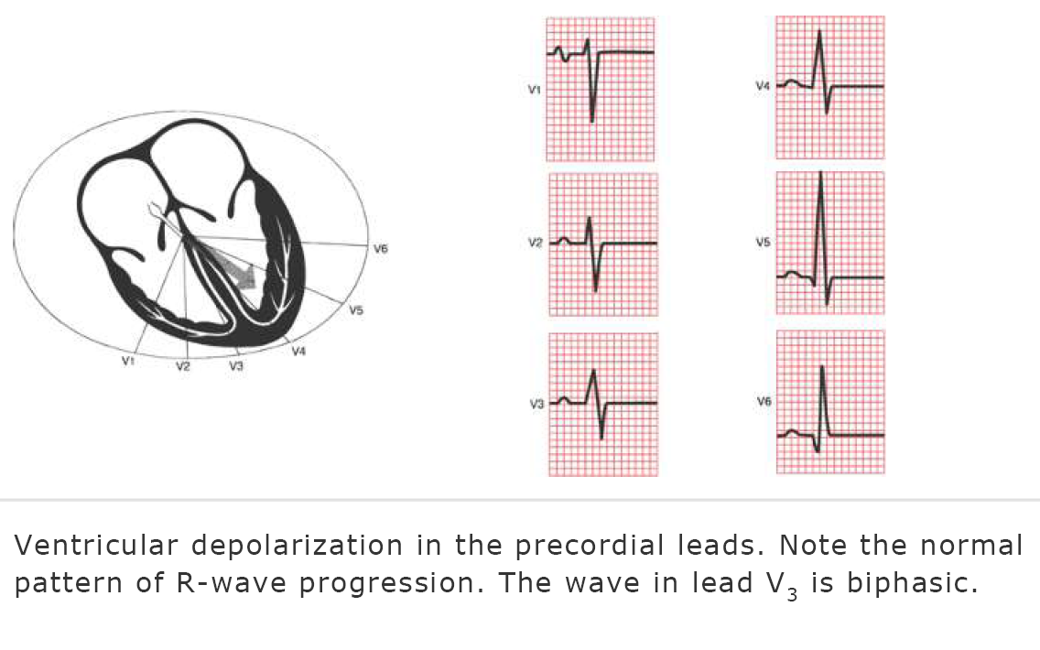

Slide 21

The ECG is characterized by a single positive QRS deflection in lead V1 that is a pure R
This condition is encountered in severe pulmonary valve stenosis, severe RVH in congenital heart diseases with Eisenmenger syndrome, and in some cases of mitral stenosis and severe cor pulmonale
There is associated QRS deviation >+120°).

Slide 22
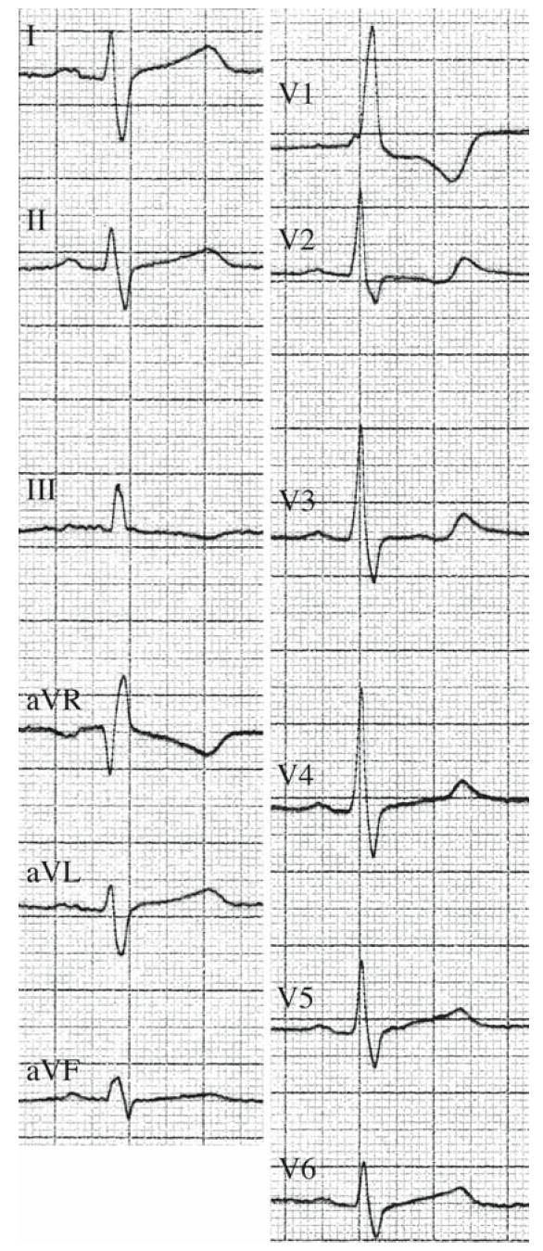


Slide 24



Slide 25



Slide 26


Slide 27



Slide 28


Slide 29





Slide 30
Κλινικά παραδείγματα

Slide 31


Slide 34


Slide 36





Slide 38


Slide 39


Slide 40


Slide 41
Practical Electrocardiography
Atrial Enlargment – Ventricular Hypertrophy
Grigorios Giamouzis, MD, PhD
Ass. Professor of Cardiology
University of Thessaly
Larissa

