Slide 1
ΗΛΕΚΤΡΟΚΑΡΔΙΟΓΡΑΦΗΜΑ
Δρ ΒΑΣΙΛΗΣ ΔΗΜΟΠΟΥΛΟΣ
ΚΑΡΔΙΟΛΟΓΟΣ
Π.Π.Γ.Ν.Λ.
ΚΑΡΔΙΟΛΟΓΙΚΗ ΚΛΙΝΙΚΗ

Slide 2
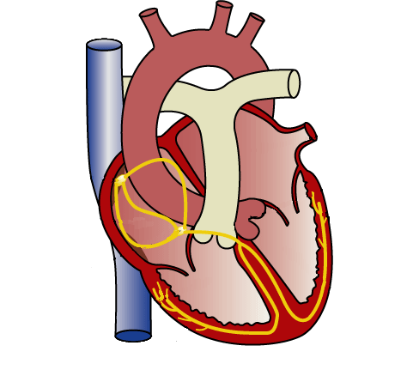
Components of the Electrical System
Atrioventricular
(AV) Node
Sinatrial (SA)
Node
Bundle of HIS
Atria
Purkinje Fibers
Ventricles
Notes:
The impulse starts in the SA node, located in the HRA near the SVC
Spreads rapidly across both atria to the AV groove (the skeleton of the heart which the valve rings are attached and separate the atria from the ventricles). This is electrically not active and acts as a insulator which causes a delay as the impulse comes thru.
Impulse is conducted thru the AV node and Bundle of His which penetrates the AV groove to the ventricles and down the right and left bundle branches of the Purkinje fibers down the ventricular myocardium which rapidly distributes the impulse thru the ventricles.
As the impulse is conducted thru the heart, it causes contraction in the atria, when the impulse reaches the AV groove, the delay that occurs allows for emptying of the atria before the impulse reaches the ventricles. The impulse then reaches the ventricles and causes contraction of both ventricles.

Slide 3
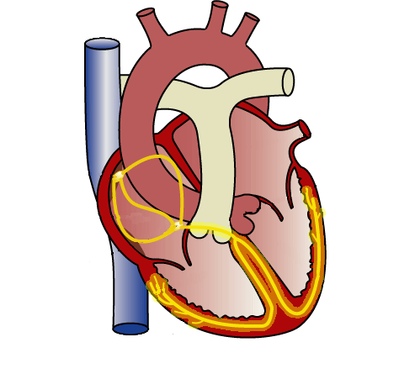
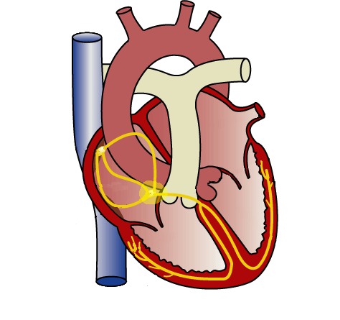
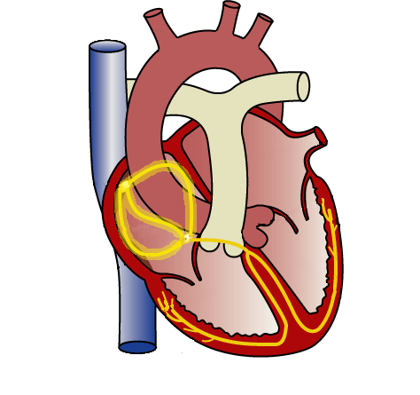
Analysis of ECGs
Relation of electrogram to the anatomy of the cardiac conduction system
QRS
PR Interval
P
T

Slide 4
Analysis of ECG
The Electrocardiogram
R R
P
T
U
Q
S
PR
Interval
QRS
Interval

Slide 5
Analysis of ECGs
Questions to ask when evaluating arrhythmia ECGs
Are there normal-looking P waves?
What is the relationship between the P waves and the QRS complexes?
Are there normal-looking QRS complexes?

Slide 6
Analysis of ECGs
REMEMBER
“Treat the patient, not the ECG”
All rhythm interpretation must be correlated with the condition of the patient

Slide 7
Tachycardia Rhythm Disorders
Supraventricular Tachycardia (SVT)
Ventricular Tachycardia (VT)

Slide 8
Arrhythmia Review
Mechanisms
Automaticity
Triggered
Reentry
Arrhythmias
SVT (not usually fatal)
VT (can be deadly)

Slide 9
Analysis of Arrhythmia ECGs
Keys to arrhythmia interpretation
Analysis of the morphology
Interrelations of the P wave, PR interval, and the QRS complex

Slide 10
Analysis of ECG
Rate
Rhythm
Site of dominant pacemaker
Configuration of P and QRS waves

Slide 11
Ventricular Tachyarrhythmias

Slide 12
Ventricular Tachyarrhythmias
Can be life-threatening
Lead to Sudden Cardiac Death

Slide 13
Sudden Cardiac Death
375,000 people suffer Sudden Cardiac Death per year
Approximately 43 people every hour
75,000 (20%) survive
Malineni, K.C. et. al. Sudden Cardiac Death. eMedicine. http://emedicine.com/med/topic276.htm Aug. 2002.

Slide 14
Sudden Cardiac Death
CAUSES
80-90% are tachyarrhythmias (fast heart rates)
Only 10-20% are due to an acute myocardial infarction (heart attack) or to bradyarrhythmias

Slide 15
Sudden Cardiac Death
Tachyarrhythmias (tachy = too fast)
Ventricular tachycardia
Ventricular fibrillation
Rate is too fast to produce adequate cardiac output

Slide 16
Ventricular Tachyarrhythmias Reentry
Frequently starts with an area of scar tissue in the heart
Result of a heart attack--lack of blood flow causes damage to the tissue, and affects conduction through the tissue

Slide 17
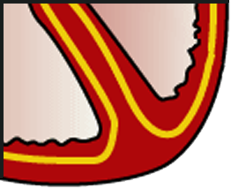
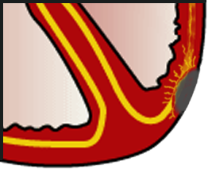
Ventricular Tachyarrhythmias Reentry
Normal Heart
Scarring Due to Myocardial Infarction

Slide 18
Ventricular Tachyarrhythmias
2 major forms:
Ventricular Tachycardia
Monomorphic
Polymorphic
Ventricular Fibrillation

Slide 19
Ventricular Tachycardia
Rate between 100 to 300 bpm
Relatively organized rhythm with regular QRS Complexes
AV dissociation is usually present
Wide QRS complex

Slide 20
Ventricular Tachycardia (Monomorphic)

Slide 21
Ventricular Tachycardia
Sinus P-waves may sometimes be recognized between QRS complexes
Retrograde conduction from the ventricles to the atria is possible
Capture beats with a normal appearing narrow QRS occasionally occur
Fusion beats may be observed with an intermediate QRS morphology

Slide 22
Ventricular Tachycardia
Sustained
> 30 seconds in length
Nonsustained
< 30 seconds in length
Monomorphic
All QRS complexes similar or from 1 location in the ventricle
Polymorphic
Constantly changing morphologies or from multiple locations in the ventricle

Slide 23
VT Examples
Monomorphic
VT
Polymorphic
VT

Slide 24
Ventricular Tachycardia
Ventricular Tachycardia that is hemodynamically unstable should be treated the same as VF

Slide 25
Ventricular Fibrillation
Completely disorganized rhythm without discrete QRS complexes
Results in instant hemodynamic collapse
No cardiac output
Ventricles just quivering
Leads to asystole and death
Requires immediate defibrillation

Slide 26
Ventricular Fibrillation

Slide 27
Ventricular Fibrillation

Slide 28
High Voltage Therapy
Ventricular Fibrillation
High Voltage shock

Slide 29
Ventricular Tachyarrhythmias Automaticity
Accounts for less than 10% of arrhythmias
Seen in acutely ill patients
Abnormal acceleration of Phase 4 occurring in the ventricles
Reversible (treat underlying problem)

Slide 30
Ventricular Tachyarrhythmias Triggered Automaticity
Seen 5-10% of the time
Caused by an underlying chemical disturbance
Electrical disturbance

Slide 31
Triggered Automaticity
Long QT syndrome
Can be inherited or acquired
Involves repolarization phase of action potential. It is slower than normal, leaving the patient vulnerable to a fast, abnormal rhythm (torsade de pointes)

Slide 32
Triggered Automaticity
Brugada Syndrome
Characterized by specific ECG changes.
Caused by genetic mutations, similar to inherited long QT syndrome (mirror images of each other).
Treatment is an ICD.

Slide 33
Triggered Automaticity
Arrhythmogenic Right Ventricular Dysplasia
A genetic disease that causes cellular changes in the right ventricle.
Leads to ventricular dysfunction and arrhythmias.
Value of ICDs not proven for these patients.

Slide 34
Torsade de Pointes
Form of VT in which the QRS complexes appear to be constantly changing
Name is derived from the fact that electrical activity appears to be twisted into a helix

Slide 35
Torsade de Pointes

Slide 36
Torsade de Pointes
Associated with a prolonged QT interval (congenital or acquired)
Usually terminates spontaneously
May degenerate into sustained VT and ventricular fibrillation

Slide 37
Summary
Supraventricular Arrhythmias
Ventricular Arrhythmias
Sudden Cardiac Death

Slide 38
Remember…….
Treat the Patient not the ECG!

Slide 41
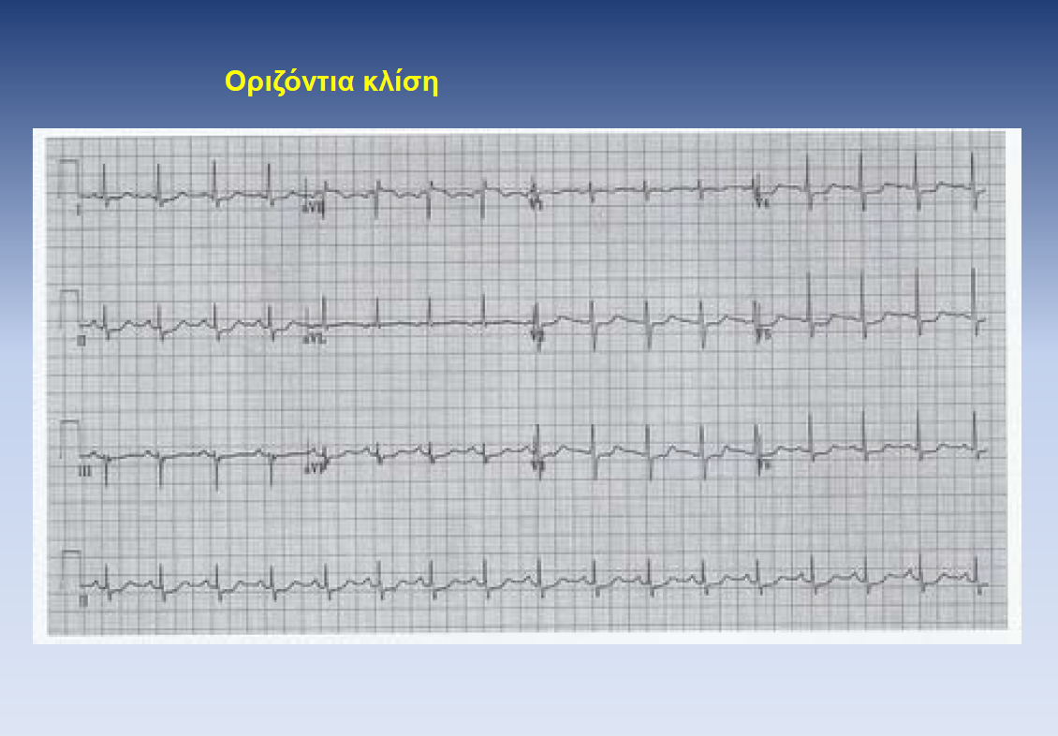

Slide 42
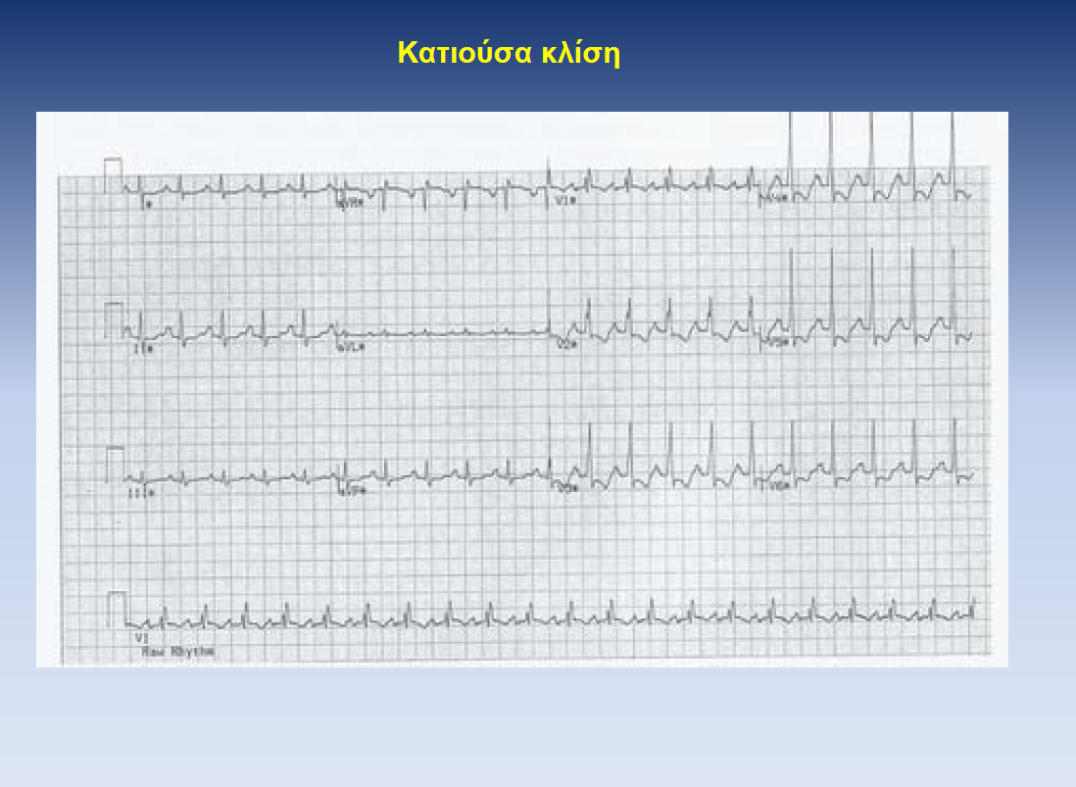

Slide 45
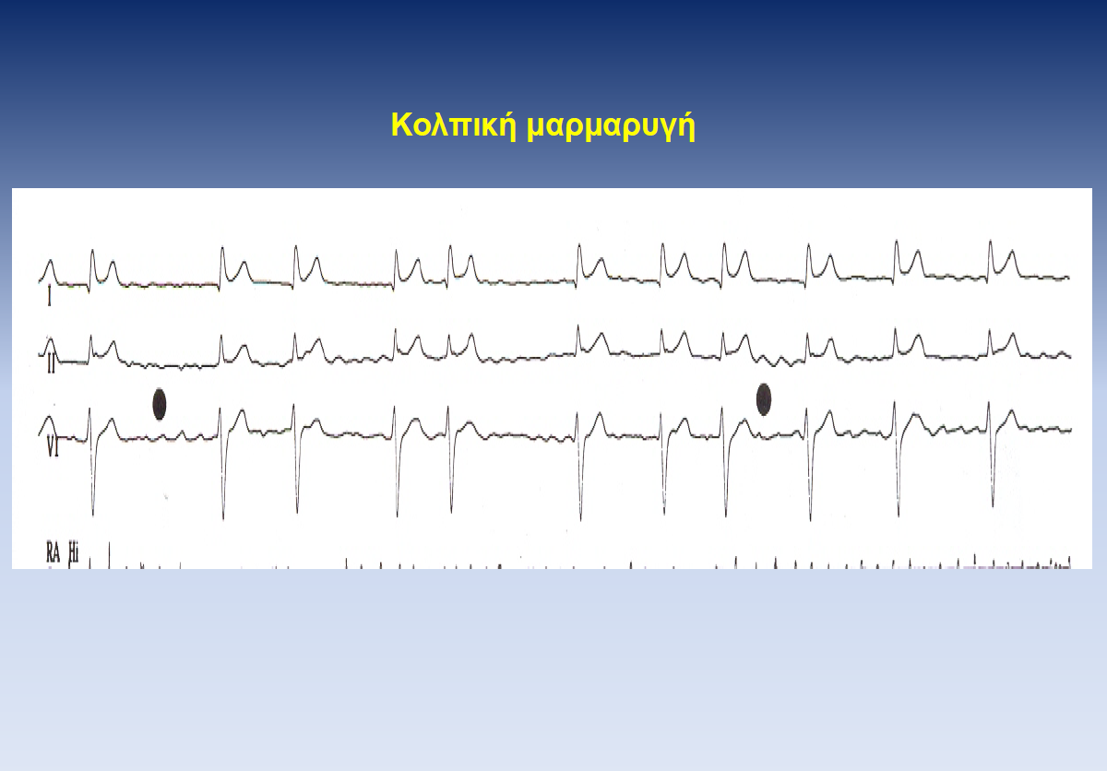

Slide 46
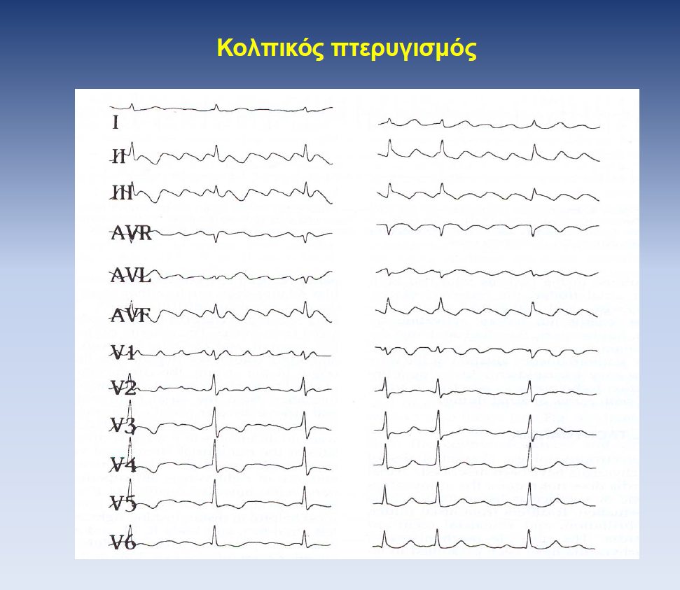

Slide 47
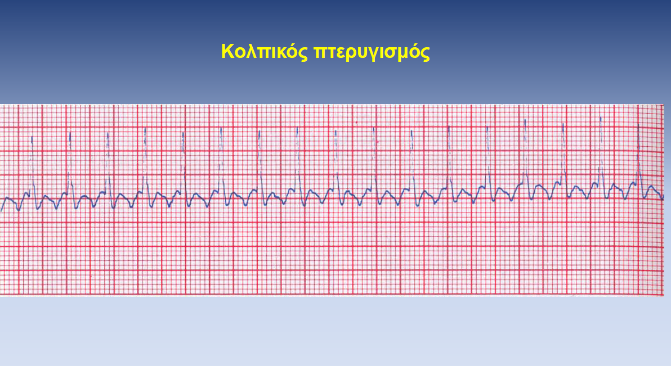

Slide 49
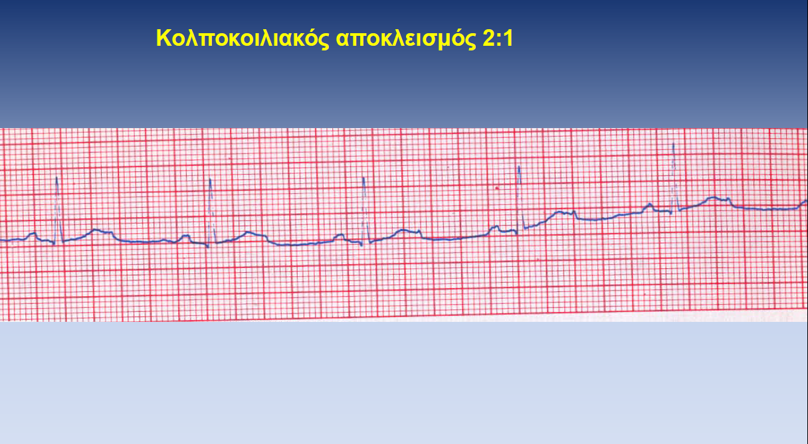

Slide 50
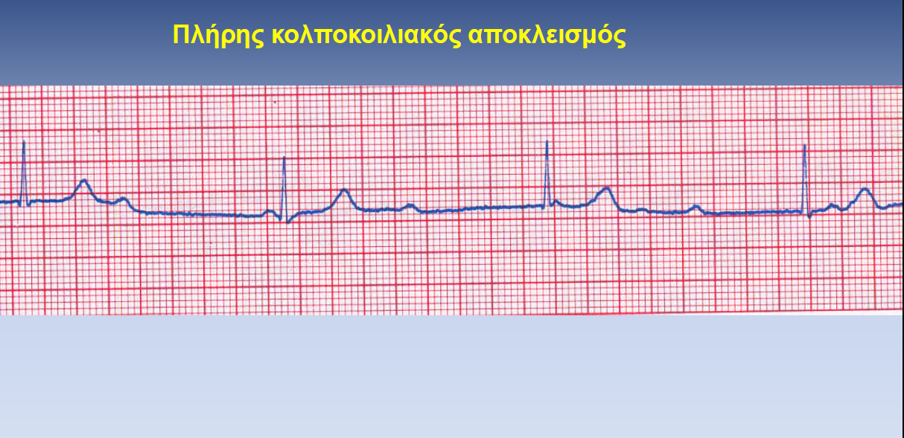

Slide 56
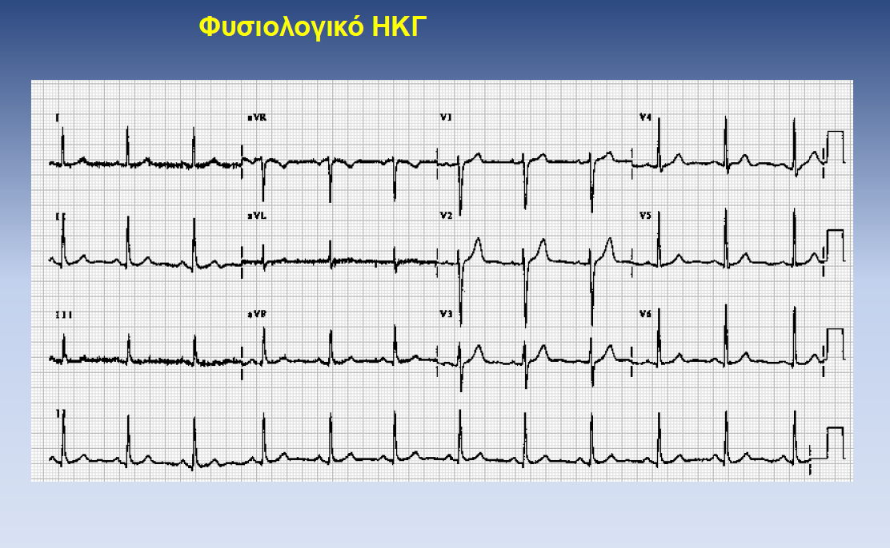

Slide 57
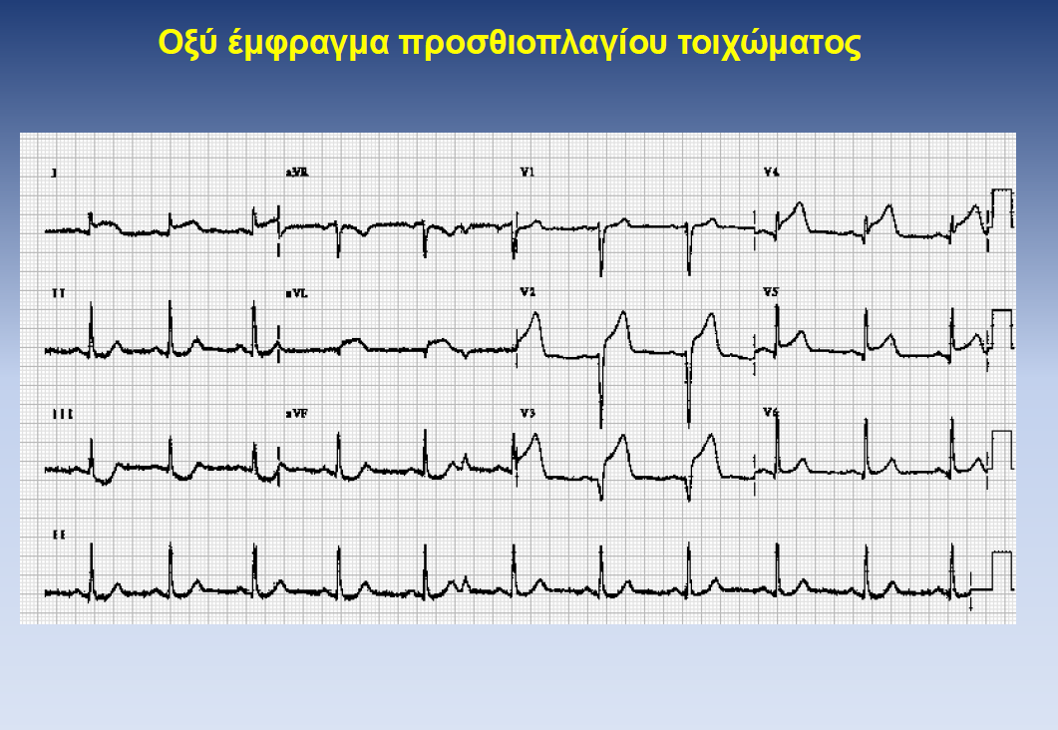

Slide 58
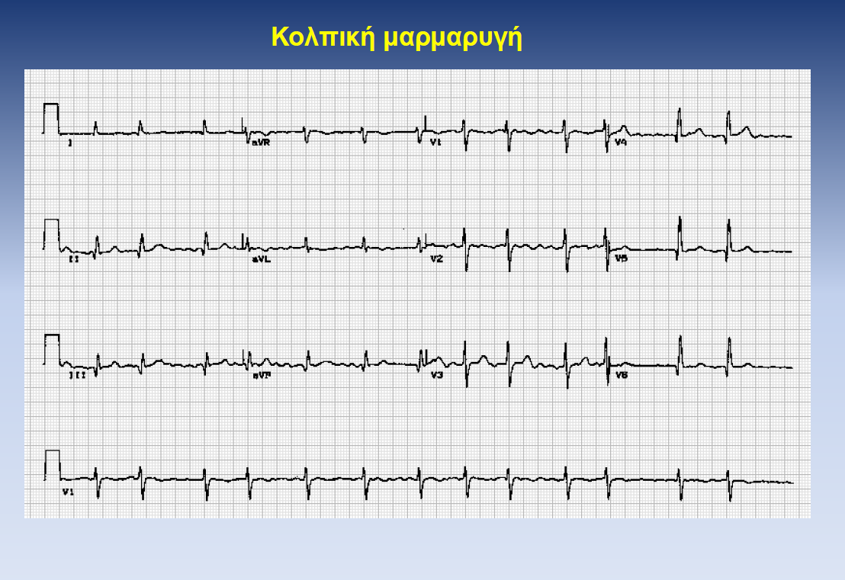

Slide 59
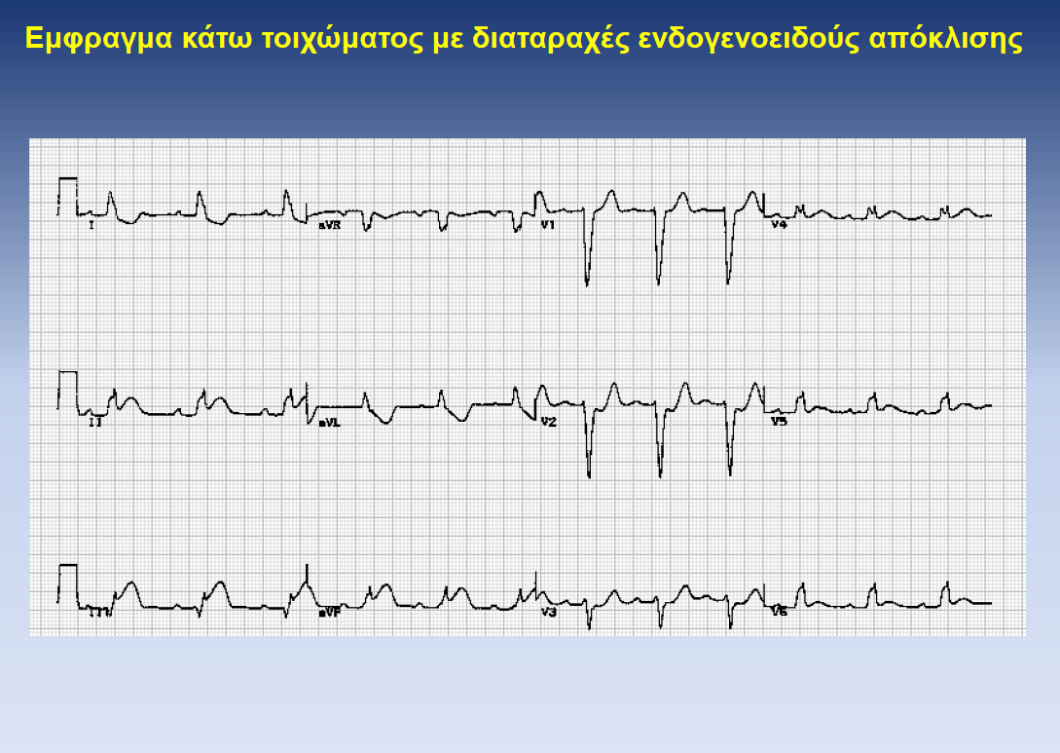

Slide 60
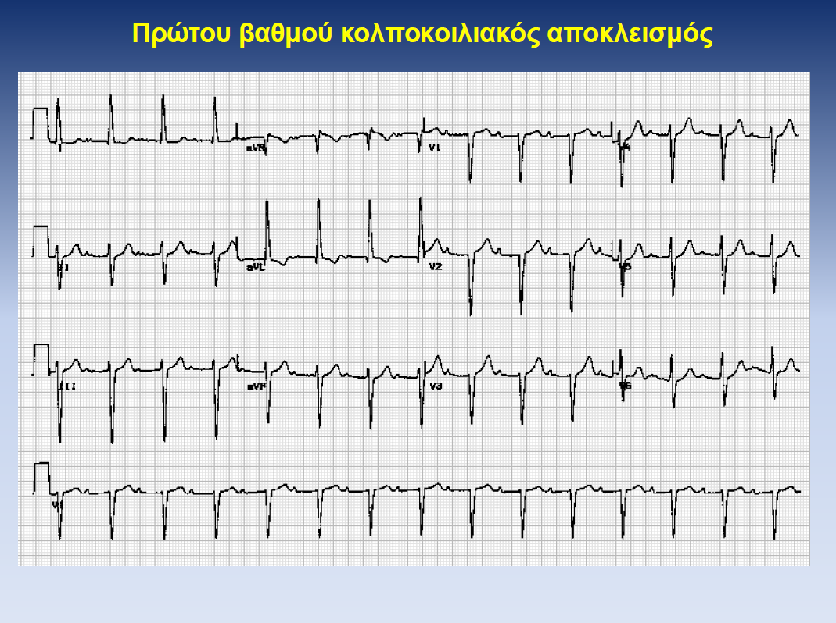

Slide 61
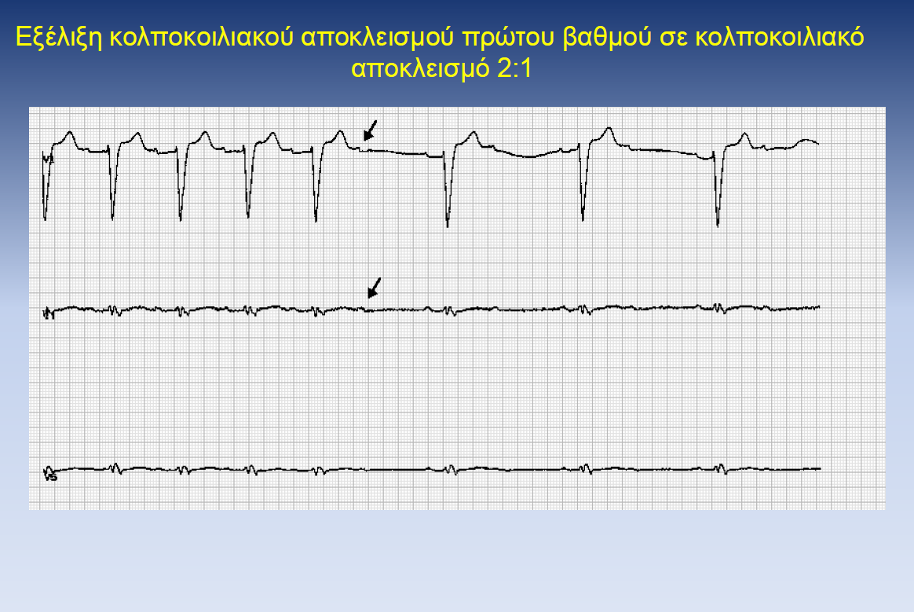

Slide 62
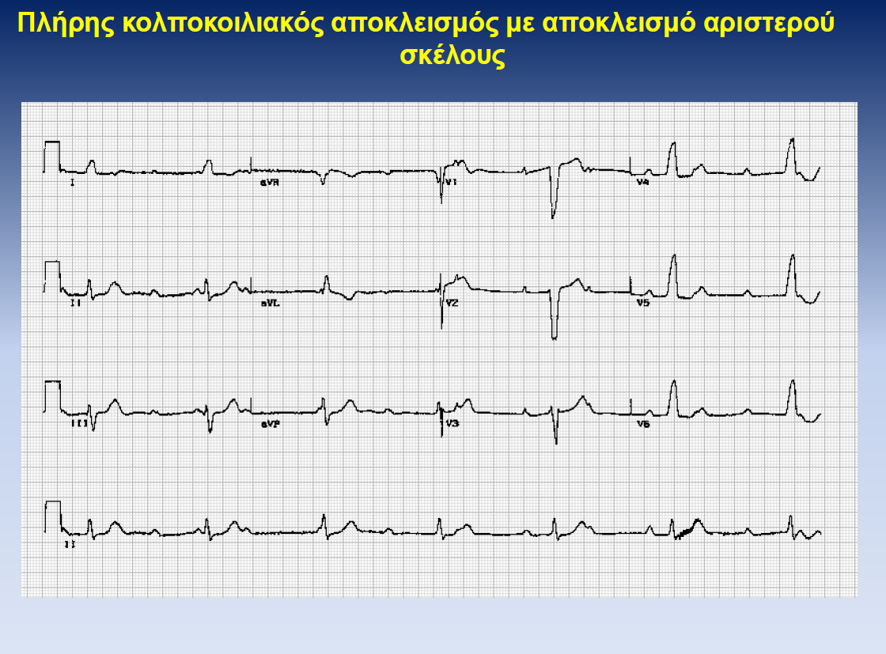

Slide 64
ΕΥΧΑΡΙΣΤΩ

