Slide 1










HORIZON-EIE-2022-SCALEUP-01-01 Expanding Entrepreneurial Ecosystems
The Pitch
Fabio Biscotti

Slide 2

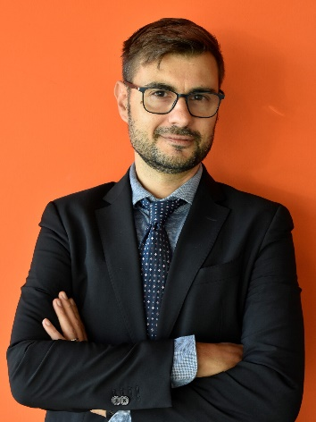

HELLO !
Business Developer at Consorzio Hypatia and Fondazione Amaldi
+20 years of experience in business consulting, business development, management, finance for innovation
Focus on: startups, technology transfer, space businesses, finance
Trainer, coach, tutor for Investment Readiness Programmes
Fabio Biscotti
ENTREPRENEDU is a project funded by the European Union under GA 101100507.

Slide 3
SUMMARY
The Pitch: Why and How
8 Tips
Pitch flashes
  Sales pitch (USP, kind of P.)
  Investor Pitch
ENTREPRENEDU is a project funded by the European Union under GA 101100507.

Slide 4
SUMMARY
1) THE PITCH: WHY AND HOW
ENTREPRENEDU is a project funded by the European Union under GA 101100507.

Slide 5
THE PITCH: WHY AND HOW
What is a Pitch
The pitch (or «investor deck») is a spot of a project (or a company) containing useful information to promote the business idea
The pitch provides key information about the project
The pitch is made during a «pitching session» or «pitch competition» involving single persons, teams, startups, companies, investors, etc.
ENTREPRENEDU is a project funded by the European Union under GA 101100507.

Slide 6
THE PITCH: WHY AND HOW
What is a Pitch
WRITTEN
The pitch startup is made of 15-20 slides max
Never too much slides: the attention goes down after a while
ORAL
Time: 1 – 3 minutes
With or without slide support
ENTREPRENEDU is a project funded by the European Union under GA 101100507.

Slide 7
2) THE PITCH: 8 TIPS
ENTREPRENEDU is a project funded by the European Union under GA 101100507.

Slide 8
THE PITCH: 8 TIPS
Tip 1: Think about the audience…
What’s the audience ?
What does the audience need ?
How can I reach properly and directly? (put yourself in his shoes)
ENTREPRENEDU is a project funded by the European Union under GA 101100507.

Slide 9
THE PITCH: 8 TIPS
Tip 2: … but at yourself also …
Ask yourself: why do I want to have attention ?
What’s my objective ?
What kind of relationship am I looking for ?
How much money (or other support) do I need ?
What will I do with that money ?
ENTREPRENEDU is a project funded by the European Union under GA 101100507.

Slide 10
THE PITCH: 8 TIPS
Tip 3: Never use too many words
… to explain a concept
If you can, show images
Underline key information .. Remember to explain why they should choose you
ENTREPRENEDU is a project funded by the European Union under GA 101100507.

Slide 11
THE PITCH: 8 TIPS
Tip 4: Use Google Slides..
… or another sharing platform
Easier to share than other tool (no annexes) and to be read by any device
More chances the pitch is read
If you use PPT, convert it in PDF
ENTREPRENEDU is a project funded by the European Union under GA 101100507.

Slide 12
THE PITCH: 8 TIPS
Tip 5: Prepare an Italian (or your language) and an English version
The Italian investor can ask a pith in English.. better to be prepared..
ENTREPRENEDU is a project funded by the European Union under GA 101100507.

Slide 13
THE PITCH: 8 TIPS
Tip 6: Before the Pitch, have clear in mind what is the Business Model
Before the Pitch, always prepare the Business Model Canvas, containing all the key elements to effectively describe and present your idea
ENTREPRENEDU is a project funded by the European Union under GA 101100507.

Slide 14
THE PITCH: 8 TIPS
Tips 7: Test the Pitch
Repeat the presentation underlying the key concepts
Repeat it to a colleague, a friend or to a person who doesn’t know exactly what you do
ENTREPRENEDU is a project funded by the European Union under GA 101100507.

Slide 15
THE PITCH: 8 TIPS
Tip 8: Use the body language
Use properly your voice, look properly, use the space around you
Do not hide yourself behind the podium, don’t look the screen but the audience
In case of pitch in person and standing, posture is important
Often you do not know how to put your hands (in your pockets, gesticulating .. ecc..)
ENTREPRENEDU is a project funded by the European Union under GA 101100507.

Slide 16
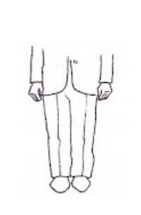
THE PITCH: 8 TIPS
Tip 8: Use the body language
Before the pitch: «Ready position»
Posture erect, relaxed and slightly inclined forward
Hands down, in front of the pockets
ENTREPRENEDU is a project funded by the European Union under GA 101100507.

Slide 17
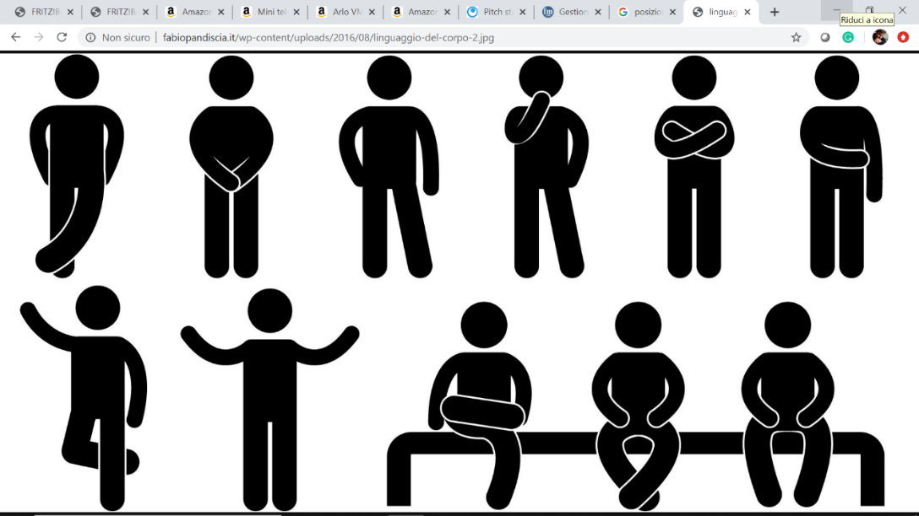
THE PITCH: 8 TIPS
Tip 8: Use the body language
Avoid positions that cover the "vital organs" (sign of nervousness)
ENTREPRENEDU is a project funded by the European Union under GA 101100507.

Slide 18
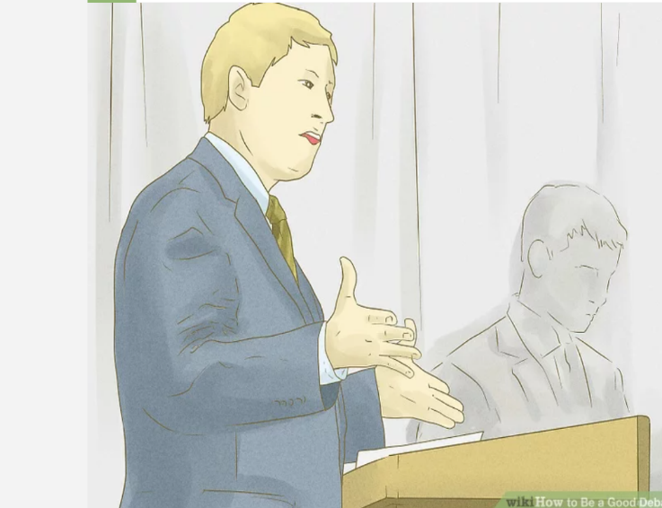
THE PITCH: 8 TIPS
Tip 8: Use the body language
During the pitch:
  «Open» body
  Show the palms of your hands (openness and contact with the audience)
ENTREPRENEDU is a project funded by the European Union under GA 101100507.

Slide 19
THE PITCH: 8 TIPS
Bonus Tip: Do what you have to do
Don’t overdo, don’t say not expected things or without context
Respect time (5/8 min.): respect for punctuality will be taken as seriousness and respect for times in the business
Brief Pitch=clear message
ENTREPRENEDU is a project funded by the European Union under GA 101100507.

Slide 20
3) PITCH FLASHES
ENTREPRENEDU is a project funded by the European Union under GA 101100507.

Slide 21
THE SALES PITCH
What is a Sales Pitch
A sales pitch is a salesperson's attempt to persuade their audience to buy or believe what they're offering. That offer might be the chance at another meeting, information on your product or service, or a personal pitch all about you. Whatever the subject matter, it should be quick, to the point, and attention-grabbing.
A sales pitch is just a way to explain your product or service's value to the buyer.
ENTREPRENEDU is a project funded by the European Union under GA 101100507.

Slide 22
THE SALES PITCH
What is a Sales Pitch
The actor of the story is the customer, not the company that makes the product (avoid saying I... I... I... My company... My company...)
Explain who the customers are (what they do and who they are), the problem they have
Explain how the product/service can help them and what benefits they will get
Give examples of cases in which the product has been used (but only if you are sure of making a good impression!!)
ENTREPRENEDU is a project funded by the European Union under GA 101100507.

Slide 23
THE SALES PITCH
Sales Pitch: Tips
Tell a story
Include a value proposition
Personalise the sales pitch
Adapt (you can choose among a series of sales pitch)
Train yourself
ENTREPRENEDU is a project funded by the European Union under GA 101100507.

Slide 24
THE SALES PITCH
Sales Pitch: Tips
Tell a story
  Engage people with a short story…
  A story that can be about the company.. Or how a customer found success through your product …
ENTREPRENEDU is a project funded by the European Union under GA 101100507.

Slide 25
THE SALES PITCH
Sales Pitch: Tips
Include a value proposition
  What value will you bring to the customer ?
  The value proposition is at the center of the sales pitch (see further slides about “USP”… )
ENTREPRENEDU is a project funded by the European Union under GA 101100507.

Slide 26
THE SALES PITCH
Sales Pitch: Tips
Personalise
  Who are you talking to ?
  Make sure the pitch interests the interlocutor
  You can personalise it focussing on the aspects that are most interesting to the specific interlocutor
  see further slides about “The Person”…
ENTREPRENEDU is a project funded by the European Union under GA 101100507.

Slide 27
THE SALES PITCH
Sales Pitch: Tips
Adapt
  There are various sales pitches to choose from:
  The “One-Word” Sales Pitch
  The “Question” Sales Pitch
  The “Rhyming” Sales Pitch
  The “Subject Line” Sales Pitch
  The “Twitter” Sales Pitch
  The “Pixar” Sales Pitch
ENTREPRENEDU is a project funded by the European Union under GA 101100507.

Slide 28
THE SALES PITCH
Sales Pitch: Tips
Train yourself
  Practice, Practice, Practice, until you feel comfortable
ENTREPRENEDU is a project funded by the European Union under GA 101100507.

Slide 29
THE SALES PITCH
The USP – Unique Selling Proposition
Include a value proposition
  What value will you bring to the customer ?
  The value proposition is at the center of the sales pitch
The USP is crucial to define the Value Proposition of your idea. To correctly identify it, you have to answer to the questions:
  What is the customer’s problem / need I’m trying to satisfy ?
  How do I satisfy it / alleviate suffering ?
  What value do we give to customers ?
While the value proposition is the set of product / services you offer .. the Unique Selling Proposition (USP) is the reason why a customer should buy your product / service (REASON TO BUY)
ENTREPRENEDU is a project funded by the European Union under GA 101100507.

Slide 30
THE SALES PITCH
The USP – Unique Selling Proposition
Include a value proposition
  What value will you bring to the customer ?
  The value proposition is at the center of the sales pitch
To identify the USP:
do not focus on detailed technical topics of your / alternative solution BUT
focus on the features that make UNIQUE your solution compared to others
ENTREPRENEDU is a project funded by the European Union under GA 101100507.

Slide 31
THE SALES PITCH
The USP – Unique Selling Proposition
Include a value proposition
  What value will you bring to the customer ?
  The value proposition is at the center of the sales pitch
The USP:
Is the base of the competitive advantage
It helps to pursue profitability and returns …
  Cost leadership (same product/benefit of other companies, BUT lower price);
  Differentiation: more benefits (quality, usability, etc) of competitors
ENTREPRENEDU is a project funded by the European Union under GA 101100507.

Slide 32
THE SALES PITCH
The USP – Unique Selling Proposition (examples)
Include a value proposition
  What value will you bring to the customer ?
  The value proposition is at the center of the sales pitch
NOVELTY
Satisfy new needs
Smartphone
PERFORMANCE
Powerful performances
New memories (SDS hard disk)..
CUSTOMISATION
Customized product, customer participation in production
Open source platforms
JOB DONE
Solve the problem; «turnkey» product/service
Rolls Royce engine; party planning services
DESIGN
Aesthetics (today design has acquired a very important part of the value)
Fashion; status symbol products
ENTREPRENEDU is a project funded by the European Union under GA 101100507.

Slide 33
THE SALES PITCH
The USP – Unique Selling Proposition (examples)
Include a value proposition
  What value will you bring to the customer ?
  The value proposition is at the center of the sales pitch
BRAND / STATUS
Satisfaction in wearing / using a product
Clothing brand
PRICE
Lower price compared to others
Ryanair, Tata (India)
COST REDUCTION
Reduce the cost for customers
Salesforce.com or other productivity CRM
RISK REDUCTIONS
Solutions reducing risks of a purchase
Used car purchase guarantee
ACCESSIBILITY
Make available inaccessible products
NetJets (private flights)
CONVENIENCE / USABILITY
Make things easier / usable
iPOD / iTunes / Apps
ENTREPRENEDU is a project funded by the European Union under GA 101100507.

Slide 34
THE SALES PITCH
The Personas
Personalise
  Who are you talking to ?
  Make sure the pitch interests the interlocutor
  You can adapt it based on the aspects that are most interesting to different interlocutors
Don’t only ask what your customer desire BUT CONSIDER HIS POINT OF VIEW
If I would have asked people what they wanted, they would have said faster horses
Henry Ford
ENTREPRENEDU is a project funded by the European Union under GA 101100507.

Slide 35
THE SALES PITCH
The Personas
Personalise
  Who are you talking to ?
  Make sure the pitch interests the interlocutor
  You can adapt it based on the aspects that are most interesting to different interlocutors
Identifying and profiling the customer is not enough .. You have to focus on the real need of the person…
THE CUSTOMER .. THE USER .. THE PERSON !
ENTREPRENEDU is a project funded by the European Union under GA 101100507.

Slide 36
THE SALES PITCH
The Personas
Personalise
  Who are you talking to ?
  Make sure the pitch interests the interlocutor
  You can adapt it based on the aspects that are most interesting to different interlocutors
?
Born in 1948 …
British ..
Rich and successful ..
With children ..
Loves dogs ..
Goes on holiday to the Alps ..
Married twice ..
ENTREPRENEDU is a project funded by the European Union under GA 101100507.

Slide 37

THE SALES PITCH
The Personas
Personalise
  Who are you talking to ?
  Make sure the pitch interests the interlocutor
  You can adapt it based on the aspects that are most interesting to different interlocutors
ENTREPRENEDU is a project funded by the European Union under GA 101100507.

Slide 38
THE SALES PITCH
The Personas
Personalise
  Who are you talking to ?
  Make sure the pitch interests the interlocutor
  You can adapt it based on the aspects that are most interesting to different interlocutors
Don’t simplify too much
let's get closer to the customer
Observe the customer: What he does (not only what he says.. Words betray, actions don’t)
Interact
Tell stories..
Look for empathy
Help yourself with tools …
ENTREPRENEDU is a project funded by the European Union under GA 101100507.

Slide 39

THE SALES PITCH
The Personas (tools)
Personalise
  Who are you talking to ?
  Make sure the pitch interests the interlocutor
  You can adapt it based on the aspects that are most interesting to different interlocutors
THE PERSON:
1) USER PROFILE CANVAS
Observations
Interactions
Interviews
Name
Description of the person
Age, gender, Place of residence, marital status, hobby, qualification, job position, social contest, way of thinking, ecc..
«Job to be done»
What are the goals ?
Why does it make sense ?
What performance does the product perform?
Advantages
To what extent do current products make the customer satisfied?
Use cases
How is the product used, where and by whom?
What happens before and after use?
How does the user get information?
How does the purchasing process take place?
Who influences the decision?
Difficulties
What causes negative customer feelings about current products?
What are the customer's concerns?
Picture
Stories
ENTREPRENEDU is a project funded by the European Union under GA 101100507.

Slide 40
THE SALES PITCH
Sales Pitch: 6 possible types
«One-Word» Sales pitch (1/6)
  The point is summed up in one word -> It may seem silly but it can be the basis of a powerful slogan.
  When someone thinks of you, say that word and vice versa…
  Example: Obama's one-word pitch for his 2012 reelection campaign was "forward"
ENTREPRENEDU is a project funded by the European Union under GA 101100507.

Slide 41
THE SALES PITCH
Sales Pitch: 6 possible types
«Question» Sales pitch (2/6)
  Rather than a statement, the pitch is an interrogative sentence
  Formulated in this way, the pitch pushes people to react and get involved
  You need to be sure of the answer, otherwise the pitch can be counterproductive; be sure the interlocutor clearly understands the value of the proposal
  Example: «The supplier makes us reduce costs» becomes «Will the supplier make us reduce costs?».
ENTREPRENEDU is a project funded by the European Union under GA 101100507.

Slide 42
THE SALES PITCH
Sales Pitch: 6 possible types
«Rhyming» Sales pitch (3/6)
  Rhyming isn't just child's play
  The rhymes speed up the so called. “processing fluency” and sensory stimulus
  Studies have shown that rhyming sentences are perceived as more accurate than non-rhyming ones, despite converging on the same messages
ENTREPRENEDU is a project funded by the European Union under GA 101100507.

Slide 43
THE SALES PITCH
Sales Pitch: 6 possible types
«Subject line» Sales pitch (4/6)
  The subject of the email/communication is important. A well-made one follows 3 principles: Utility, Curiosity, Specificity. One excludes the other... How to do it?
  Prepare two types: e.g. one “useful”, the other “curious”;
    use the first if the interlocutor has little time and has a lot of information from competitors;
    use the second if the interlocutor is at the beginning of the day and may be inclined to a more calm and pleasant tone
ENTREPRENEDU is a project funded by the European Union under GA 101100507.

Slide 44
THE SALES PITCH
Sales Pitch: 6 possible types
«Twitter» Sales pitch (5/6)
  Tweeting is an exercise in clarity and brevity. What would the pitch sound like if it only had to work with 140 characters?
  Writing this pitch forces you to think critically and creatively about the important things in your offering. And discard less necessary information.
  However, avoid an aseptic list of characteristics…
ENTREPRENEDU is a project funded by the European Union under GA 101100507.

Slide 45
THE SALES PITCH
Sales Pitch: 6 possible types
«Pixar» Sales pitch (6/6)
  Use the pitch as a story to tell;
  Follow the pattern:
  Once upon a time _____. Every day, _____. One day _____. Because of that, _____. Because of that, _____. Until finally, _____.
  (Former Story Artist Emma Coats at Pixar)
  And automatically a story is created... Easier to remember
ENTREPRENEDU is a project funded by the European Union under GA 101100507.

Slide 46
THE SALES PITCH
Sales Pitch: 6 possible types
«Pixar» Sales pitch (6/6)
  Once upon a time, staffing agencies struggled to find the quality talent they needed.
  Every day, they checked a number of social media sites and sifted through dozens of resumes searching for needles in the haystacks.
  One day, a new type of software was invented that automated this search process and quickly returned qualified candidates based on sophisticated algorithms.
  Because of that, staffing agencies were able to more efficiently fill open positions.
  Because of that, they were able to serve more clients without taking a toll on productivity.
  Until finally, the agencies vastly increased their number of customers and amount of new revenue.
ENTREPRENEDU is a project funded by the European Union under GA 101100507.

Slide 47
THE SALES PITCH
Structure of a Sales Pitch: basic elements
Character
  Who are the customers and what do they do ?
Problem
  What problem do they have currently ?
Plan
  How does your product help them ?
Success
  What benefit do customers get after adopting your product ?
ENTREPRENEDU is a project funded by the European Union under GA 101100507.

Slide 48

THE SALES PITCH
Structure of a Sales Pitch: Canvas
Problem
How we do it
Customer
stories
Value
statement
Proof points
Engaging
questions
ENTREPRENEDU is a project funded by the European Union under GA 101100507.

Slide 49
THE SALES PITCH
Structure of a Sales Pitch: Canvas
Problem
Start with a statement or question about the problem you solve and share eye-opening statistics. Answer the why
ENTREPRENEDU is a project funded by the European Union under GA 101100507.

Slide 50
THE SALES PITCH
Structure of a Sales Pitch: Canvas
Value statement
Share a very clear, concise statement of value. Be action-oriented and outcome focused. Avoid using jargon. Share benefits.
ENTREPRENEDU is a project funded by the European Union under GA 101100507.

Slide 51
THE SALES PITCH
Structure of a Sales Pitch: Canvas
How we
do it
Highlight unique differentiators and explain what you do.
ENTREPRENEDU is a project funded by the European Union under GA 101100507.

Slide 52
THE SALES PITCH
Structure of a Sales Pitch: Canvas
Proof Points
Provide clear reference examples and list recognizable achievements. Share industry validation and awards
ENTREPRENEDU is a project funded by the European Union under GA 101100507.

Slide 53
THE SALES PITCH
Structure of a Sales Pitch: Canvas
Customer stories
Share customer examples and successes.
Tell emotional and personalized customer stories. Make it real and tangible
ENTREPRENEDU is a project funded by the European Union under GA 101100507.

Slide 54
THE SALES PITCH
Structure of a Sales Pitch: Canvas
Engaging questions
Close the pitch with an open-ended question creating a space to have a conversation
ENTREPRENEDU is a project funded by the European Union under GA 101100507.

Slide 55
4) INVESTOR PITCH TEMPLATE
ENTREPRENEDU is a project funded by the European Union under GA 101100507.

Slide 56
Pitch Startup
(Name of the company)
THE FIRST IMPRESSION IS THE ONE THAT COUNTS. THE FIRST SLIDE IS LIKE THE COVER OF A BOOK.
IN THIS SLIDE ENTER THE NAME OF YOUR STARTUP, YOUR CLAIM, THE LINK TO YOUR WEBSITE
Possible subtitle or statement
date, web site, etc..

Slide 57
Insert a short presentation
ENTER A SHORT PRESENTATION OF WHAT YOUR COMPANY DOES OR WHAT IT AIMS TO DO (NOT AN ADVERTISING SLOGAN BUT A SHORT PRESENTATION)
THE FIRST SECONDS ARE CRUCIAL: THEY MUST "HAVE AN IMPACT“.
MAKE PASSION, PERSEVERANCE, PROFIT/BENEFITS SHINE THROUGH.
AMBITION, ENTREPRENEURIAL ATTITUDE, FOCUS ON PRODUCT AND RESULTS MUST SHINE THROUGH
Notes:
Breve descrizione della tua startup.

Slide 58
Summary
HERE INSERT THE HIGHLIGHTS ON THE BUSINESS OPPORTUNITIES OR MORE SIMPLY THE INDEX OF YOUR ELEVATOR PITCH.
Brief summary (4 / 5 points)

Slide 59
Problem
DESCRIBE THE MARKET PROBLEM YOU WANT TO SOLVE, WHAT YOUR POTENTIAL CUSTOMERS ARE EXPERIENCING AND WHY THEY ARE DISSATISFIED.
The reason why your target market is dissatisfied with current market solutions

Slide 60
Solution
PRESENT THE SOLUTION YOU FOUND AND BRIEFLY DESCRIBE THE BENEFITS FOR YOUR CUSTOMERS.
How you solve the problem and the benefits for your customers.

Slide 61

Product
Solution
SHOW HOW YOUR PRODUCT WILL ACTUALLY PRESENT ITSELF AND ITS MAIN FEATURES
1st feature
SITE/PRODUCT SCREENSHOTS SHOWING KEY FEATURES – DON'T GIVE DETAILS ON FEATURES BUT TALK ABOUT BENEFITS

Slide 62
Product
Solution
2nd feature
USE MAX 3 RELEVANT IMAGES

Slide 63
Product
Solution
3rd feature

Slide 64
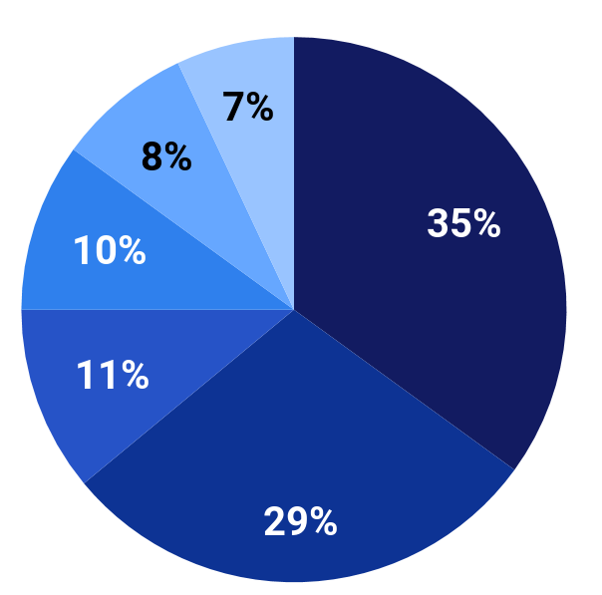
Market Opportunity
Potential customers and Total Addressable Market (TAM)
DON'T TRY TO IMPRESS;
DO NOT DECLARE THE TOTAL CUSTOMERS (E.G. WORLDWIDE...) BUT A REASONABLE TARGET

Slide 65



REFER TO THE MAIN PLAYERS OPERATING IN YOUR MARKET, HIGHLIGHTING WHAT MAKES YOU UNIQUE COMPARED TO THEM.
BETTER TO DO A MARKET ANALYSIS / SWOT ANALYSIS FIRST
Competitor
COMP 01
COMP 02
COMP 03
Differentiation

Slide 66
THE STRATEGY YOU WILL PLAN AND THE CHANNELS YOU WILL IMPLEMENT (MARKETING, RETAILS, STRATEGIC PARTNERS, SALES) TO DELIVER YOUR PRODUCT/SERVICE TO CUSTOMERS.
Growth
Go-to-market strategy (which channels will you use to sell/offer the product: brand, marketing, retail, partners, etc..)
How you obtain and maintain customers, profitability, scalability and competitive advangates

Slide 67
SET REALISTIC MARKET OBJECTIVES WITHIN A GIVEN TIME; LIST THE RESULTS ACHIEVED FOR DIFFERENT TYPES OF CUSTOMERS (%)
Traction
 |  | Three months after activation
 |  | 1 |  | 2 |  | 3 |  | 4
Group 1 |  | 100% |  | 96% |  | 96% |  | 91%
Group 2 |  | 100% |  | 94% |  | 89%
Group 3 |  | 99% |  | 98%
Group 4 |  | 100%
Our current customers...
Feedbacks:
How we are keeping them:
IF YOU RECEIVED FEEDBACKS, TELL ABOUT THEM
E.G.: CONSTANTLY LAUNCHING NEW PRODUCT VERSIONS VS. CONSTANTLY ALIGN THE PRODUCT WITH CUSTOMER NEEDS …
THE INVESTOR NEEDS TO KNOW HOW YOU WILL REACH THE MARKET

Slide 68
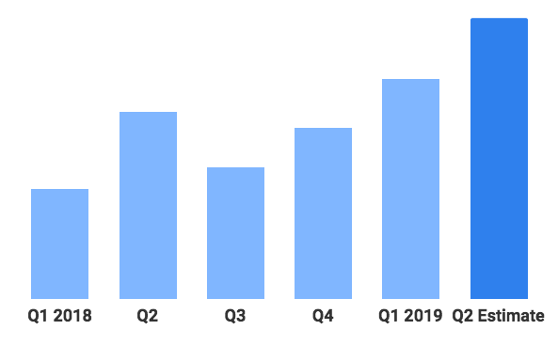
WORK ON THE CANVAS AND THE PRICING MODEL
Business Model
How we intend to generate revenue, make profits and the growth of our customers.
THE Q IS THE QUARTER... THE HEIGHT OF THE HISTOGRAM CAN BE THE REVENUE OR THE PRICE LEVEL OF THE PRODUCT...
THIS IS A STANDARD REPRESENTATION MODEL.. CHECK IF APPROPRIATE FOR THE SPECIFIC CASE BY ILLUSTRATING SOME VARIATIONS

Slide 69
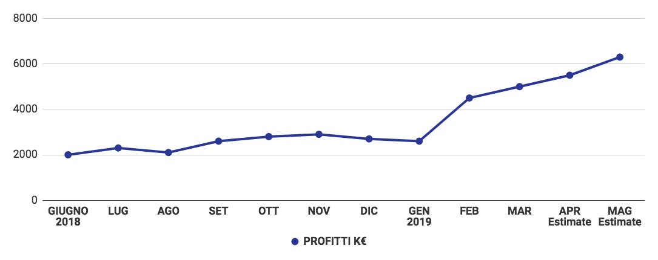
DON'T TRY TO IMPRESS. IT MUST BE CONSISTENT WITH THE MARKET AND THE BUSINESS MODEL.
SIMPLE CHART
Financials
REVENUE FORECAST. USUALLY THE FORECAST IS 3 YEARS OUT.

Slide 70

INSERT A PHOTO FOR EACH MEMBER OF THE TEAM, THE ROLE THEY OCCUPY IN THE PROJECT, A SHORT BIO OF EACH ONE AND LINKS TO THE SOCIAL / BLOG.
Team
IT CAN GO AT THE BEGINNING BUT IT DEPENDS ON THE TIME AND WHAT YOU WANT TO FOCUS ON
XXXX
YYYY
CEO
Linkedin - Blog
XXXX
YYYY
VP ENGINEERING
Linkedin - Blog
XXXX
YYYY
VP PRODUCT
Linkedin - Blog
XXXX
YYYY
CFO
Linkedin - Blog
XXXX
YYYY
VP MARKETING
Linkedin - Blog
Insert: Team, Board members, investors, business angels….
MUST UNDERSTAND THAT: THERE ARE THOSE WHO KNOW HOW TO MAKE THE PRODUCT AND... HOW TO MANAGE THE COMPANY AND MAKE PROFITS

Slide 71
HOW MUCH WE ASK ? WHY ?
AND WHAT TO DO WITH IT (E.G. MARKETING) ?
IF WE ARE LOOKING FOR A PARTNER TO GIVE GENERAL IMPETUS, WE WILL STILL NEED TO GIVE AN IDEA OF ​​THE SHORT-MEDIUM TERM PROGRAMS
Funding
The amount of money you are asking for and why.
Ex 1: X€ for marketing
Ex. 2: Y€ for Technical development
Etc.
VALUATION:
INTANGIBLE: FOCUS, MOMENTUM (COMMERCIAL, MANAGERIAL, TECHNOLOGICAL, ETC.), BUZZ / WORD-OF-MOUTH / CREDIBILITY (CRITICAL FOR EARLY STAGE COMPANIES) FROM CREDIBLE SOURCES

Slide 72
Logo and contacts

Slide 73
Appendix
4/5 SLIDES:
INFORMATION ABOUT TECHNOLOGY
DETAILED FINANCIAL PLAN
…

Slide 74
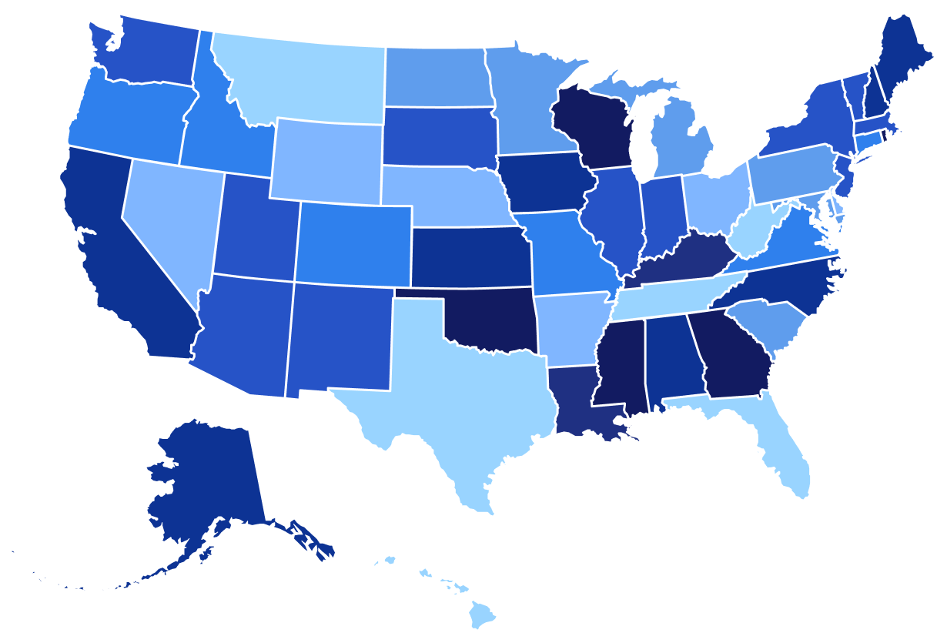
U.S. Map
EX.: MARKET AREA WHERE YOU WANT TO LAUNCH THE PRODUCT
THE INVESTOR NEEDS TO KNOW HOW YOU WILL BE ABLE TO REACH THE MARKET (LINKED TO THE «TRACTION» SLIDE

Slide 75
Timeline
INSERT IT!! IT MUST BE CONSISTENT WITH ALL THE INFORMATION
TIMELINE EVENT
EVENT
Entering in the US market
Q2
Q4
Q1
2017
Q3
EVENT
New feature of the product
EVENT
Entering in the Asian Market
IF THERE ARE TECHNOLOGY ASPECTS, INDICATE THE STAGES THAT ALLOWED THE USABILITY OF THE PRODUCT (E.G. A SPECIFIC TEST THAT ENSURED THAT THE PRODUCT CORRESPONDS TO CUSTOMER NEEDS, OR THE FILING OF A PATENT)

Slide 76



BIBLIOGRAPHY
ENTREPRENEDU is a project funded by the European Union under GA 101100507.

Slide 77
Università di Tor Vergata, Laboratorio Incubatore E2BLab, Guida E2BLab all’elaborazione del Business Plan, 2007.
Università di Tor Vergata, Laboratorio E2BLab, Guida all’utilizzazione del template excel per l’elaborazione del Piano Economico-Finanziario, 2007
Camp, Venture Capital Due Diligence, Wiley Finance, 2002
M. Lewrick et al., Manuale di Design Thinking, Progettare la trasformazione digitale di team, prodotti, servizi ed ecosistemi, LSWR, 2018
M. Lewrick et al., Gli strumenti per il Design Thinking, La guida alle migliori tecniche per facilitare l’innovazione, LSWR, 2021
M. Trombetti, il Nuovo principe. Perché e come fare start-up, PI Campus, 2018
Del Cogliandro, Polidoro, Il Business Plan nelle imprese di servizi, Franco Angeli, 1993.

Slide 78
Thank you for your attention!
Get in touch at: info@fondazioneamaldi.it
ENTREPRENEDU is a project funded by the European Union under GA 101100507.

