Slide 1










HORIZON-EIE-2022-SCALEUP-01-01 Expanding Entrepreneurial Ecosystems
Tech Feasibility
12 October 2023
Fabio Biscotti

Slide 2

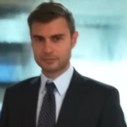

HELLO !
Business Developer at Consorzio di ricerca Hypatia and Fondazione E. Amaldi
+20 years of experience in business consulting, business development, management, finance for innovation
Focus on: startups, technology transfer, space businesses, finance
Trainer, coach, tutor for Investment Readiness Programmes
Fabio Biscotti
ENTREPRENEDU is a project funded by the European Union under GA 101100507.

Slide 3
SUMMARY
TECH FEASIBILITY
Tech Feasibility: intro
Tech Feasibility: Contents
Tips for writing a Tech Feasibility
Resources and costs
Risk Analysis
Methodologies: a case study (ORAC)
Tech Feasibility: an example
From Tech Feasibility to Technical Plan
Bibliography
ENTREPRENEDU is a project funded by the European Union under GA 101100507.

Slide 4
1) TECH FEASIBILITY: INTRO
ENTREPRENEDU is a project funded by the European Union under GA 101100507.

Slide 5
TECHNICAL FEASIBILITY: INTRO
What is a Technical Feasibility Plan ?
The Tech Feasibility Plan (or Study) is a formal document, an output (intermediate or final) of a long reasoning iterative process made up of data search, analysis, simulations, to define qualitative and quantitative technical options of a project
ENTREPRENEDU is a project funded by the European Union under GA 101100507.

Slide 6
TECHNICAL FEASIBILITY: INTRO
Why is a technical feasibility study essential for Any Project? (1/4)
Identifying potential problems and challenges that may arise during the implementation project
Helping in planning for contingencies and mitigate risks before they become major issues
ENTREPRENEDU is a project funded by the European Union under GA 101100507.

Slide 7
TECHNICAL FEASIBILITY: INTRO
Why is a technical feasibility study essential for Any Project? (2/4)
Assessing resource requirements such as equipment, software, raw materials and personnel
Estimating costs, plan budgets, and allocate resources more effectively
ENTREPRENEDU is a project funded by the European Union under GA 101100507.

Slide 8
TECHNICAL FEASIBILITY: INTRO
Why is a technical feasibility study essential for Any Project? (3/4)
Evaluating technical requirements of a project (e.g. HW and SW compatibility, data management, production process and security, etc.) to ensure the project is technically sound and can be successfully implemented
Ensuring project viability, helping to decide whether to proceed with the project or consider other alternatives
ENTREPRENEDU is a project funded by the European Union under GA 101100507.

Slide 9
TECHNICAL FEASIBILITY: INTRO
Why is a technical feasibility study essential for Any Project? (4/4)
Overall, technical feasibility is essential for any project because it helps identify potential problems, assess resource requirements, evaluate technical requirements, and ensure project viability.
By conducting this study, project managers can improve the chances of project success and avoid costly mistakes.
ENTREPRENEDU is a project funded by the European Union under GA 101100507.

Slide 10
TECHNICAL FEASIBILITY: INTRO
3 Things to consider while conducting a Tech FS
Is the proposed technology or solution practical?
  Do we currently possess the necessary technology?
  Do we possess the necessary technical expertise?
    …and is the schedule reasonable for this team?
  What kind of technology will we need?
ENTREPRENEDU is a project funded by the European Union under GA 101100507.

Slide 11
TECHNICAL FEASIBILITY: INTRO
3 Things to consider while conducting a Tech FS
Is the relevant technology mature enough to be easily applied to our problem?
  Some organizations like to use state-of-the-art technology
    …but most prefer to use mature and proven technology
  A mature technology has a larger customer base for obtaining advice concerning problems and improvements
ENTREPRENEDU is a project funded by the European Union under GA 101100507.

Slide 12
TECHNICAL FEASIBILITY: INTRO
3 Things to consider while conducting a Tech FS
Is the required technology available “in house”?
  If the technology is available:
    …does it have the capacity to handle the solution?
  If the technology is not available:
    …can it be acquired?
ENTREPRENEDU is a project funded by the European Union under GA 101100507.

Slide 13
2) TECH FEASIBILITY: CONTENTS
ENTREPRENEDU is a project funded by the European Union under GA 101100507.

Slide 14
TECHNICAL FEASIBILITY: CONTENTS
Typical contents
Several parameters should be considered. Here we suggest 10:
Technical Requirements: Define the technical requirements that are necessary for the project. (e.g. hardware, software, production process and other technical infrastructure, etc.)
ENTREPRENEDU is a project funded by the European Union under GA 101100507.

Slide 15
TECHNICAL FEASIBILITY: CONTENTS
Typical contents
Resource Availability: Evaluate the availability of technical resources such as hardware, software, raw materials and technical personnel
ENTREPRENEDU is a project funded by the European Union under GA 101100507.

Slide 16
TECHNICAL FEASIBILITY: CONTENTS
Typical contents
Scalability: Determine if the project can be scaled up or down as needed to meet changing requirements
ENTREPRENEDU is a project funded by the European Union under GA 101100507.

Slide 17
TECHNICAL FEASIBILITY: CONTENTS
Typical contents
Compatibility: Determine the compatibility of the proposed technical solution with existing systems and infrastructure
ENTREPRENEDU is a project funded by the European Union under GA 101100507.

Slide 18
TECHNICAL FEASIBILITY: CONTENTS
Typical contents
Security: Evaluate the security of the proposed technical solution and identify potential vulnerabilities
ENTREPRENEDU is a project funded by the European Union under GA 101100507.

Slide 19
TECHNICAL FEASIBILITY: CONTENTS
Typical contents
Cost: Evaluate the cost of the proposed technical solution, including hardware, software, and personnel costs
ENTREPRENEDU is a project funded by the European Union under GA 101100507.

Slide 20
TECHNICAL FEASIBILITY: CONTENTS
Typical contents
Maintenance: Determine the maintenance requirements for the proposed technical solution and evaluate the availability of technical personnel to perform maintenance tasks
ENTREPRENEDU is a project funded by the European Union under GA 101100507.

Slide 21
TECHNICAL FEASIBILITY: CONTENTS
Typical contents
Technical Risk: Identify and assess the technical risks associated with the proposed technical solution
ENTREPRENEDU is a project funded by the European Union under GA 101100507.

Slide 22
TECHNICAL FEASIBILITY: CONTENTS
Typical contents
Technical Expertise: Evaluate the technical expertise required to implement the proposed technical solution and determine if the organization has the necessary skills in-house or if outside expertise is needed
ENTREPRENEDU is a project funded by the European Union under GA 101100507.

Slide 23
TECHNICAL FEASIBILITY: CONTENTS
Typical contents
Timeframe: Define the timeframe for the technical feasibility study and ensure that it aligns with the project timeline.
ENTREPRENEDU is a project funded by the European Union under GA 101100507.

Slide 24
3) TIPS FOR WRITING A TECH FEASIBILITY
ENTREPRENEDU is a project funded by the European Union under GA 101100507.

Slide 25
TIPS FOR WRITING A TECHNICAL FEASIBILITY STUDY
10 Tips for a Tech FS
Define the purpose and scope
Clearly define the purpose and scope of the study. This will help ensure that the study is focused and provides relevant information for the proposed project
ENTREPRENEDU is a project funded by the European Union under GA 101100507.

Slide 26
TIPS FOR WRITING A TECHNICAL FEASIBILITY STUDY
10 Tips for a Tech FS
Identify key stakeholders
Identify the key stakeholders who will be impacted by the project and ensure that their requirements and concerns are duly addressed in the study
ENTREPRENEDU is a project funded by the European Union under GA 101100507.

Slide 27
TIPS FOR WRITING A TECHNICAL FEASIBILITY STUDY
10 Tips for a Tech FS
Include technical details
While the study should be accessible to non-technical stakeholders, it should also provide enough technical details and specifications to accurately assess the feasibility of the project (e.g. in Annexes)
ENTREPRENEDU is a project funded by the European Union under GA 101100507.

Slide 28
TIPS FOR WRITING A TECHNICAL FEASIBILITY STUDY
10 Tips for a Tech FS
Assess costs
Provide an idea / assessment of the technical / productive costs, to be linked with the other analysis of your project (e.g. economic viability, business plan, etc..)
ENTREPRENEDU is a project funded by the European Union under GA 101100507.

Slide 29
TIPS FOR WRITING A TECHNICAL FEASIBILITY STUDY
10 Tips for a Tech FS
Identify and evaluate alternatives
Identify and evaluate alternative solutions or technologies that could be used instead of the proposed solution. This will help provide context for the feasibility of the proposed project
ENTREPRENEDU is a project funded by the European Union under GA 101100507.

Slide 30
TIPS FOR WRITING A TECHNICAL FEASIBILITY STUDY
10 Tips for a Tech FS
Assess risks and opportunities
Conduct a thorough risk assessment, identifying potential technical risks and opportunities. This will help stakeholders understand the potential impact of the project on their organization
ENTREPRENEDU is a project funded by the European Union under GA 101100507.

Slide 31
TIPS FOR WRITING A TECHNICAL FEASIBILITY STUDY
10 Tips for a Tech FS
Provide recommendations
Based on the findings of the study, provide clear recommendations for whether or not we should go on with the project, and if so, any necessary modifications required, or contingencies envisaged
ENTREPRENEDU is a project funded by the European Union under GA 101100507.

Slide 32
TIPS FOR WRITING A TECHNICAL FEASIBILITY STUDY
10 Tips for a Tech FS
Review and revise
Review and revise the study multiple times to ensure accuracy, clarity, and completeness. Consider having a peer review by someone with technical and professional expertise to ensure that the study is accurate and complete
ENTREPRENEDU is a project funded by the European Union under GA 101100507.

Slide 33
TIPS FOR WRITING A TECHNICAL FEASIBILITY STUDY
10 Tips for a Tech FS
Use clear and concise language
Avoid technical jargon or terms that may be confusing to non-technical stakeholders
ENTREPRENEDU is a project funded by the European Union under GA 101100507.

Slide 34
TIPS FOR WRITING A TECHNICAL FEASIBILITY STUDY
10 Tips for a Tech FS
Use a structured format
Include an executive summary, introduction, methodology, results, and conclusion. This will help ensure that the study is organized and easy to navigate
ENTREPRENEDU is a project funded by the European Union under GA 101100507.

Slide 35
4) TECH FEASIBILITY: RESOURCES AND COSTS
ENTREPRENEDU is a project funded by the European Union under GA 101100507.

Slide 36
TECH FEASIBILITY: RESOURCES AND COSTS
Technical costs
Addressability:
Direct costs: sustained to realise the product and directly addressable to it (raw materials, semi-finished, consumables, licences)
Indirect costs: they are general costs, sustained also for other industrial activities (energy, personnel, etc.). They are counted on the basis of selected «drivers» or ratios
ENTREPRENEDU is a project funded by the European Union under GA 101100507.

Slide 37
TECH FEASIBILITY: RESOURCES AND COSTS
Technical costs
Proportionality:
Variable costs: they are proportioned to the produced quantity (raw materials, consumables, direct labour, etc.). They are also called «product costs»
Fixed costs: they are independent from the produced quantity (equipment, amortisations, leasing, licences, insurances)
Semi-variable (or semi-fixed) costs: costs that are prevalently variable (or fixed) depending on the case (e.g. personnel)
ENTREPRENEDU is a project funded by the European Union under GA 101100507.

Slide 38
TECH FEASIBILITY: RESOURCES AND COSTS
Technical costs
Typology:
Productive costs
Personnel
Raw Materials
Energy
Equipment
Other
FIXED and VARIABLE
ENTREPRENEDU is a project funded by the European Union under GA 101100507.

Slide 39
TECH FEASIBILITY: RESOURCES AND COSTS
Technical costs
Typology:
R&D Costs
R&D Personnel
Patent
Software
Other
Consulting
FIXED and VARIABLE
ENTREPRENEDU is a project funded by the European Union under GA 101100507.

Slide 40
5) RISK ANALYSIS
ENTREPRENEDU is a project funded by the European Union under GA 101100507.

Slide 41
TECH FEASIBILITY: RISK ANALYSIS
Risk Analysis
Planning means to take precise decisions about the path of a project. The desired plan, can however be difficult
Project Management techniques help to professionally, systematically and proactively manage risks and emergencies
ENTREPRENEDU is a project funded by the European Union under GA 101100507.

Slide 42
TECH FEASIBILITY: RISK ANALYSIS
Risk Analysis
Plan of the process
Risks Identification
Risk management Process
Risk Analysis
Answers to Risks
Monitoring and control
ENTREPRENEDU is a project funded by the European Union under GA 101100507.

Slide 43
TECH FEASIBILITY: RISK ANALYSIS
Risk Analysis
1 | 2 | 3 | 4 | 5 | 6 | 7 | 8 | 9 | 10
1 |  | 2 |  | 3 |  | 4 |  | 5
Very Low |  | Low |  | Medium |  | Medium-High |  | High
10% | 20% | 30% | 40% | 50% | 60% | 70% | 80% | 90% | 95%
ENTREPRENEDU is a project funded by the European Union under GA 101100507.

Slide 44
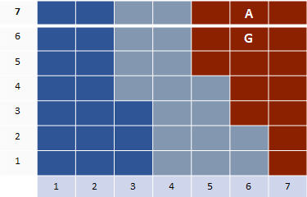
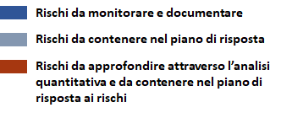
TECH FEASIBILITY: RISK ANALYSIS
Risk Analysis
Likelihood
Risks to monitor and report
Risks to mitigate in the mitigation plan
Risks to go into details through quantitative analysis
Impact
ENTREPRENEDU is a project funded by the European Union under GA 101100507.

Slide 45
TECH FEASIBILITY: RISK ANALYSIS
Risk Analysis Table
Risk | Cause | Effect / impact | Likelihood of occurrency | Impact / Risk Magnitude | Precaustion measure | Mitigation Plan | Ranking/ Cost of risk
ENTREPRENEDU is a project funded by the European Union under GA 101100507.

Slide 46
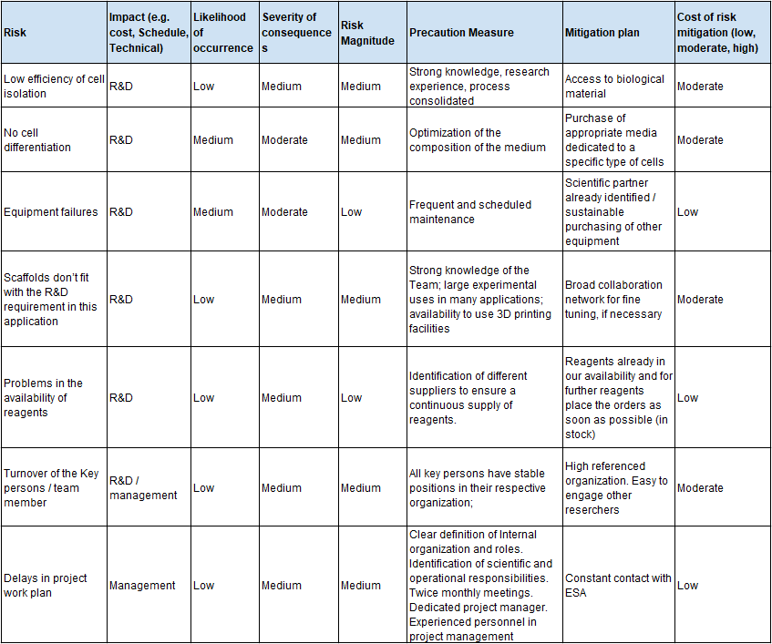
TECH FEASIBILITY: RISK ANALYSIS
Risk Analysis Table: example
ENTREPRENEDU is a project funded by the European Union under GA 101100507.

Slide 47
6) METHODOLOGIES: A CASE STUDY
ENTREPRENEDU is a project funded by the European Union under GA 101100507.

Slide 48
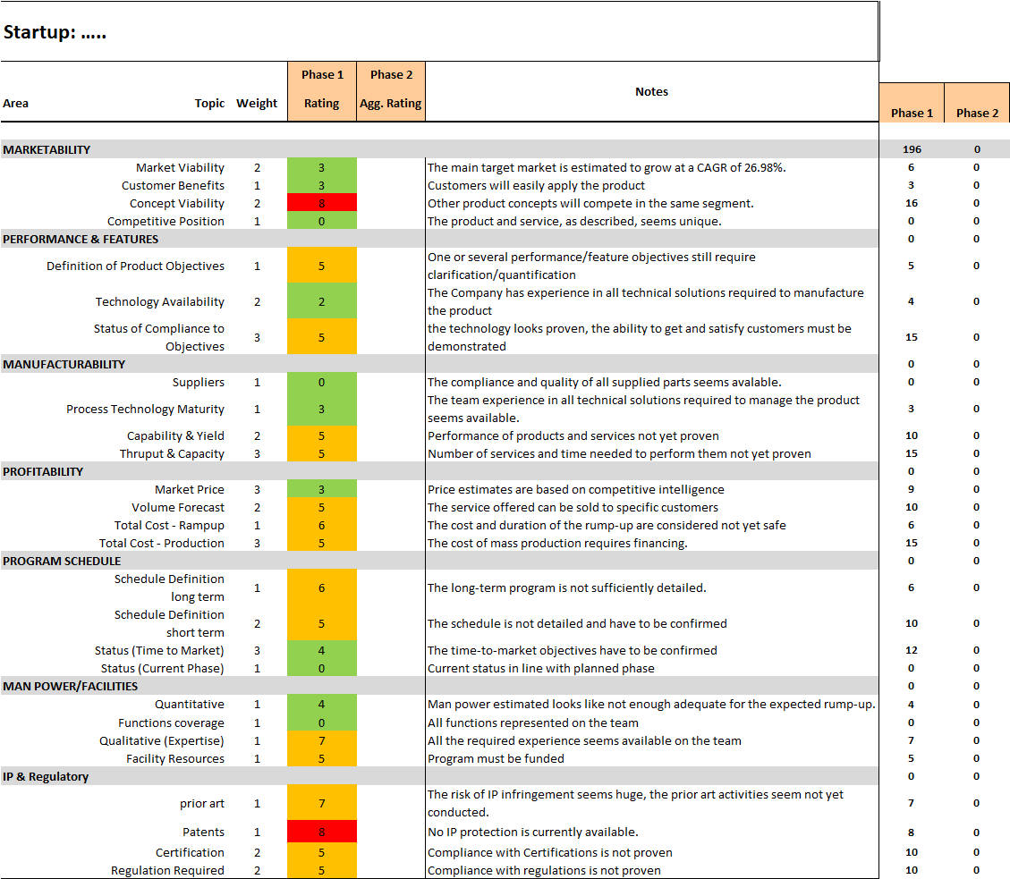
METHODOLOGIES: A CASE STUDY
A Quantitative Methodology: ORAC
ENTREPRENEDU is a project funded by the European Union under GA 101100507.

Slide 49
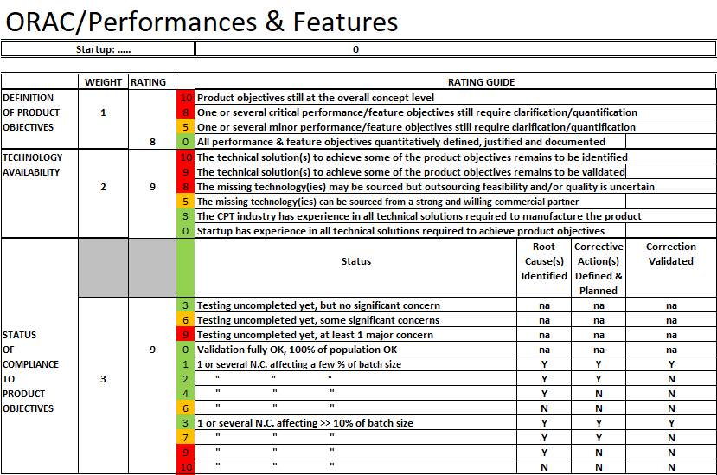
METHODOLOGIES: A CASE STUDY
A Quantitative Methodology: ORAC
ENTREPRENEDU is a project funded by the European Union under GA 101100507.

Slide 50
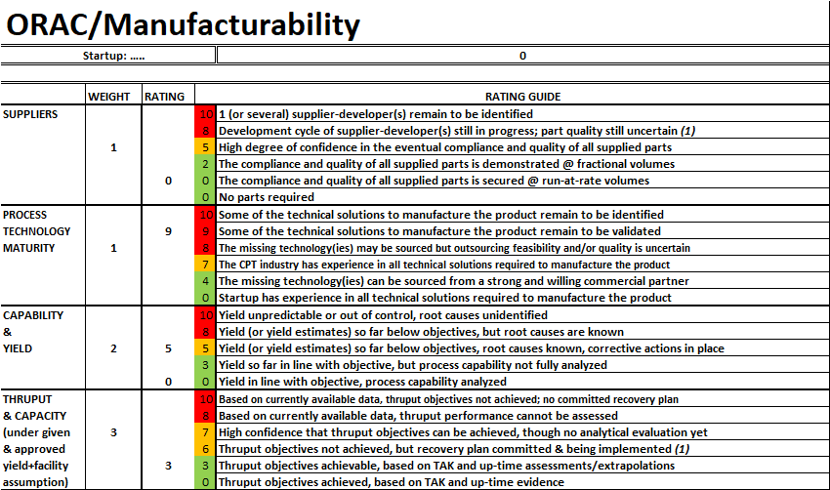
METHODOLOGIES: A CASE STUDY
A Quantitative Methodology: ORAC
ENTREPRENEDU is a project funded by the European Union under GA 101100507.

Slide 51
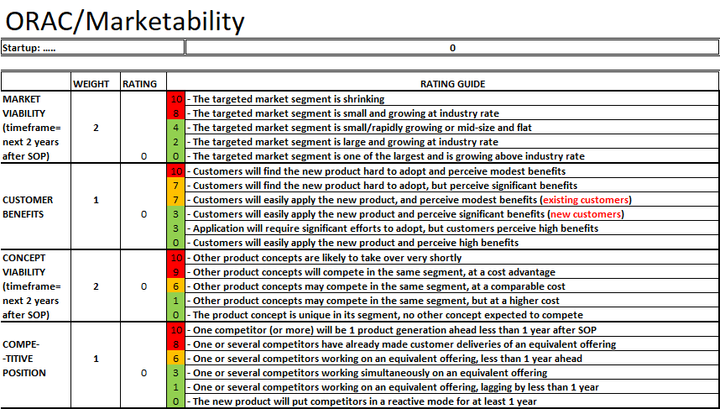
METHODOLOGIES: A CASE STUDY
A Quantitative Methodology: ORAC
ENTREPRENEDU is a project funded by the European Union under GA 101100507.

Slide 52
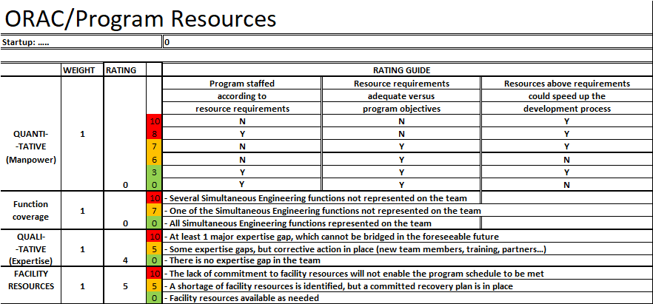
METHODOLOGIES: A CASE STUDY
A Quantitative Methodology: ORAC
ENTREPRENEDU is a project funded by the European Union under GA 101100507.

Slide 53
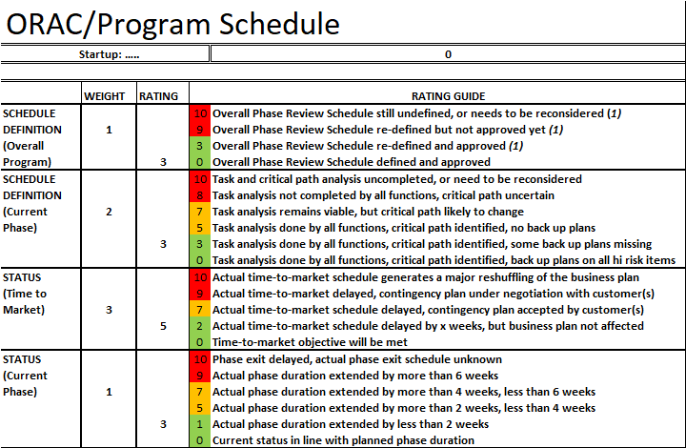
METHODOLOGIES: A CASE STUDY
A Quantitative Methodology: ORAC
ENTREPRENEDU is a project funded by the European Union under GA 101100507.

Slide 54
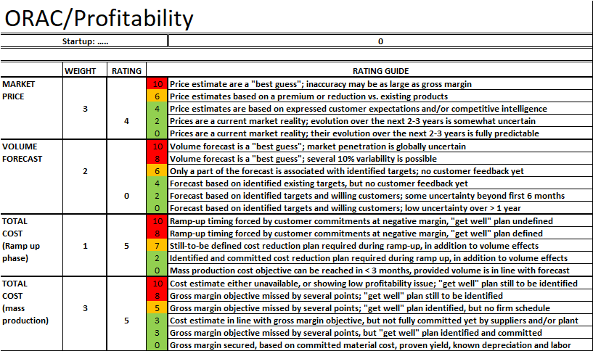
METHODOLOGIES: A CASE STUDY
A Quantitative Methodology: ORAC
ENTREPRENEDU is a project funded by the European Union under GA 101100507.

Slide 55
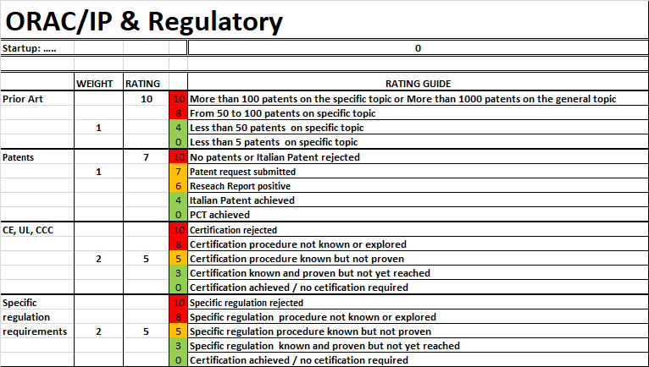
METHODOLOGIES: A CASE STUDY
A Quantitative Methodology: ORAC
ENTREPRENEDU is a project funded by the European Union under GA 101100507.

Slide 56
7) TECH FEASIBILITY: AN EXAMPLE
ENTREPRENEDU is a project funded by the European Union under GA 101100507.

Slide 57
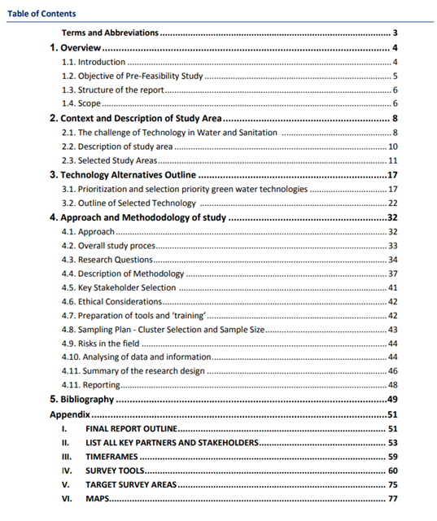
TECH FEASIBILITY: AN EXAMPLE
A Report summary
ENTREPRENEDU is a project funded by the European Union under GA 101100507.

Slide 58
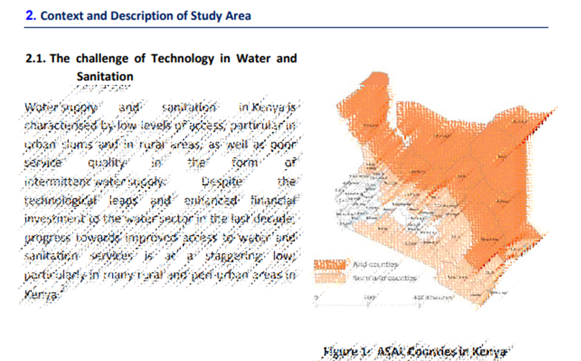
TECH FEASIBILITY: AN EXAMPLE
A Report summary
ENTREPRENEDU is a project funded by the European Union under GA 101100507.

Slide 59
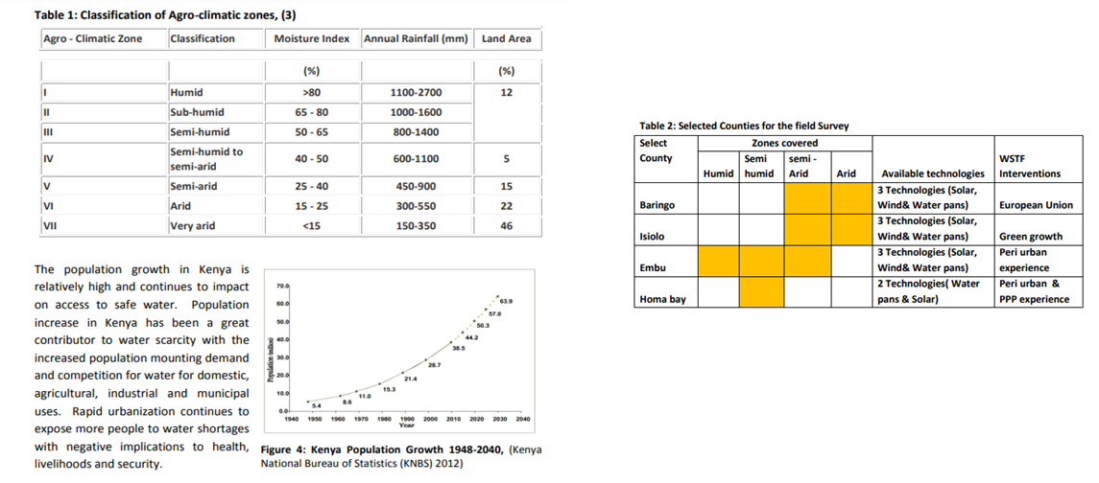
TECH FEASIBILITY: AN EXAMPLE
A Report summary
ENTREPRENEDU is a project funded by the European Union under GA 101100507.

Slide 60
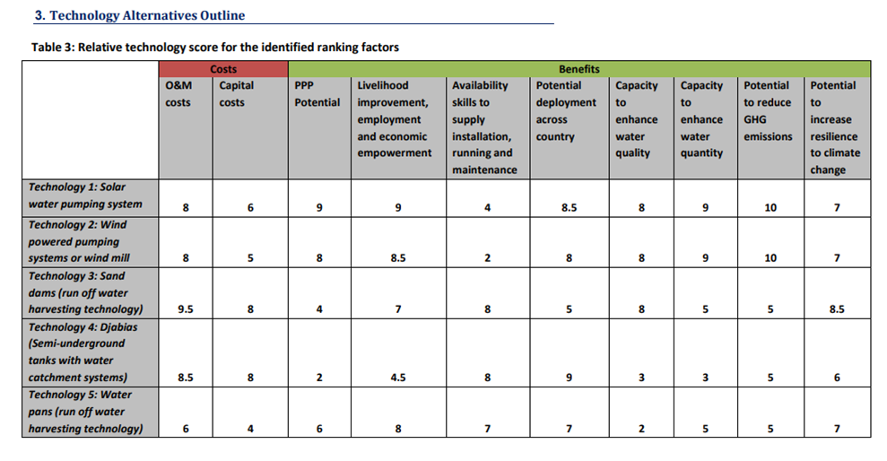
TECH FEASIBILITY: AN EXAMPLE
A Report summary
ENTREPRENEDU is a project funded by the European Union under GA 101100507.

Slide 61
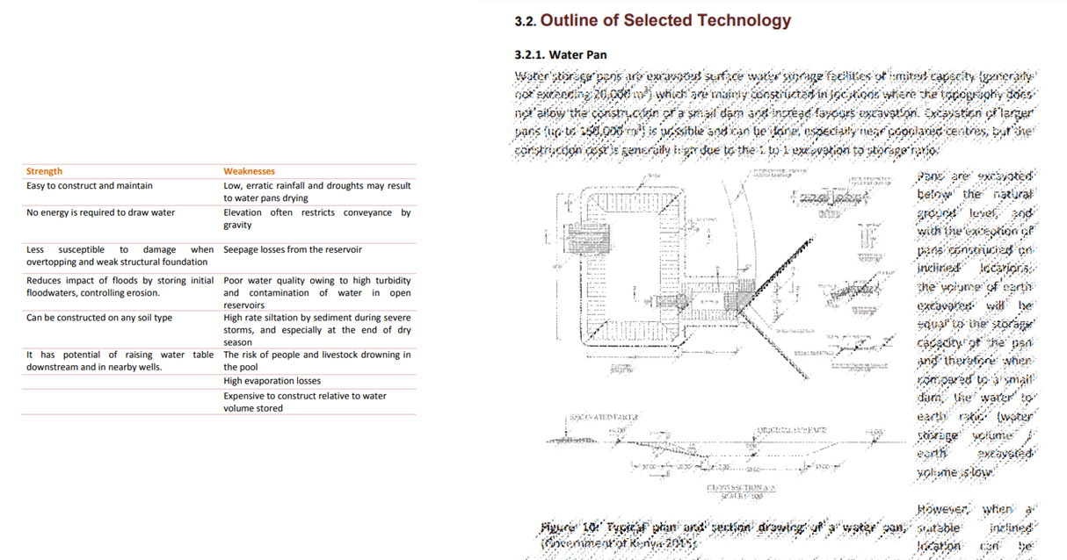
TECH FEASIBILITY: AN EXAMPLE
A Report summary
In-depth tech analysis
ENTREPRENEDU is a project funded by the European Union under GA 101100507.

Slide 62
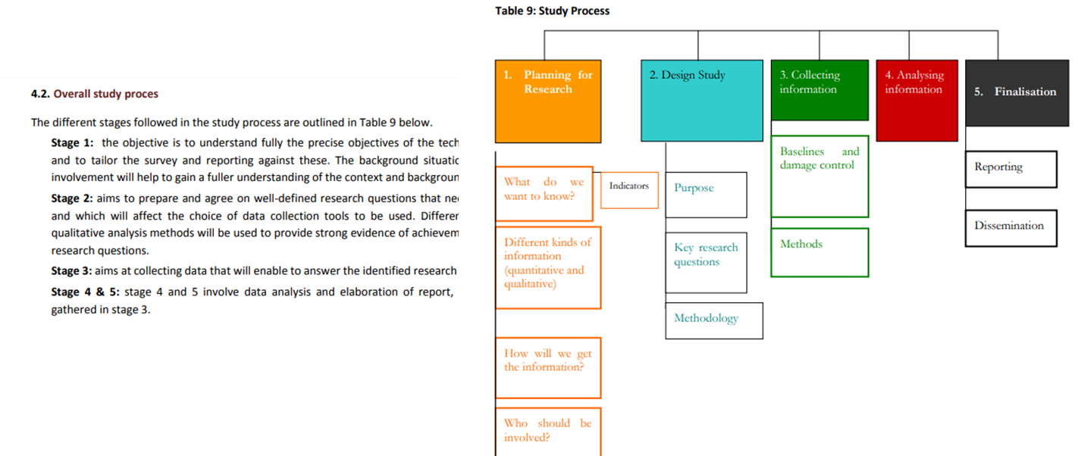
TECH FEASIBILITY: AN EXAMPLE
A Report summary
ENTREPRENEDU is a project funded by the European Union under GA 101100507.

Slide 63
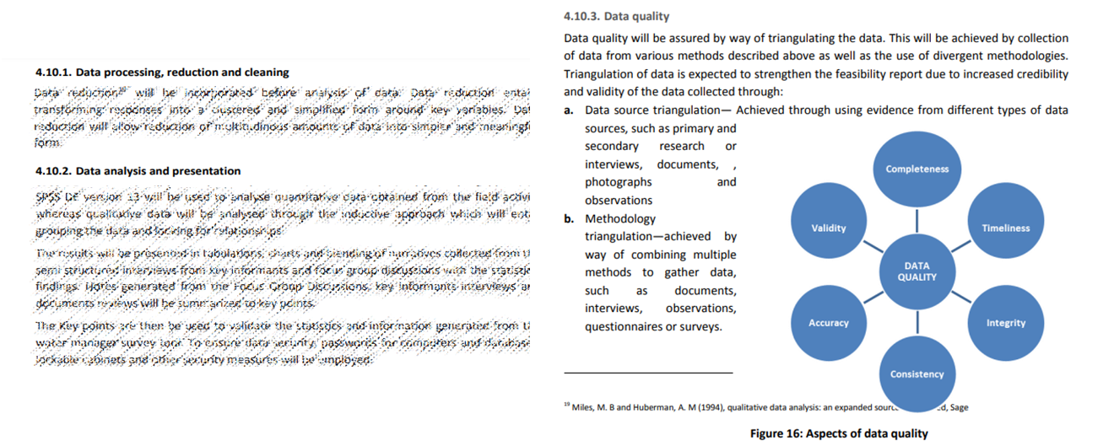
TECH FEASIBILITY: AN EXAMPLE
A Report summary
ENTREPRENEDU is a project funded by the European Union under GA 101100507.

Slide 64
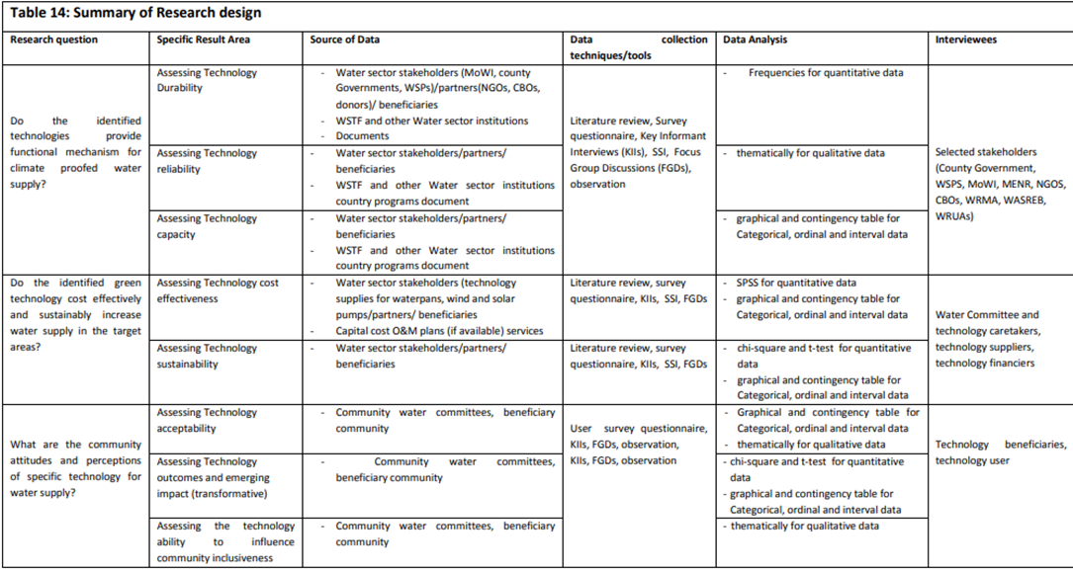
TECH FEASIBILITY: AN EXAMPLE
A Report summary
ENTREPRENEDU is a project funded by the European Union under GA 101100507.

Slide 65
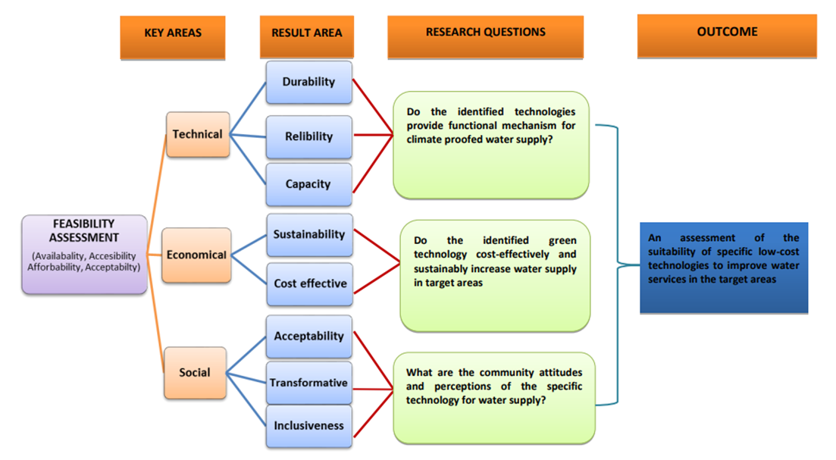
TECH FEASIBILITY: AN EXAMPLE
A Report : Key areas and research questions
ENTREPRENEDU is a project funded by the European Union under GA 101100507.

Slide 66
8) FROM TECH FEASIBILITY TO TECHNICAL PLAN
ENTREPRENEDU is a project funded by the European Union under GA 101100507.

Slide 67
FROM THE TECH FEASIBILITY TO THE TECHNICAL PLAN
Goals
To transform the results of the technical requirement into precise and executable actions
To reach this goal we have to:
  Design productive processes, technologies, R&D, etc..
  Design a productive structure that fits with the strategy
ENTREPRENEDU is a project funded by the European Union under GA 101100507.

Slide 68
FROM THE TECH FEASIBILITY TO THE TECHNICAL PLAN
Typical contents of a Technical Plan (1/3)
Topic | Contents
Productive Processes | Activities enabling a complete productive system. Technical description of the product/service Productive process, kind of process, timing Planning of production Supplying system Warehouse management Critical points of the production processes Other production strategies Opening / availability time Etc.
ENTREPRENEDU is a project funded by the European Union under GA 101100507.

Slide 69
FROM THE TECH FEASIBILITY TO THE TECHNICAL PLAN
Typical contents of a Technical Plan (2/3)
Topic | Contents
Productive Structure | Set of productive plant, equipment, personnel, procedures, …. Equipment, machines, layout, productive capacity Site offices Manpower, teams .. Represent it with diagrams Agreement, contracts, plans (in Annexes)
ENTREPRENEDU is a project funded by the European Union under GA 101100507.

Slide 70
FROM THE TECH FEASIBILITY TO THE TECHNICAL PLAN
Typical contents of a Technical Plan (3/3)
Topic | Contents
Technology, R&D | Technology: description of the developed or used Technology, strengths, competitive advantages Innovation, IP strategy (patent, licence, know how) with eventual agreement Development Plan: plants and resources for R&D (offices, machines, personnel, investments), timing, costs
ENTREPRENEDU is a project funded by the European Union under GA 101100507.

Slide 71
FROM THE TECH FEASIBILITY TO THE TECHNICAL PLAN
Mistakes to avoid (1/2)
No clear definition of the manufacturing, distribution and selling processes
Repetition of the description of the product / Tech feasibility
Absence of cost estimations
Absence of inventory and quality guidelines (if needed)
ENTREPRENEDU is a project funded by the European Union under GA 101100507.

Slide 72
FROM THE TECH FEASIBILITY TO THE TECHNICAL PLAN
Mistakes to avoid (2/2)
Gap in the design of plants, manufacturing processes, procedures, ..
Gap in mitigation plans and risk analysis
Partial identification of the equipment and other needed resources
No long-term strategy for plants and equipment
ENTREPRENEDU is a project funded by the European Union under GA 101100507.

Slide 73
BIBLIOGRAPHY
ENTREPRENEDU is a project funded by the European Union under GA 101100507.

Slide 74
BIBLIOGRAPHY
M. Lewrick et al., Manuale di Design Thinking, Progettare la trasformazione digitale di team, prodotti, servizi ed ecosistemi, LSWR, 2018
M. Lewrick et al., Gli strumenti per il Design Thinking, La guida alle migliori tecniche per facilitare l’innovazione, LSWR, 2021
Del Cogliandro, Polidoro, Il Business Plan nelle imprese di servizi, Franco Angeli, 1993.
ENTREPRENEDU is a project funded by the European Union under GA 101100507.

Slide 75
Thank you for your attention!
Get in touch at: info@fondazioneamaldi.it
ENTREPRENEDU is a project funded by the European Union under GA 101100507.

