Slide 1
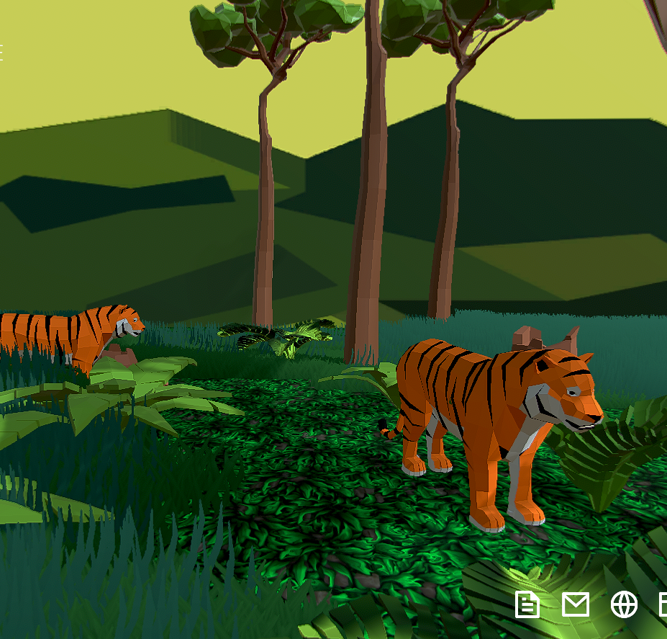

Slide 2
Green or sustainable?
Going green refers to all aspects of environmentally-friendly products from fashion to buildings to the movement as a whole.
Sustainability means that what we do today doesn’t deplete resources for future generations.
Some products can be green due to their appearance, but they are not sustainable due to their production (e.g. life-cycle analysis).
NB! Greenwashing!

Slide 3
Environ-ment
Three pillars of sustainability
One pillar
Society
Economy
Sustainability means meeting our own needs without compromising the ability of future generations to meet their own needs.
Sustainability is a holistic approach that considers ecological, social and economic dimensions, recognizing that all must be considered together to find lasting prosperity.
Notes:
(Klein, 2917 põhjal)
Loodus VS keskkond
3 Kaplinski, Jaan. 2003. Mitte keskkond vaid loodus. - Looduskaitsealaseid töid VII. Tartu Üliõpilaste Looduskaitsering, lk 9.
Mõneti peegeldab seda erinevust ka sõnade „keskkond” ja „loodus” kasutamine. Eesti keeles ja teisteski keeltes on „keskkonna” sõna väga uus, isegi inglise keelde ilmus see tänapäevases tähenduses alles 19. sajandil. „Keskkonna” sõna kasutuselevõtt seal, kus vanasti räägiti „loodusest” viitab Jaan Kaplinski sõnutsi teatavale kontseptuaalset laadi muutusele. „Loodus on midagi, mis pole inimese tehtud, on loodud, tekkinud meieta. Nii on maa ja metsa, jõgede ja järvede, loomade ja lindudega, nii on ka inimese endaga. /-/ Loodusel ei ole keskpunkti. Keskkonnal aga on keskpunkt, keskkonna keskpunkt on see elusolevus, kelle keskkonnast räägime. /-/ Mida enam räägime looduse asemel kesk- 14 konnast, seda enam rõhutame tahes või tahtmata, et oleme ise selle keskkonna keskpunktis.” (Kaplinski, 2003)
sõna ökoloogia ilmuski inglise keelde esmakordselt aastal 1873.
Tänapäeval laialdaselt käibiva arusaama kohaselt peetakse nüüdisaegse teaduse alguseks aastat 1543, mil nii Kopernik kui Vesa­lius avaldasid oma suurteosed.
Eriti oma läänelikul kujul on kristlus kõige inimkesksem religioon, mida maailm on kunagi näinud. Inimene andis nimed kõikidele loomadele, kehtestades seeläbi oma võimu nende üle. Jumal kavandas kõik selgesti inimese kasuks ja tema valitseda: mitte ühelgi asjal füüsilises maailmas ei ole muud otstarvet peale inimese huvide teenimise. Ja kuigi inimese keha on tehtud põrmust, ei ole ta lihtsalt looduse osa: ta on tehtud Jumala näo järgi
Täieliku kontrastina muistsele paganlusele ja Aasia religioonidele (erandiks vaid ehk zoroastrism) ei rajanud kristlus mitte ainult inimese ja looduse vahelist dualismi, vaid rõhutas ka, et Jumala tahe on, et inimene tarvitaks loodust endale sobivatel eesmärkidel.
Rohkem teadust ja rohkem tehnoloogiat ei aita meid käesolevast ökoloogilisest kriisist välja, senikaua kuni me ei leia uut religiooni, või ei mõtesta ümber vana.
Ühelt poolt peetakse inimkeskset hoiakut meie keskkonnaprobleemide peasüüdlaseks
ühelt poolt on tavapärane rääkida „keskkonnaprobleemidest”, justkui oleks probleemidetekitajaks keskkond ise, mitte inimese tegevus.

Slide 4
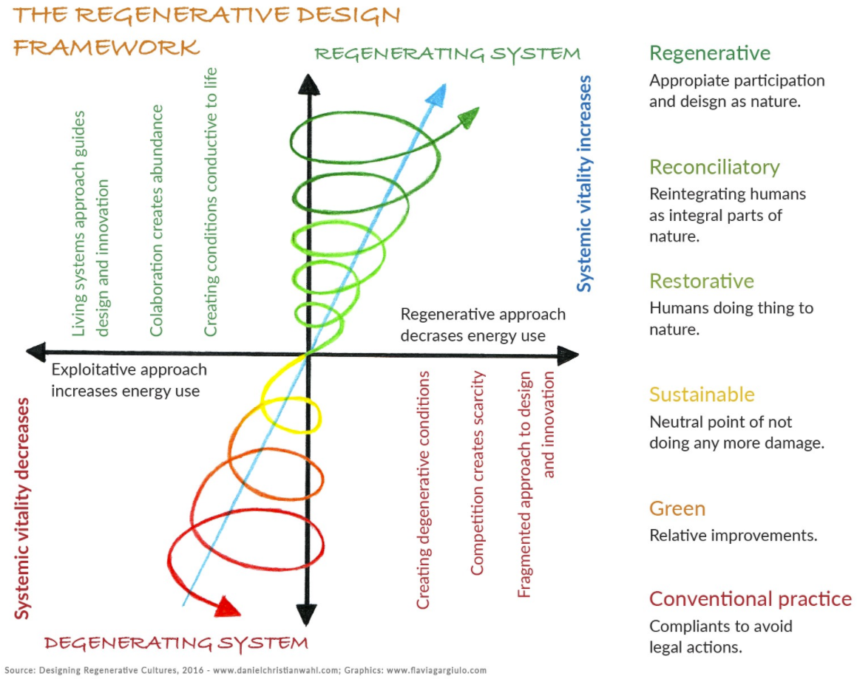
Αναγεννητικός σχεδιασμός
Where we need to be
Συμφιλιωτικός
Αποκατάσταση
Where we want to be
Where we are
Εκφυλιστικός σχεδιασμός
Notes:
Where we are
Where we wan’t to go
Where we need to be

Slide 5
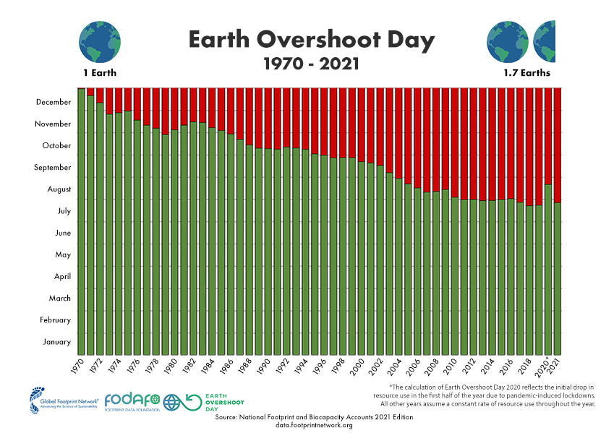
Earth overshoot day
In 2021 by 29. July we had used all the resources that Earth can reproduce in a year.
For the rest of the year, we are maintaining our ecological deficit by drawing down local resource stocks and accumulating carbon dioxide in the atmosphere.
https://www.overshootday.org/
Notes:
1 Qatar February 9, 2021
2 Luxembourg February 15, 2021
3 United Arab Emirates March 7, 2021
4 Bahrain March 9, 2021
5 Trinidad and Tobago March 12, 2021
6 Canada March 14, 2021
7 Mongolia March 14, 2021
8 United States of America March 14, 2021
9 Kuwait March 14, 2021
10 Bermuda March 14, 2021

Slide 6
Earth overshoot day
Top Ten overshooters
1 Qatar February 9, 2021
2 Luxembourg February 15, 2021
3 United Arab Emirates March 7, 2021
4 Bahrain March 9, 2021
5 Trinidad and Tobago March 12, 2021
6 Canada March 14, 2021
7 Mongolia March 14, 2021
8 United States of America March 14, 2021
9 Kuwait March 14, 2021
10 Bermuda March 14, 2021

Slide 7
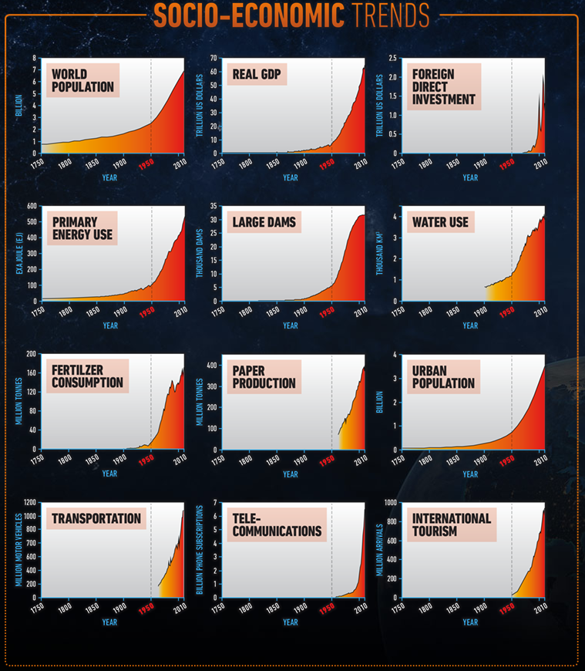
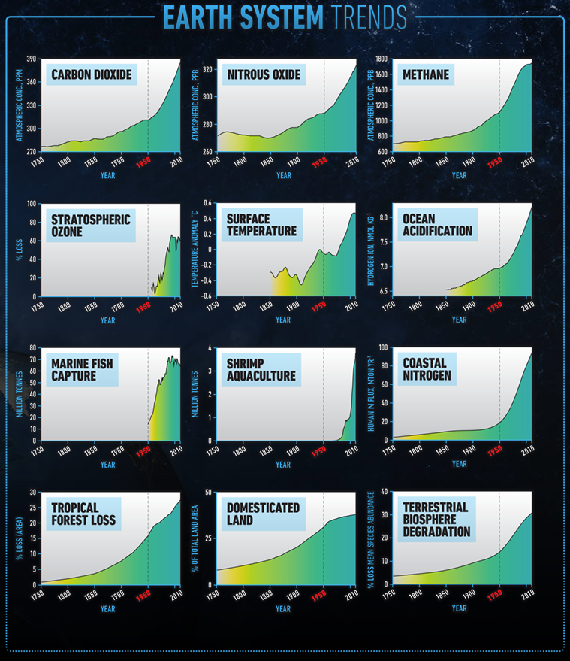
Great Acceleration
http://www.anthropocene.info/great-acceleration.php
Notes:
http://www.anthropocene.info/great-acceleration.php
http://www.horisont.ee/arhiiv-2015/Horisont-5-2015.pdf

Slide 8
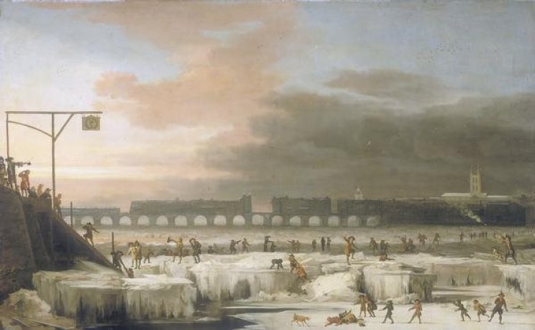
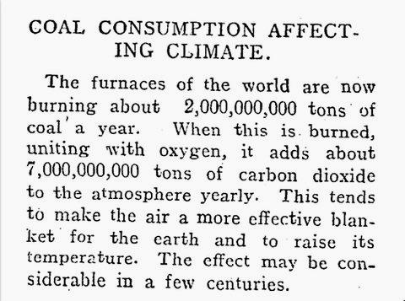
CLIMATE
Frozen Thames River Source: Abraham Hondius
Published Aug. 14, 1912.
How much CO₂ we are adding to the atmosphere yearly?
Five times more: ~35,500,000,000 t of CO₂ yearly.
Notes:
Seven billion tonnes VS 35 billion tonnes
How much CO2 we are adding to the atmosphere yearly?

Slide 9
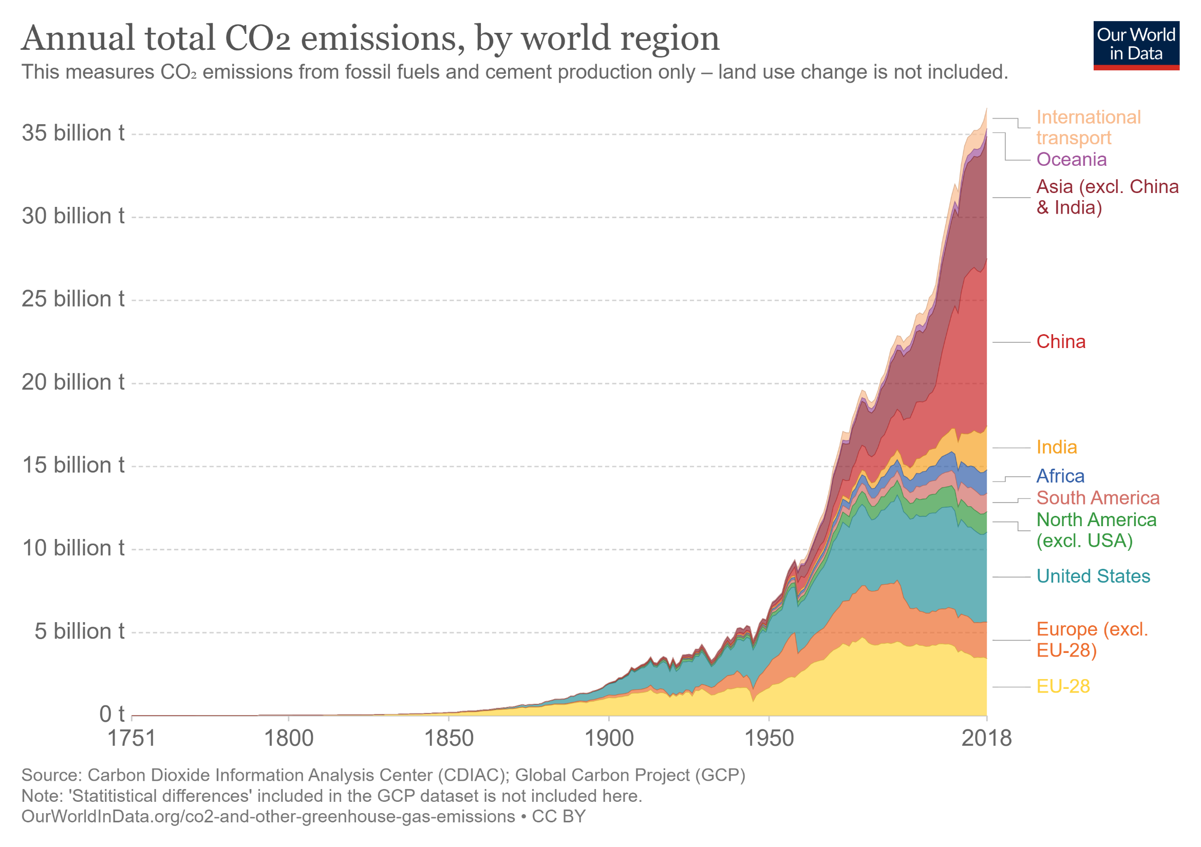

Slide 10
Pakistan
Portugal
Greece
Nepal
Average temperatures (1901 – 2020)
Malaysia
Estonia
Vietnam
Italy
https://showyourstripes.info/
Notes:
These ‘warming stripe’ graphics are visual representations of the change in temperature as measured in each country over the past 100+ years. Each stripe represents the temperature in that country averaged over a year. For most countries, the stripes start in the year 1901 and finish in 2020. Average temperatures 1901 - 2020
For each country, the average temperature in 1971-2000 is set as the boundary between blue and red colours, and the colour scale varies from +/- 2.6 standard deviations of the annual average temperatures between 1901-2000.

Slide 11
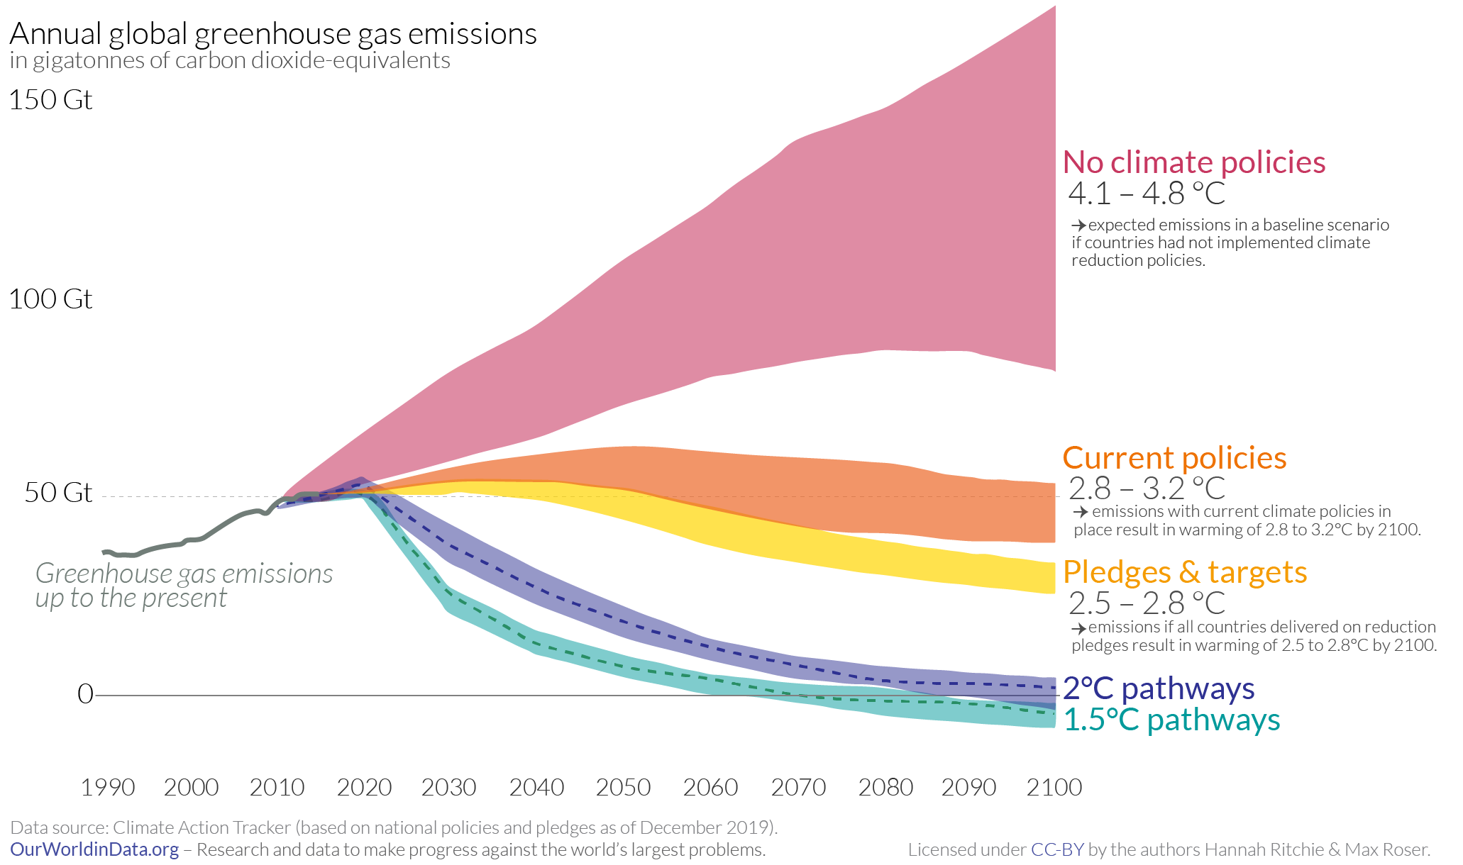
The Conference of Parties (COP) to the United Nations Framework Convention on Climate Change (UNFCCC) at its 21st Session in Paris, France (30 November to 11 December 2015), agreed to keep the global warming of 1.5°C above pre-industrial levels.
Limiting warming to 1.5°C is possible within the laws of chemistry and physics but would require unprecedented transitions in all aspects of society.
https://www.ipcc.ch/
Notes:
new "optimistic analysis" now suggests a rise of 2.1C by 2100.
The past three months have seen some key developments.
In September, China's President Xi Jinping told the UN that his country will reach net zero emissions by 2060, and that its emissions will peak before 2030. According to the CAT researchers, this could reduce warming by 0.2 to 0.3C by the end of the century.
Japan and South Korea have both followed suit, pledging to reach net zero by 2050. South Africa and Canada have also announced their own net zero targets.
The other significant change is the election of Joe Biden in the US.

Slide 12
https://www.ipcc.ch/
Notes:
: Climate change represents an urgent and potentially irreversible threat to human societies and the planet. In recognition of this, the overwhelming majority of countries around the world adopted the Paris Agreement in December 2015, the central aim of which includes pursuing efforts to limit global temperature rise to 1.5°C. In doing so, these countries, through the United Nations Framework Convention on Climate Change (UNFCCC), also invited the IPCC to provide a Special Report on the impacts of global warming of 1.5°C above preindustrial levels and related global greenhouse gas emissions pathways.
Human-induced warming has already reached about 1°C above pre-industrial levels at the time of writing of this Special Report. By the decade 2006–2015, human activity had warmed the world by 0.87°C (±0.12°C) compared to pre-industrial times (1850–1900). If the current warming rate continues, the world would reach human-induced global warming of 1.5°C around 2040.

Slide 13
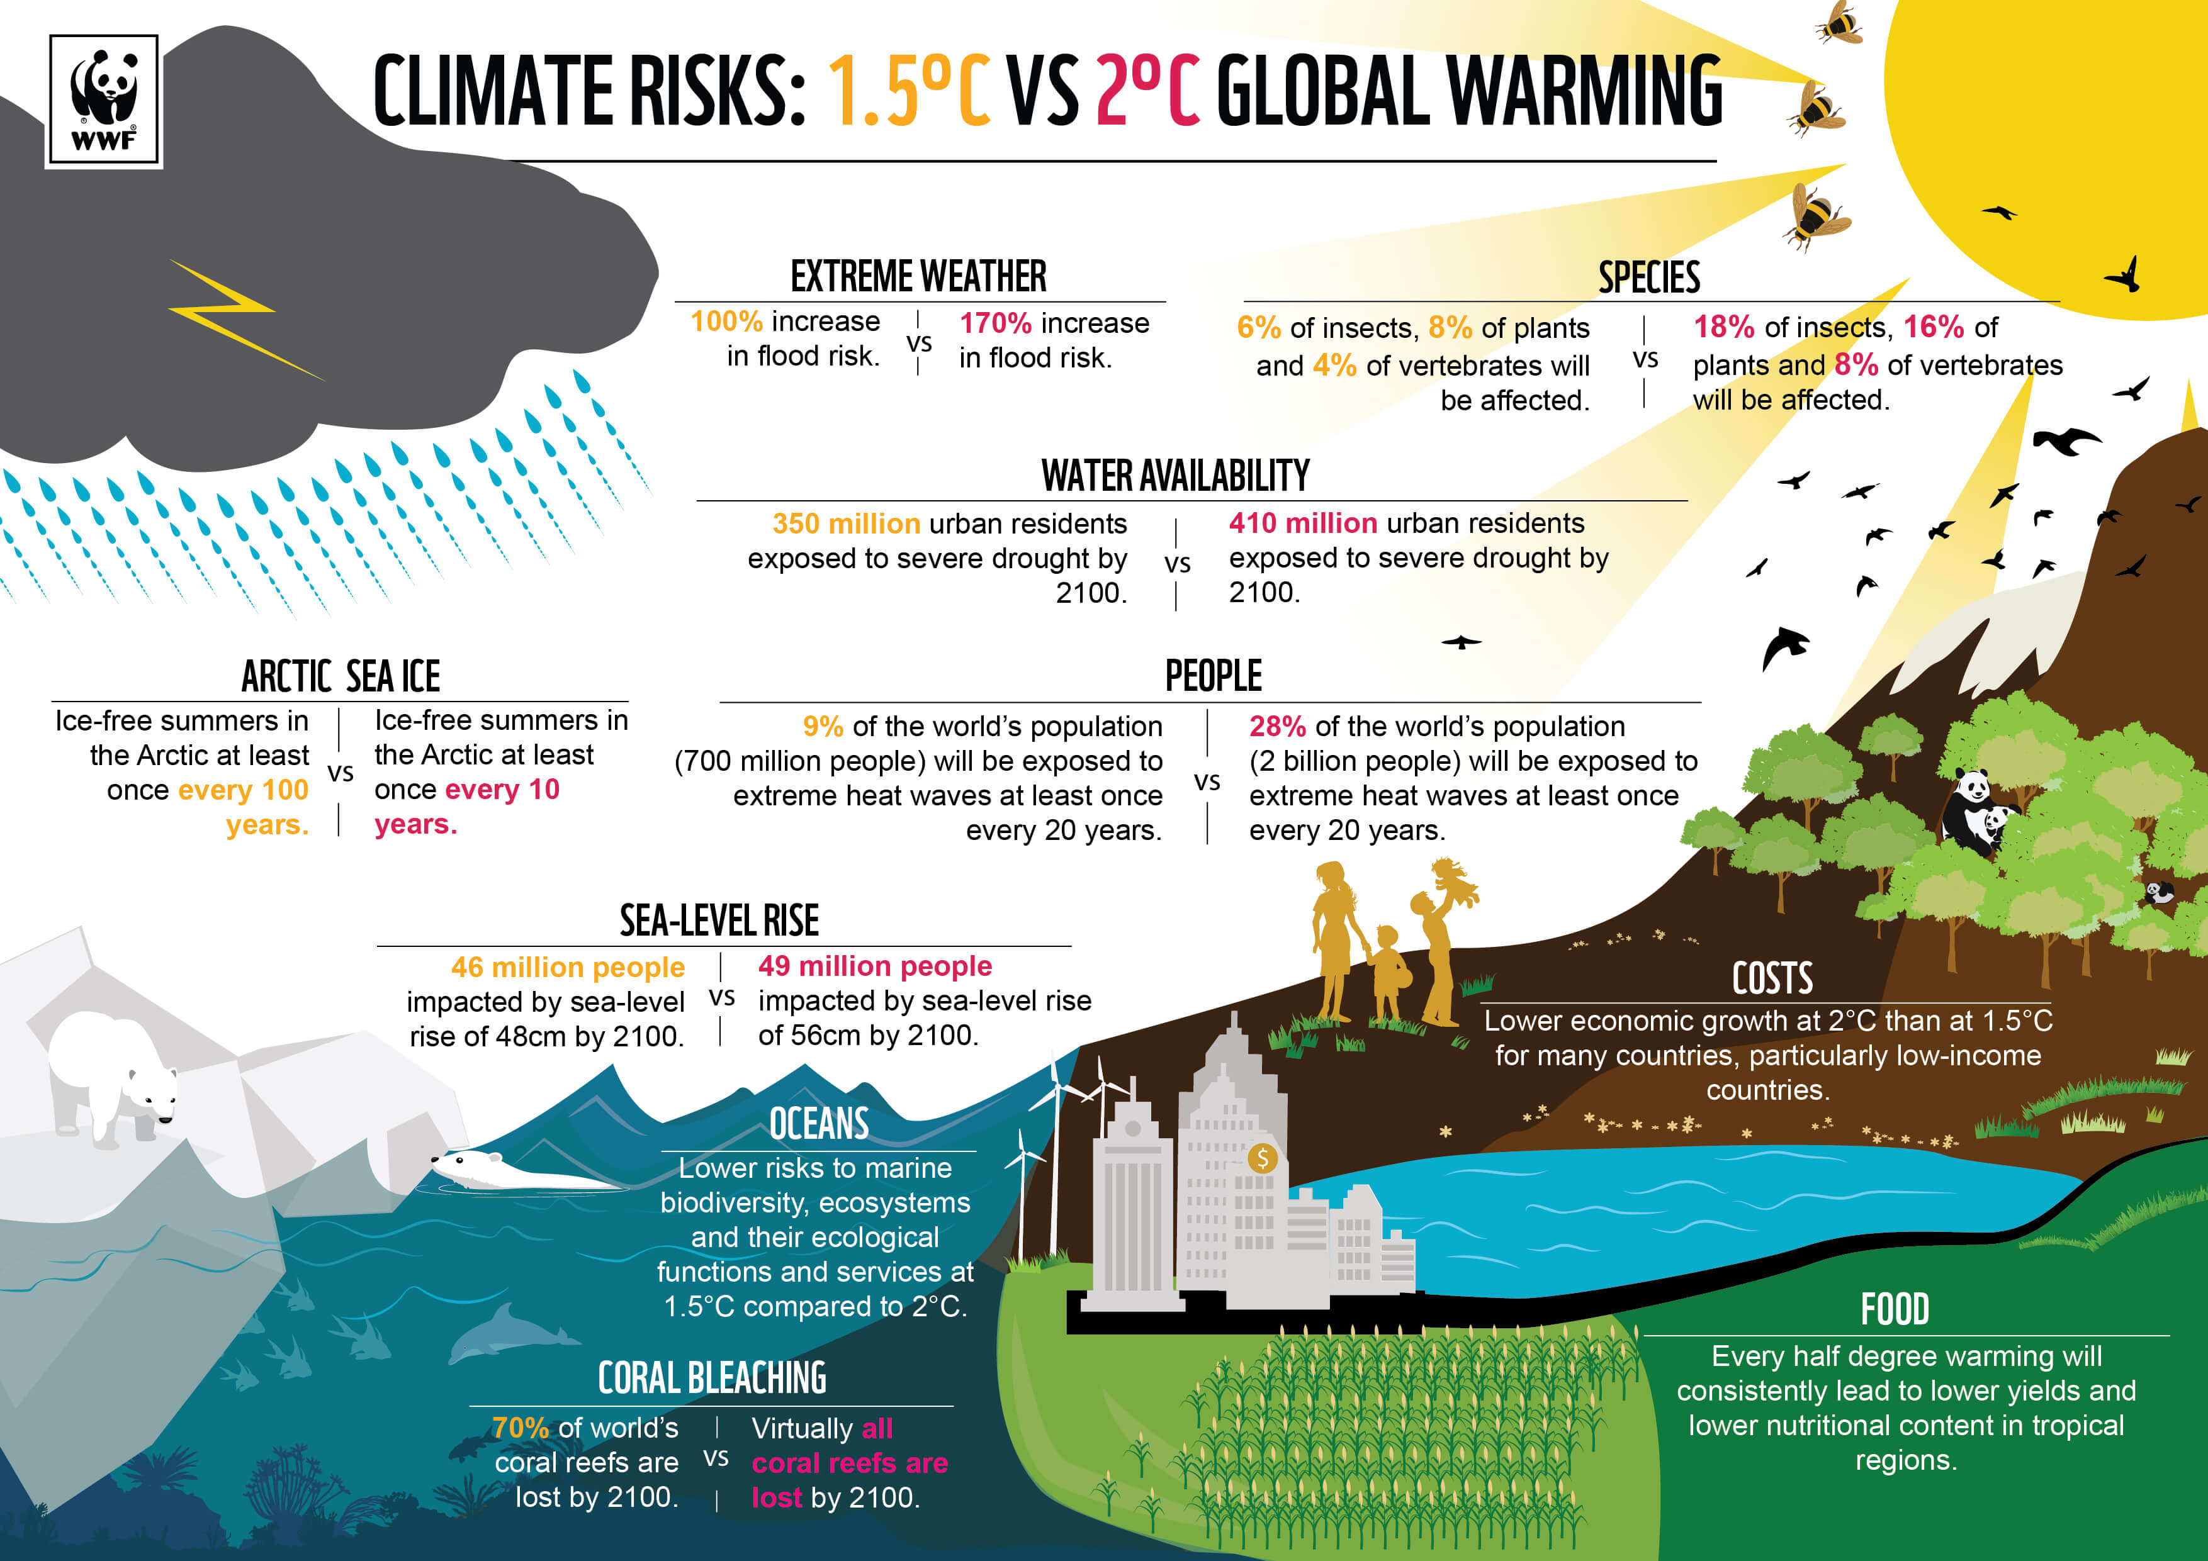
https://www.wwf.org.uk/

Slide 14
Biggest Environmental problems of 2022
Poor governance
Food waste
Biodiversity loss
Plastic pollution
Deforestation
Air pollution
Melting ice caps and sea level rise
Ocean acidification
Agriculture
Food and water insecurity
https://earth.org/the-biggest-environmental-problems-of-our-lifetime/
Notes:
Biggest Environmental problems of 2021

Slide 15
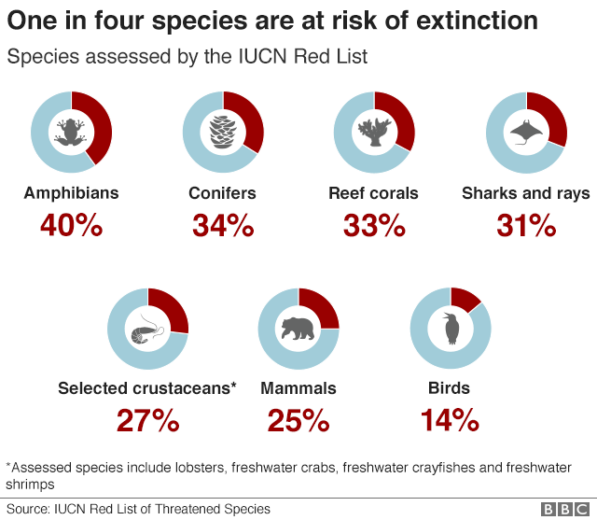
BIODIVERSITY
Notes:
Nature's emergency: Where we are in five graphics
ˇHelen Briggs, Becky Dale and Nassos Stylianou
5 May 2019
https://www.bbc.com/news/science-environment-48104037?fbclid=IwAR2pJ2XwEgXC1_D4LatAdbADhR1dmddGtVm8lFEFZtxTnCaGB4KeAjf7AD8

Slide 16
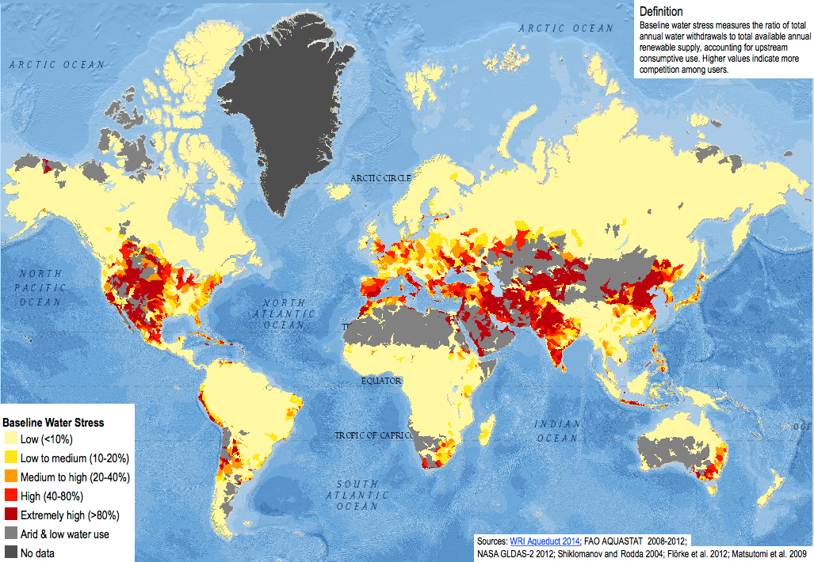
WATER

Slide 17
WATER AVAILABILITY
- 3.4 million people die due lack of clean drinking water
- 1 billion people do not have enough water
- 4.5 billion people live in the proximity <50 km from a problematic water resource (polluted, drying).
- By 2030 more than half of humans will suffer from water deprivation.
- By 2050 the global need for water will be increased by 55%

Slide 18
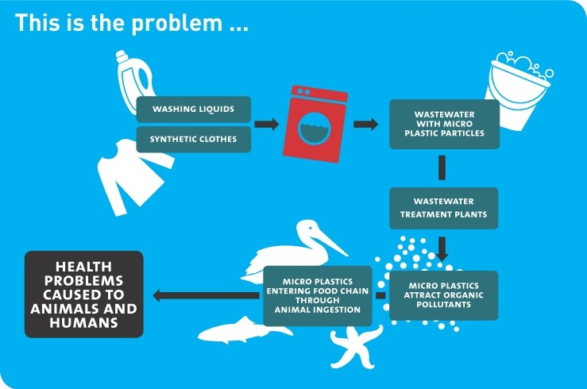
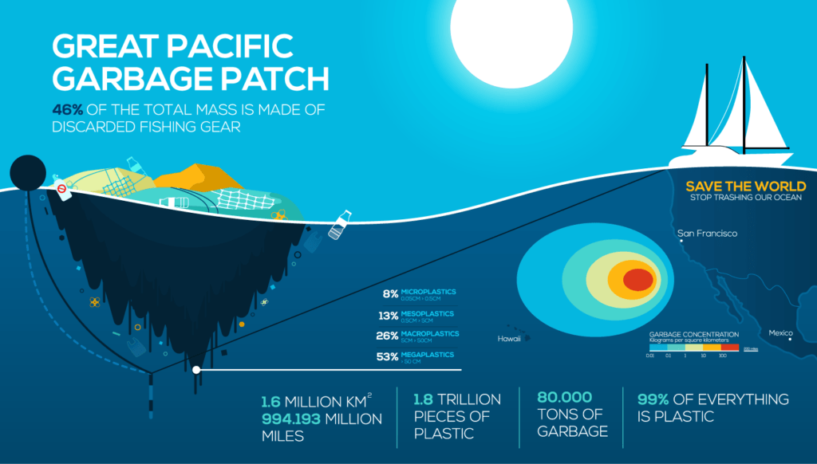
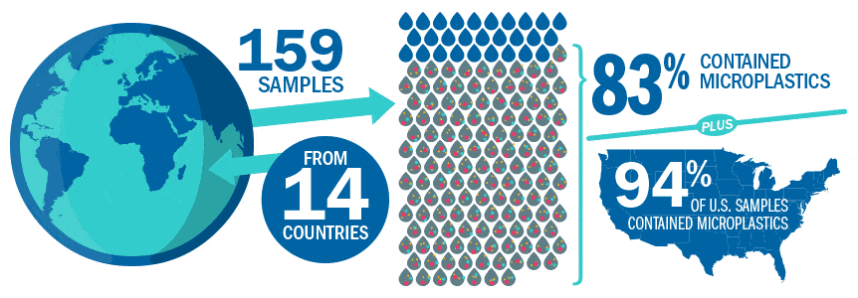
WATER POLLUTION
https://cdn.aquasana.com/images/wordpress/2019/02/microPlasticsInfoGraphic2-min.gif

Slide 19
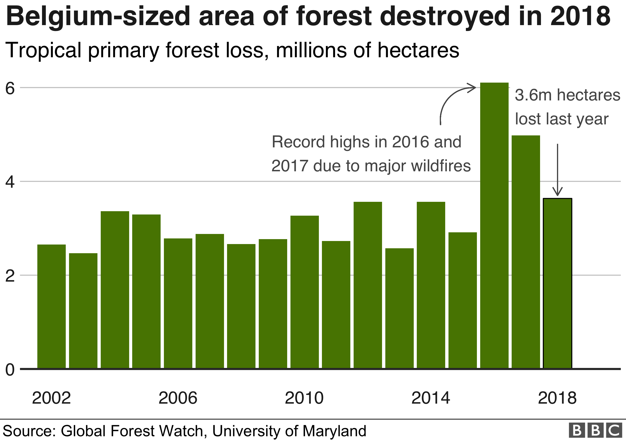
DEFORESTATION
Notes:
Around 12 million hectares of forest in the world's tropical regions were lost in 2018, equivalent to 30 football fields per minute

Slide 20
What happens when a forest is destroyed?
The habitat is destroyed
Flora and fauna species may disappear
We may not even know what the benefit of these species are to us yet, e.g. medical and other
We don’t know exactly what we have lost

Slide 21
What is the value of a forest?
Not only the trees, but an ecosystem, flora and fauna
Ecosystem services: the benefits that humans get from ecosystems
Provisioning services: Tangible goods and resources, such as food, water, timber, fiber, and fuel
Regulating services: Ecosystem processes that regulate environmental conditions and provide benefits, such as climate regulation, water purification, pollination, and erosion control
Cultural services: Non-material benefits that humans obtain from ecosystems, such as recreational, aesthetic, and spiritual values

Slide 22
DEFORESTATION – not only biodiversity
Forests are intimately linked to rainfall and water availability. On average, at least 40% of rainfall over land originates from evapotranspiration (ET), in some regions in Amazonas ET contributes more than 70% of rainfall (Van der Ent et al., 2010)
Over most of the tropics, air that passes over forests for ten days typically produces at least twice as much rain as air that passes over sparse vegetation (Spracklen et al., 2012).
Satellite observations suggest European forests are a major influence on cloud formation (Teuling et al., 2017), and thus sunshine/shade dynamics and rainfall.
Forest loss and degradation reduce ET, with important implications for rainfall thousands of kilometers downwind (Aldrich and Imberger, 2013; Debortoli et al., 2016). Large-scale deforestation will reduce rainfall in some regions by as much as 30% (Lawrence and Vandecar, 2015; Spracklen and Garcia-Carreras, 2015)
Εξάτμιση και διαπνοή
(Ellison et al. 2017)

Slide 23
DEFORESTATION – not only biodiversity
Trees and forests contribute to the intensification of rainfall through the biological particles (fungal spores, pollen, bacterial cells) they release into the atmosphere. Atmospheric moisture condenses when air becomes saturated and particles (condensation nuclei), are present (Morris et al., 2014; Sheil, 2014).
The combination of warming and altered rainfall patterns due to climate change can lead to feedback effects on remaining vegetation, reduced biomass accumulation, drought, die-off and fires (Brienen et al., 2015; Duffy et al., 2015).
(Ellison et al. 2017)

Slide 24
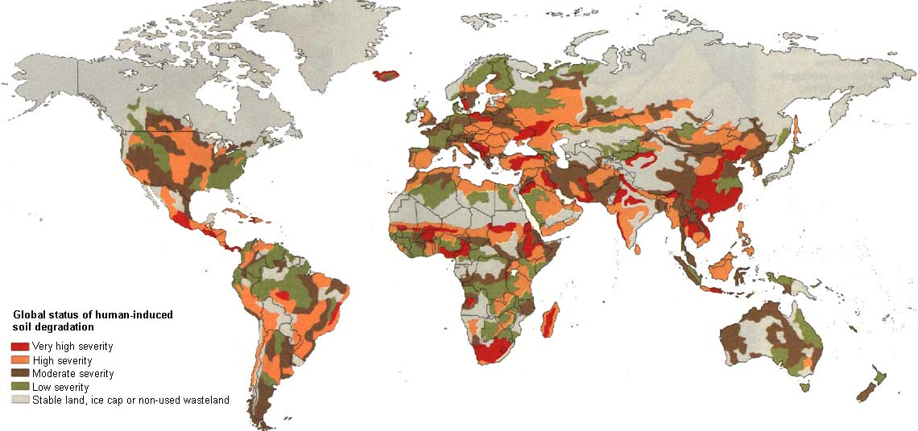
SOIL DEGRADATION

Slide 25
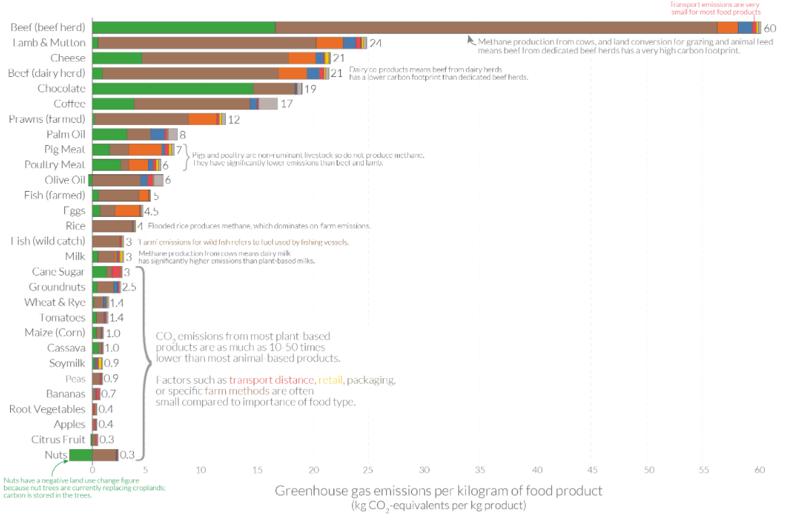
FOOD

Slide 26
WHAT WE CAN DO?

Slide 27
UN SUSTAINABLE DEVELOPMENT GOALS
A set of 17 goals for the world’s future, through 2030
Backed up by a set of 169 detailed Targets
Negotiated over a two-year period at the United Nations
Agreed to by nearly all the world’s nations, on 25 Sept 2015

Slide 28
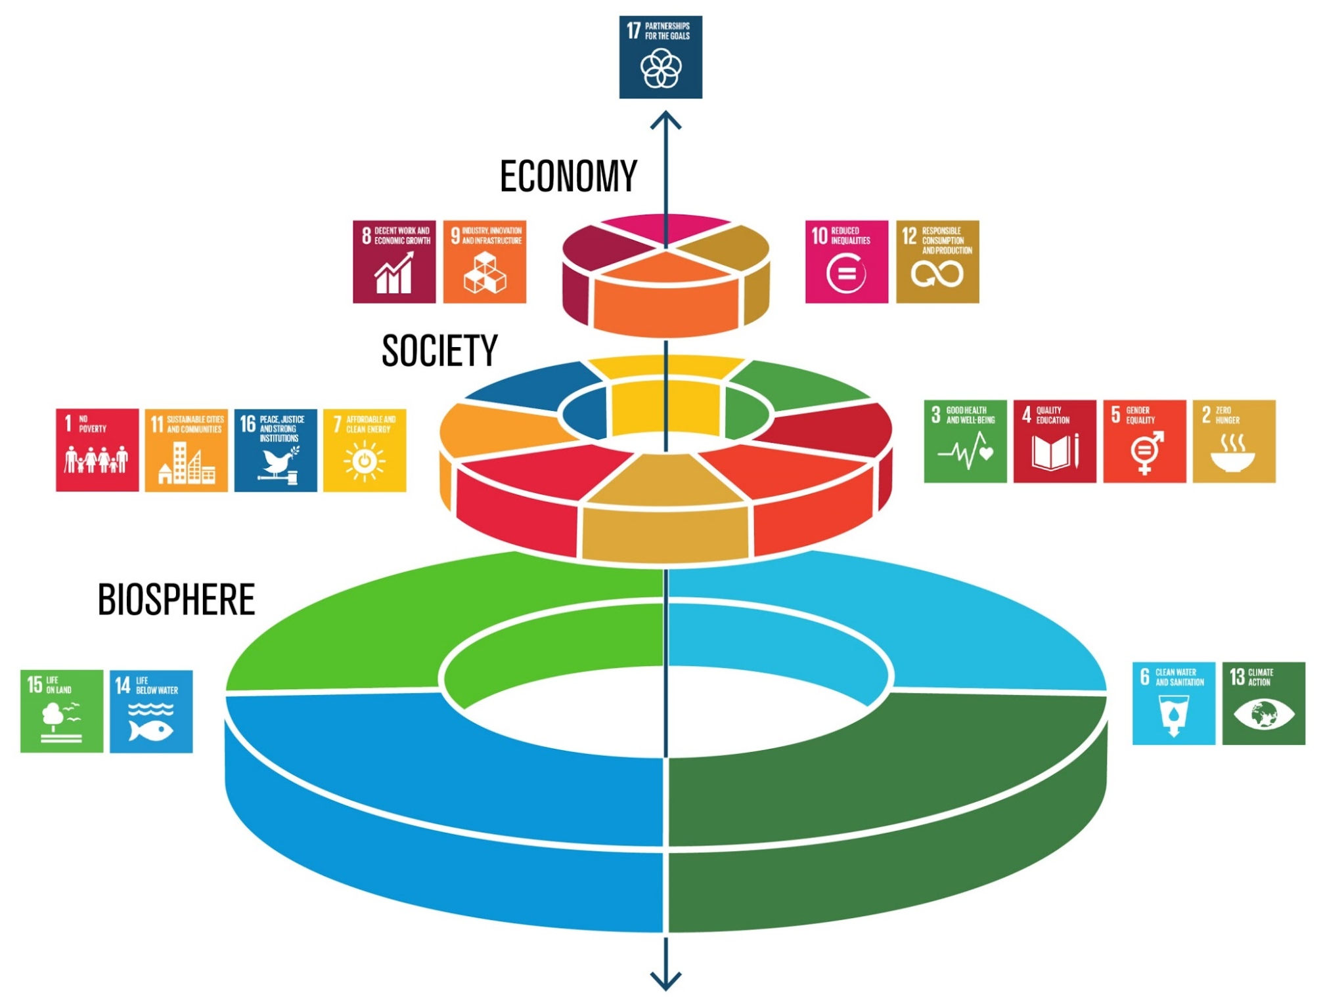
Healthy biosphere functions are the basis of healthy society and healthy economy
Notes:
Healthy Biosphere functions are the basis of healthy society and healthy economy

Slide 29
Where we need to be
Where we want to be
Where we are
Notes:
Where we are
Where we wan’t to go
Where we need to be

Slide 30
Project NATURE
Digital game for promoting skills on responsible natural resources management
Scenarios inspired by real life
Educator support

Slide 31
Serious games
Games developed for a purpose other than entertainment
Learning, government, crisis management, research

Slide 32
Serious games
Not only for children
A learning tool for all
Particularly when other options are too risky or expensive

Slide 33
Play
Simply for fun
No structure
Types of play
Body play
With objects
Group play
Ritual play
Story telling

Slide 34
Games
They are a system
They have structure
Rules
Players
Are voluntary
Separate from the real world

Slide 35
How do games affect the brain?
We don’t really know
Research
3D games affect the cerebellum - παρεγκεφαλίδα
Coordination
Contextual memory
Much more

Slide 36
Not only for building skills
Games help an individual become integrated into society
Understand the rules
We like better someone that we have played with
Even if we have lost
Play history of individuals

Slide 37
Learning advantages
Everyone likes to solve a puzzle!
Clear and interesting goals
Feedback that helps link cause and effect of actions
Adaptable to the knowledge level of each student
Fantasy and imagination elements

Slide 38
Not a new idea
The idea to use games in learning is as old as digital games themselves
$151b industry in 2019 (larger than the movie industry)
Expected to increase by $ 105b until 2025
Serious games are $2-3b
The European Commission encourages the development of serious games through industry – academia collaboration

Slide 39
Advantages in learning
Learning cost containment (e.g. pilots, doctors)
Use when no physical infrastructures are available
Use when there is danger (e.g. pilots, doctors)

Slide 40
Some criticism
Must avoid the possibility of random answers or choices
E.g. clicking everywhere on the screen until we hit the correct answer

Slide 41
The question is …
Not if we should integrate games in learning
But how
So that we advance learning goals

Slide 42
Integrating games into learning
Process
Game content
Learning results
Behaviour
Game cycle
Debriefing
Game elements
Feedback
*Garris et al, 2002

Slide 43
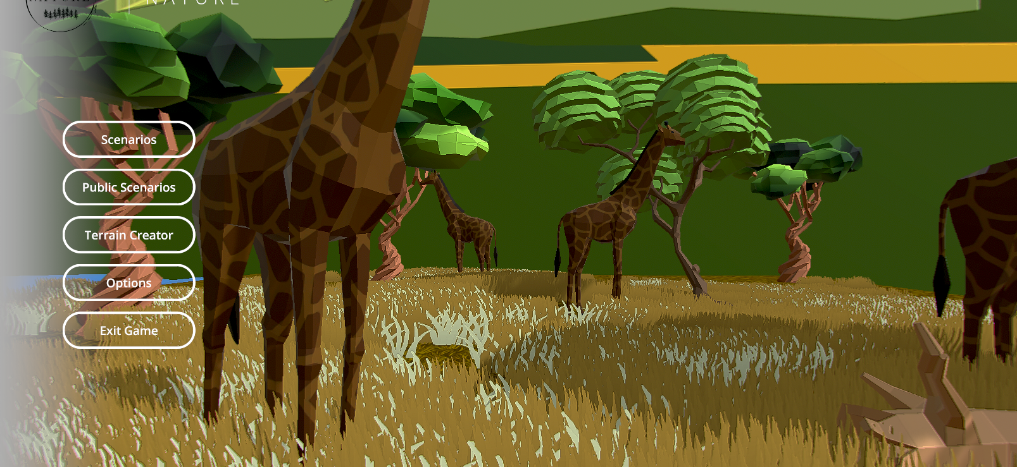
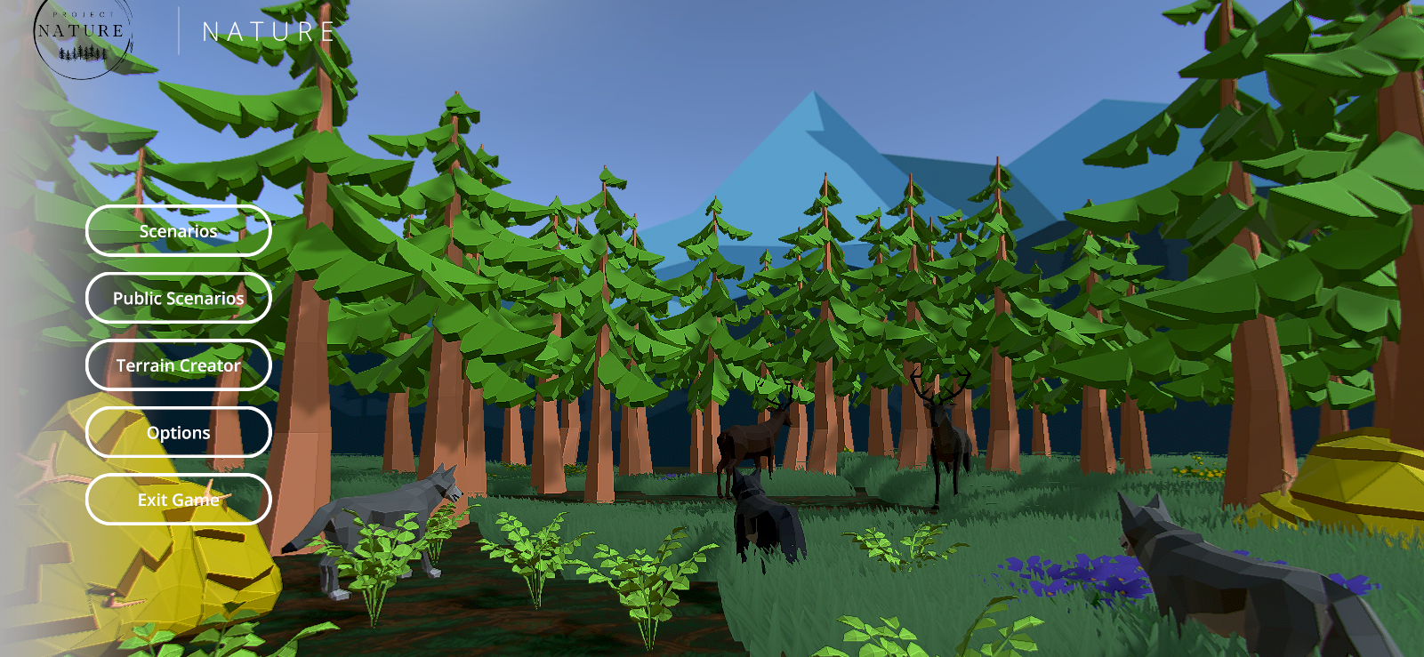
Partners
University of Thessaly, Greece
University of Latvia, Latvia
Tallinn University, Estonia
Virtual Campus, Portugal
University of Vigo, Spain

Slide 44
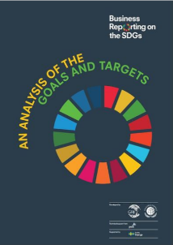
ADDITIONAL INFORMATION
Overview of indicators including the metadata and explanations - https://unstats.un.org/sdgs/indicators/database/ and https://unstats.un.org/sdgs/indicators/Global%20Indicator%20Framework%20after%202020%20review_Eng.pdf
Country profiles - https://country-profiles.unstatshub.org/
UN Data catalog - http://www.sdg.org/#
UN, GRI and PwC reporting guide - https://www.globalreporting.org/resourcelibrary/GRI_UNGC_Business-Reporting-on-SDGs_Analysis-of-Goals-and-Targets.pdf
Overview of the SDG related global data - https://sdg-tracker.org/
SDG Report 2019 - https://www.sustainabledevelopment.report/
Voluntary national review results - https://sustainabledevelopment.un.org/content/documents/26136Estonia_Main_messages_VNR_Estonia_2020_700.pdf
Estonia specific tool - https://tamm.stat.ee/

