Slide 1
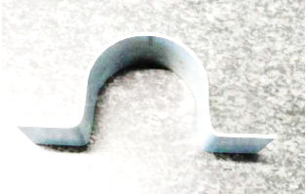
Procedure for Producing a Pipe Clamp
Mascil team Freiburg in cooperation with the Siedle company
Fotos: SSS Siedle
CC BY-SA mascil consortium 2014
The mascil project has received funding from the European Union’s Seventh Framework Programme for research, technological development and demonstration under grant agreement no 320 693

Slide 2
Procedure for Producing a pipe Clamp
1. Sketch the bending edges
x
a) Draw a line through the middle of the sheet metal’s width.
Note: For exactness, use a marker with a fine tip.

Slide 3
Procedure for Producing a pipe clamp
1. Sketch the bending edges
x
x
b) Also draw lines for the other two bending edges at the beginning and end of the sheet metal to mark where the clamp tabs will be. Keep in mind that the sheet metal is 1mm thick.

Slide 4
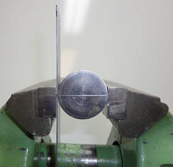
Procedure for Producing a pipe clamp
2. Bending the semicircle
a) Span the sheet metal in the vice for bending. When doing so, make sure that the line you drew to mark the middle of the sheet metal is aligned with the middle of the bending cylinder and the edge of the vice. Double check that the entire width of the sheet metal is aligned!

Slide 5
Procedure for Producing a pipe clamp
2. Bending the semicircle
b) Hammer firmly near the bend …

Slide 6
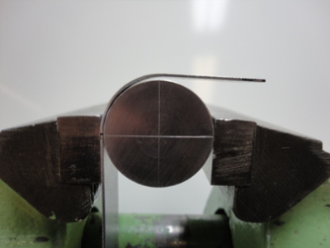
Procedure for Producing a pipe clamp
2. Biegen des Halbkreises
… until a right angle forms.

Slide 7
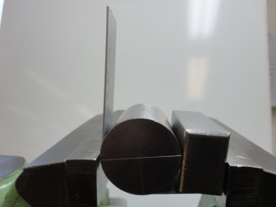
Procedure for Producing a pipe clamp
2. Bending the semicircle
c) Now turn the sheet metal so that the unbent end is pointing up. Make sure that all the measurement marks are positioned as before…

Slide 8
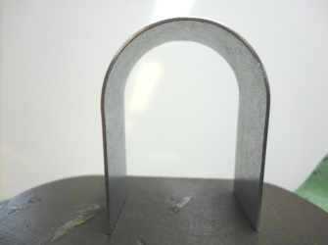
Procedure for Producing a pipe clamp
2. Bending the semicircle
… and use the hammer to bend this end, too. This should result in a semicircle.

Slide 9
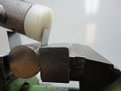
Procedure for Producing a pipe clamp
3. Bend the tabs
a) Span the sheet metal for bending the first tab.
Make sure that the markings are aligned with the rectangular bending block.

Slide 10
Procedure for Producing a pipe clamp
3. Bend the tabs
As you can see in the photo, you will also need the bending cylinder.

Slide 11
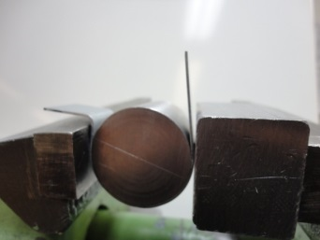
Procedure for Producing a pipe clamp
3. Bend the tabs
b) Turn the sheet metal so that the other end is up and bend the second tab just like you did for the first one.

Slide 12
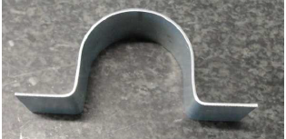
Procedure for Producing a pipe clamp
Your Pipe clamp is finished!

