Slide 1
Wind
City
Buildings
Nicolas Remy
Department of Architecture – University of Thessaly

Slide 2
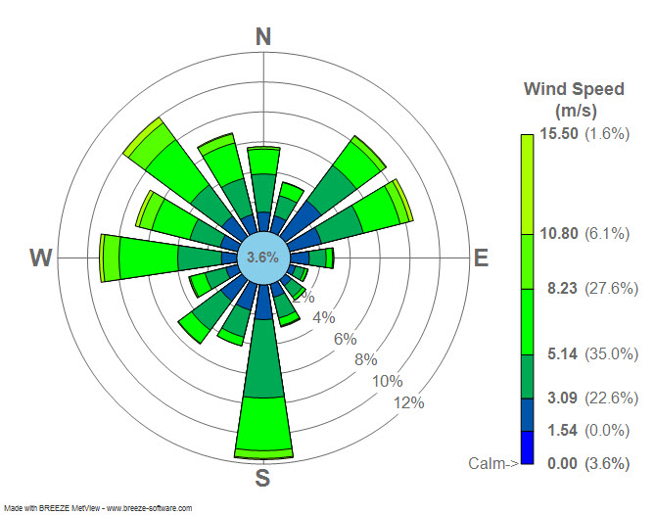
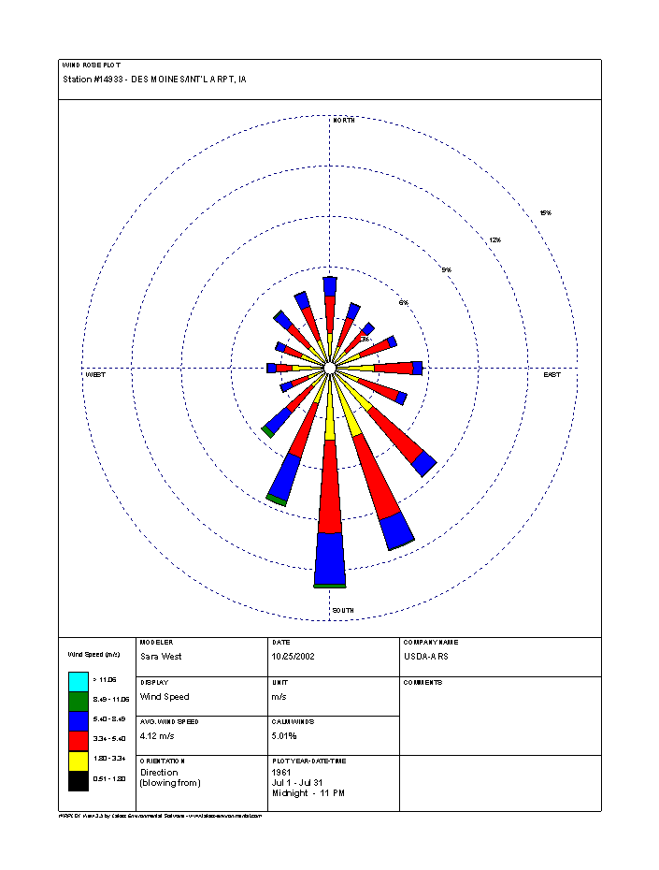
Wind Rose (charts)
nremy@uth.gr

Slide 3
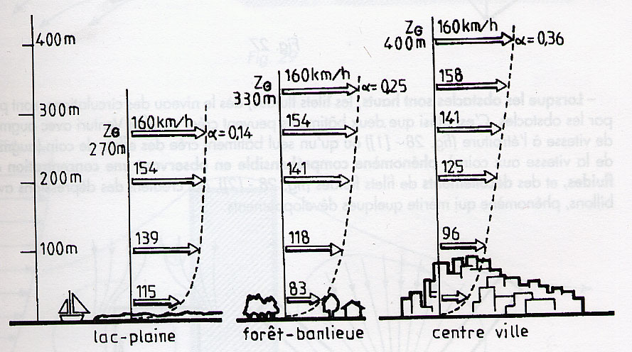
The wind phenomenon on an urban scale
1- Wind, boundary layer and roughness
Cf. Chatelet et alii

Slide 4
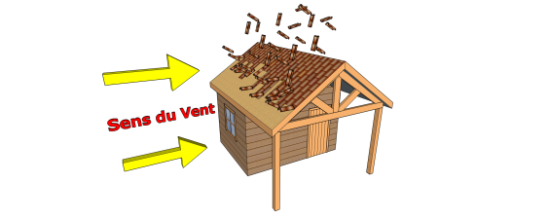
We want to calculate the wind load that will be exerted on a wooden construction of 3.00 x 5.00 m with a wall height of 3.00 m. The construction is located in the Ardèche department at an altitude of 800 m. The maximum wind speed is 150km/h. A. Density calculation According to the formula, we must find P and t°. At an altitude of 800m, we have an atmospheric pressure of 92,078 Pa (value obtained on the internet) and a temperature of: 15 - (800 x 6.4) / 1000 = 9.88 °C or 283.03 °K The density is therefore equal to: (92078 x 28.9644) / (8314.32 x 283.03) = 1.133 kg/m3 B. Wind speed calculation 150/3.6 = 41.67 m/s C. Application area calculation. 5.00x3.00 = 15.00 m² D. Wind load calculation 0.5 x 1 x 1.133 x 41.67² x 15 = 14754.96 N or 14.75496 kN Therefore, we can conclude that the load of the wind exerted on our construction is of the order of
14.75 kN or 14 750 N
This construction will therefore have to withstand a force equal to 14.75 kN.@

Slide 5
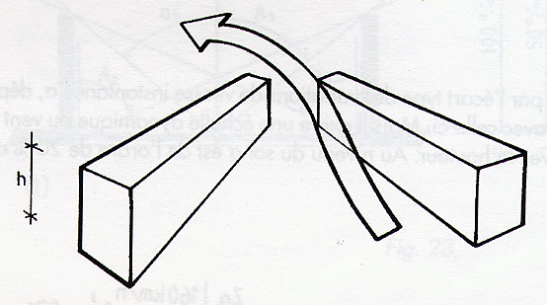
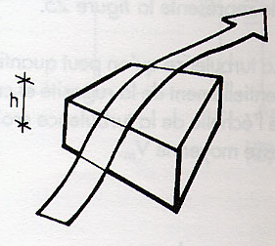
The wind phenomenon on an urban scale
. To have low wind speeds on facades and pathways, it is in your interest to build low-rise buildings in rough areas. Low obstacle (h<15m) ... the wind passes over it
Cf. Chatelet et alii

Slide 6
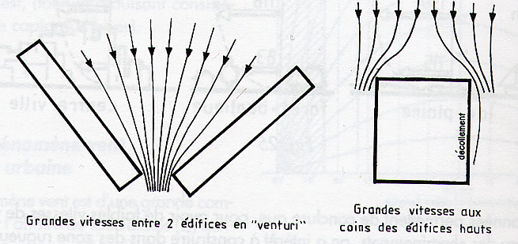
High obstacle (h>15m) = Venturi effect creation = concentration of fluid threads + detachment
Cf. Chatelet et alii

Slide 7
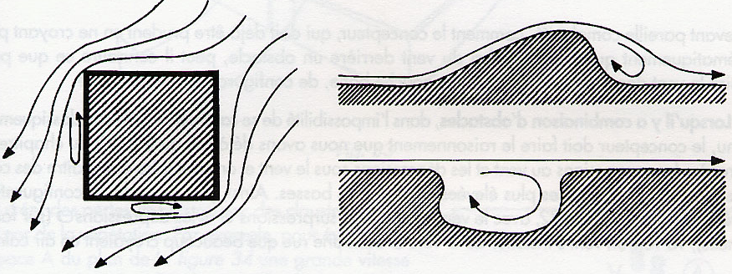
Rapid variation in the profile of the obstacle = Fluid thread detachment + vortex creation
Cf. Chatelet et alii

Slide 8
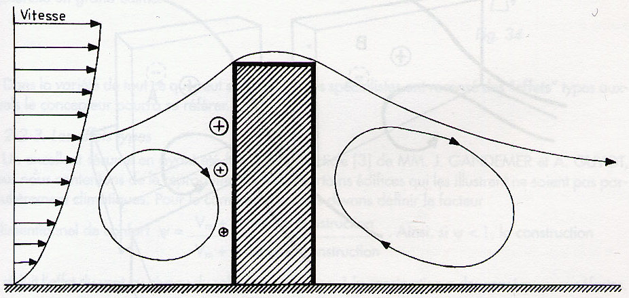
Cf. Chatelet et alii

Slide 9
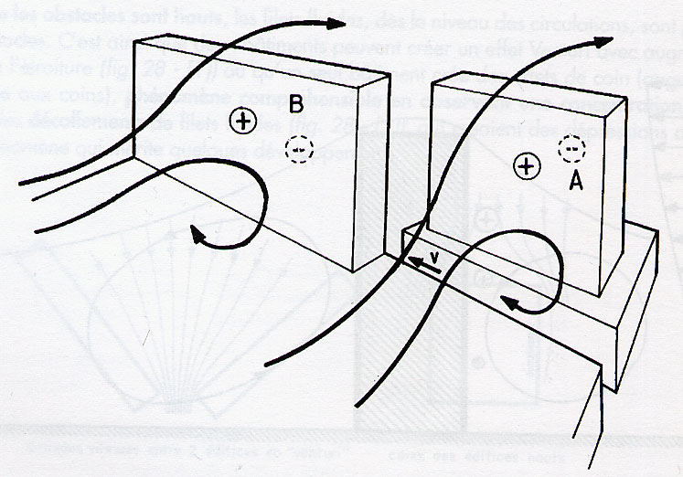

Slide 10
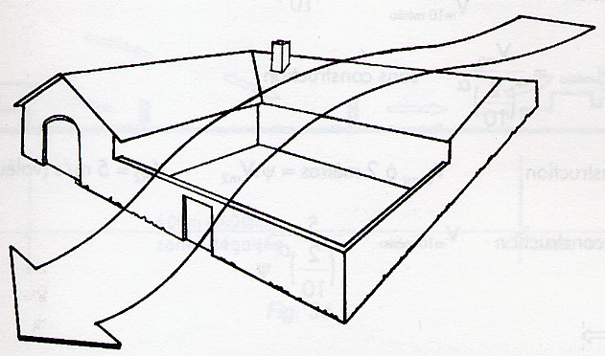
protect a yard from high wind speeds at ground level

Slide 11
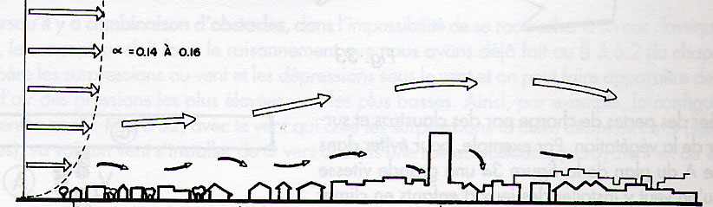
The wind only drops if it finds an open area of about 400 m x 400 m

Slide 12
Le phénomène vent à l’échelle urbaine
3- Wind effect due to buildings
. Free areas of the order of 160,000 m2 (sports field) cause the wind to fall
. Sets of "seed" towers produce virtually no roughness effect due to their high height and wide spaces between them.
. Old city centres, by their density and low height, create a protective effect.
However, aerodynamic accidents can occur in this type of fabric at the foot of large elements
. The effect of a building construction on the wind is defined by a coefficient for a given height. Ψ = (wind speed with construction) / (wind speed without construction) . If ψ < 1 , then the construction reduces the effect of wind at ground level . The maximum allowable speed of comfort for the pedestrian is v = 5m/S

Slide 13
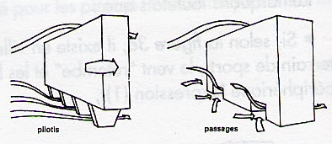
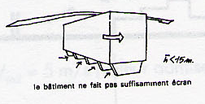
Typical wind effects on buildings with high >15m phenomenon of flow in holes or passage under buildings

Slide 14
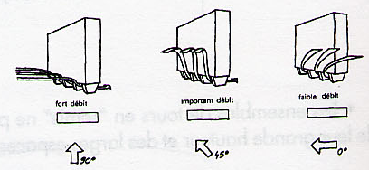

Slide 15
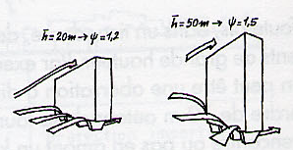

Slide 16
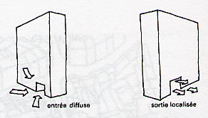

Slide 17
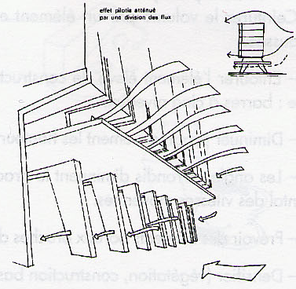
Orient buildings on stilts or with holes under an incidence parallel to the wind Provide the foot of vegetation buildings and buildings Introduce elements that introduce pressure drops in the link volumes Avoid solid-form stilted buildings Divide the flows at the foot of the buildings by increasing the porosity of the building

Slide 18
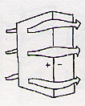
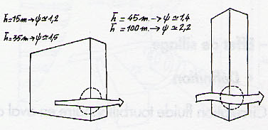
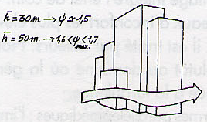
Corner Effect phenomenon of flow at the corners of buildings that connect the upstream overpressure zone and the lateral depression zone of the building.

Slide 19
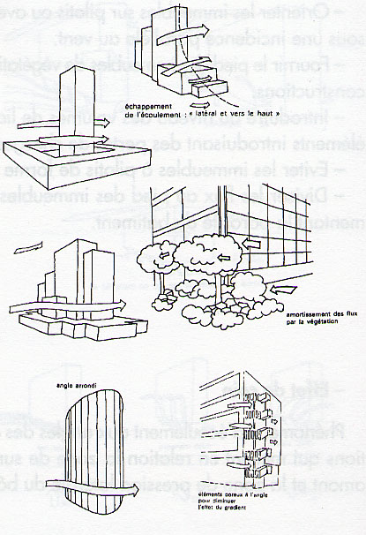
Corner effect
. Conseils pratiques
Ceinturer le volume par un élément en rez-de-chaussée
Entourer l’élément élevé de constructions telles que :
. Diminuer progressivement les hauteurs
. Les angles arrondis diminuent la variation de vitesse aux angles
. Prévoir des éléments poreux aux angles
. Densifier (végétation, construction basse) le voisinage immédiat des coins
Cf. Chatelet et alii

Slide 20
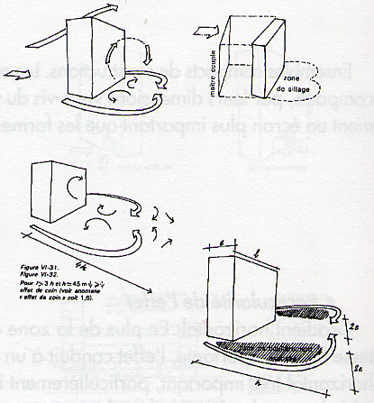
Wake effect swirling fluid circulation downstream of the shapes Parallelepiped buildings 45m < h < 100m Persistence of the effect over 4 x h Exposure area = h x 2e - planting breaks the wake effect - the denser the built environment the more the wake effect is attenuated

Slide 21
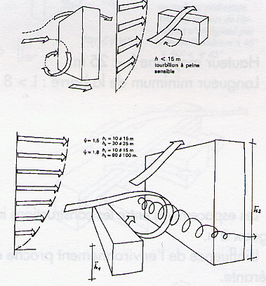
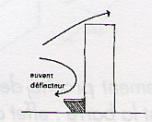
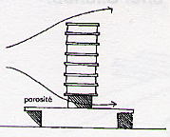
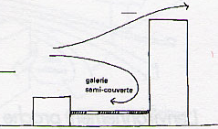
whirlwind roller whirlwind roller at the foot of the windward face Tips Densifying the surrounding environment Introducing deflector awnings introduce porosity above the level pedestrian

Slide 22
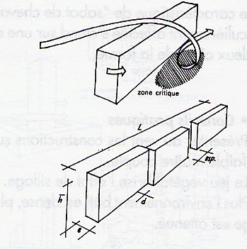
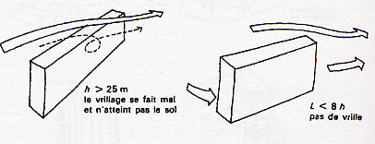
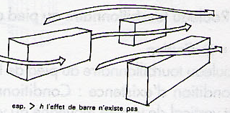
Helm wind effect . Definition: twisted deflection of the flow when passing a bar for an incidence of around 45°
Minimal conditions of the phenomen to be observed . Average height h < 25m .
. Minimum bar length L > 8h . Spacing too large, no effect
Cf. Chatelet et alii

Slide 23
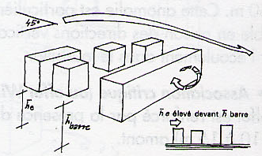
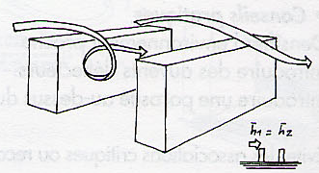
Helm wind effect
If the Near Environment of Medium Height ->Reduced Effect
Near environment is a parallel the helm wind effect is maintained on the first building

Slide 24
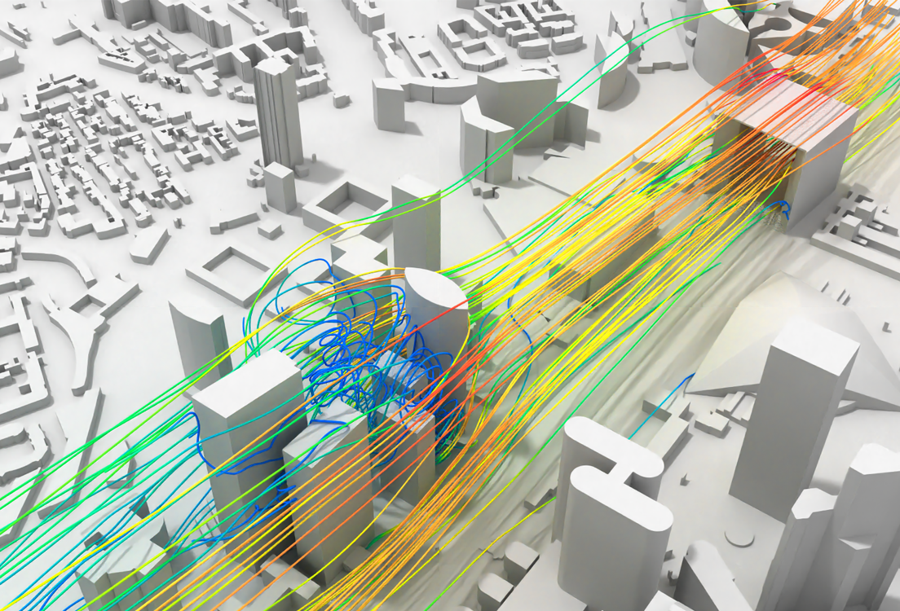

Slide 25
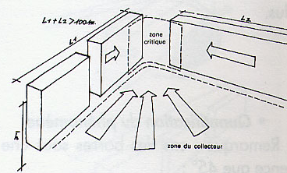
Venturi effect
Collector phenomenon formed by constructions drawing an angle open to the wind. The critical zone for comfort is at the choke

Slide 26
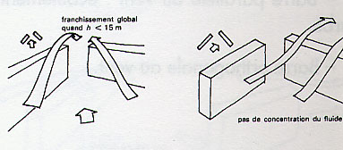
No Venturi effect in these case studies

Slide 27
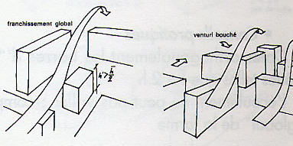
No Venturi effect in these case studies

Slide 28
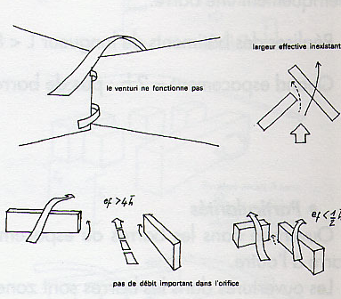
No Venturi effect in these case studies

Slide 29
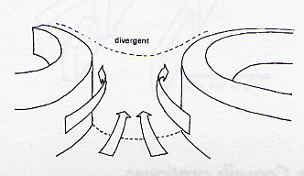
Effect Venturi
Particular venturi: curved shapes create aerodynamic nozzles. The overspeed effect is violently amplified
Cf. Chatelet et alii

Slide 30
To avoid Venturi effect .
. Making porous « arms » . Do not align the bisector of the collector opening according to the prevailing winds . Building as low as possible . Reduce arm length . Densifying the immediate environment . Open or close the Venturi corner . Extend as much as possible beyond the strangulation of one of the arms
Cf. Chatelet et alii

Slide 31
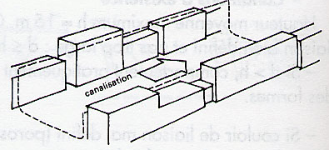
Channeling effect
Built complex forming an open-air corridor A pipe does not constitute a particular hindrance except that it can transmit an anomaly along its entire length (Venturi)
Cf. Chatelet et alii

Slide 32
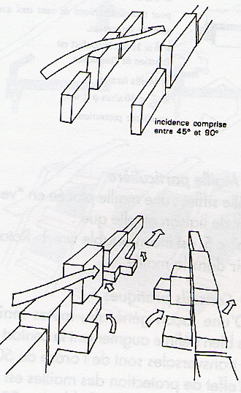
Effet de canalisation
Miniaml condition to be observed . Low-porous walls Width of the corridor< 2 h (if width > 3 h, the effect fades) tips to avoid such wind effect
- adjust a direction of streets under incidence between 90° and 45° (beware of the helm effect) - increade spacing (porosity) - foster building dropouts to introduce pressure drops - Introduce a width > 2h
Cf. Chatelet et alii

Slide 33
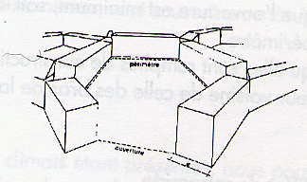
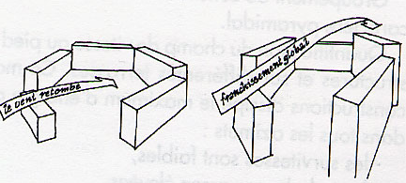
Mesh effect
. Juxtaposition of buildings that form a cell or pocket … depends on height h and wind direction
Cf. Chatelet et alii

Slide 34
Cf. Chatelet et alii

Slide 35
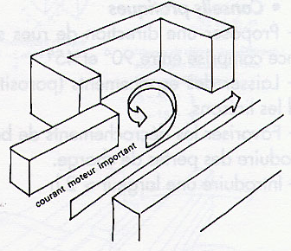
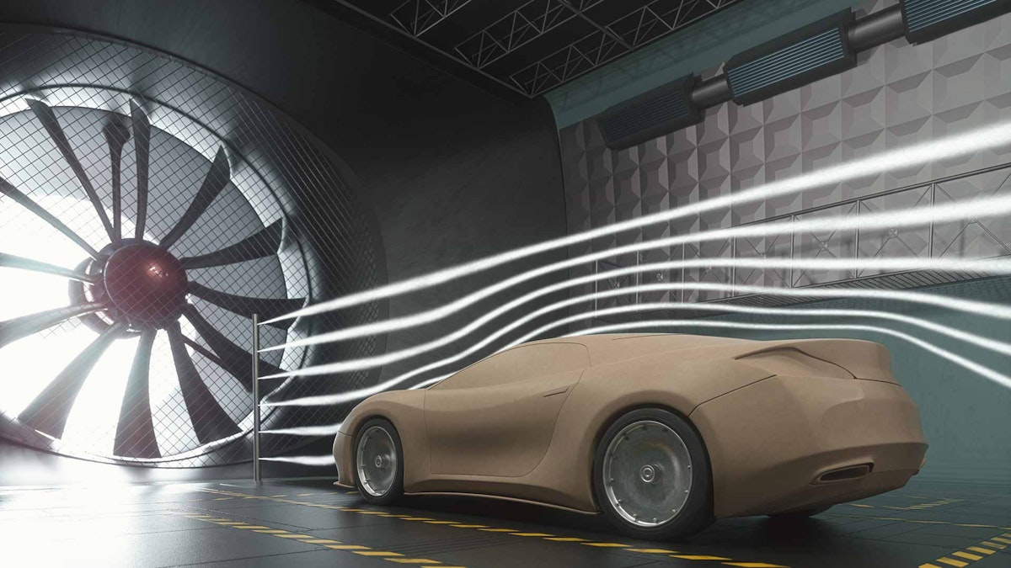
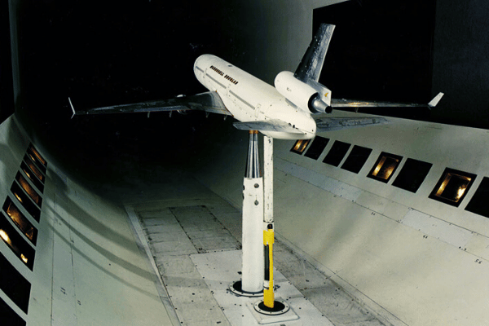

Slide 36
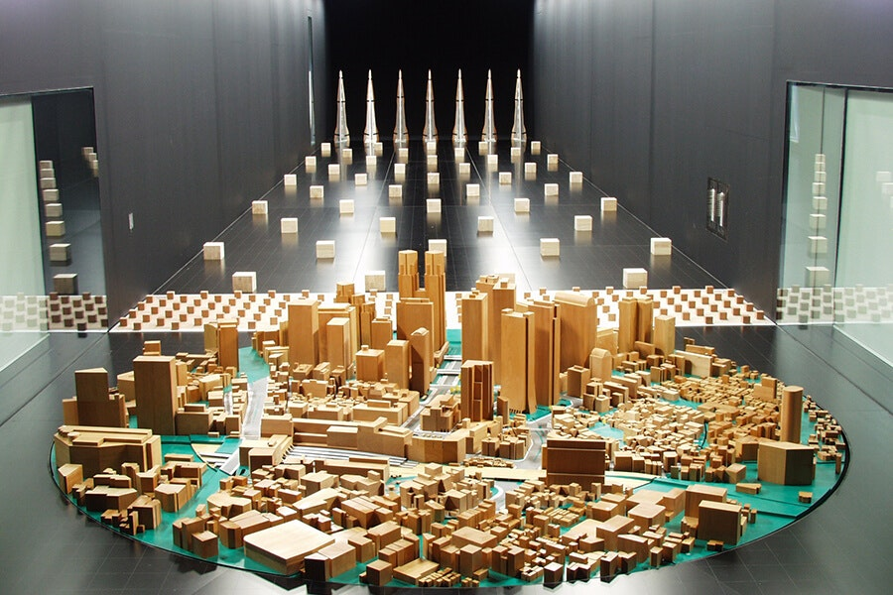

Slide 38
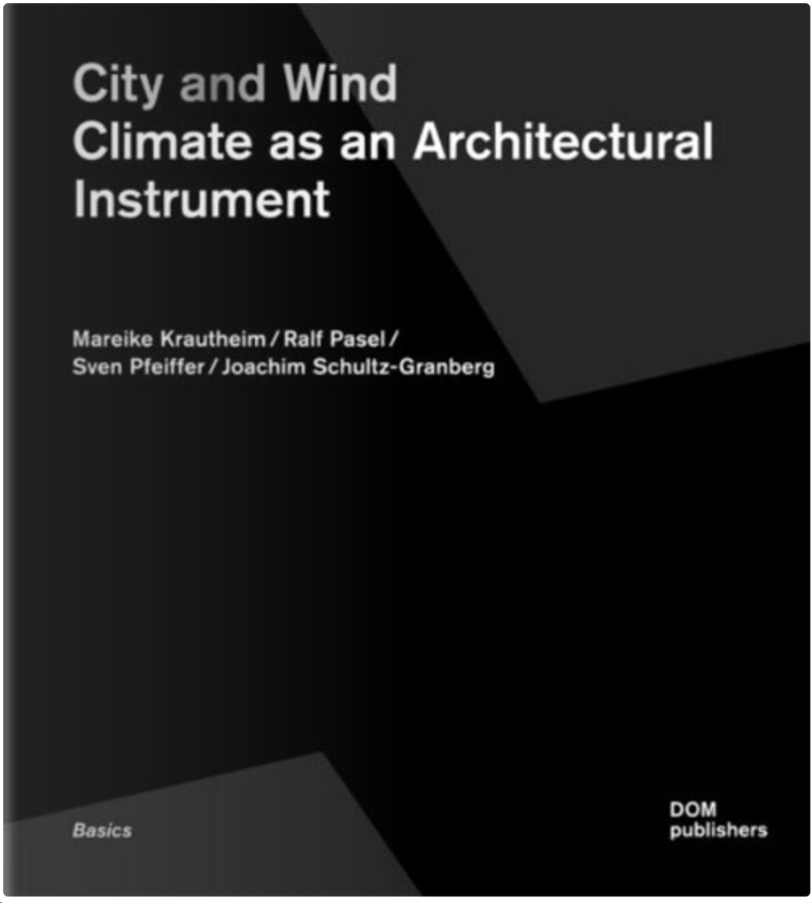
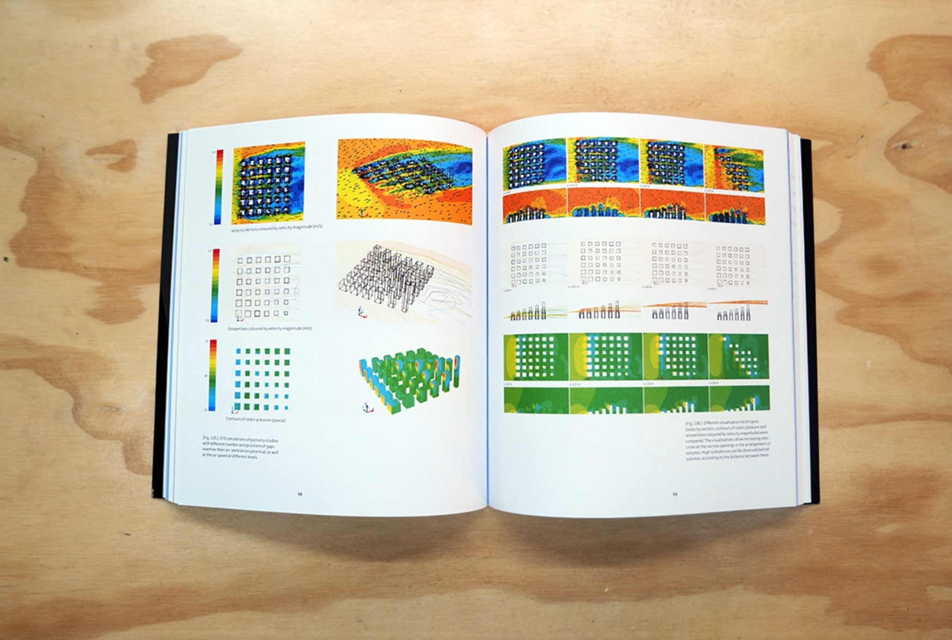

Slide 39
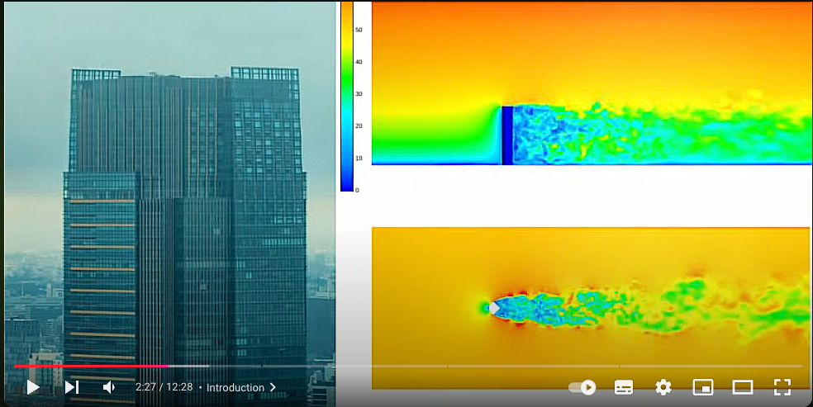
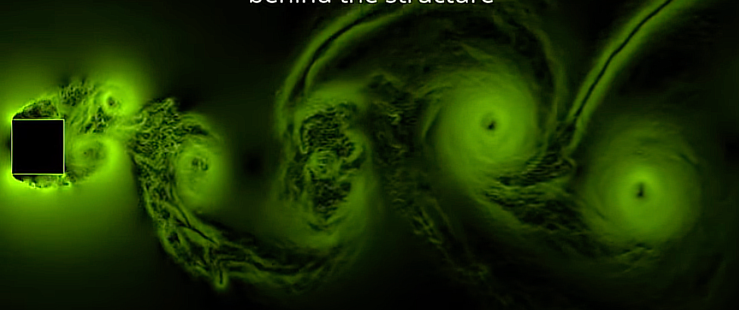
Shaping buildings to reduce wind loads | Designing tall buildings for wind
https://youtu.be/lgnFvl9rlsc?si=nvyf5I5Wv5Wdd9hz

Slide 44
Autodesk Vasari Wind Tunnel
Vasari 2.1 Ecotect Wind Tunnel
(free until 2015)

Slide 45
Anemoi: The Greek Winds

