Slide 1
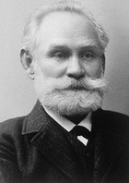
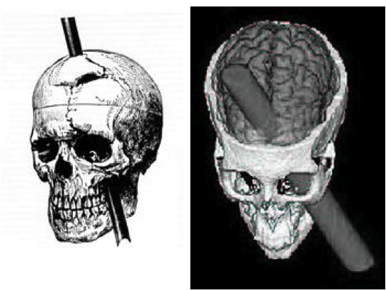

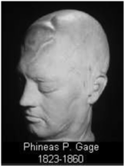
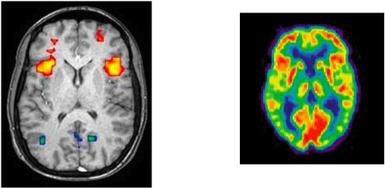
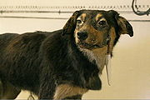
Ακουστικό Design
Οι Θεωρίες της αντίληψης

Slide 4
«The equilibrium or balance, so to speak, between his intellectual faculties and animal propensities, seems to have been destroyed. He is fitful, irreverent, indulging at times in the grossest profanity (which was not previously his custom), manifesting but little deference for his fellows, impatient of restraint or advice when it conflicts with his desires, at times pertinaciously obstinate, yet capricious and vacillating, devising many plans of future operations, which are no sooner arranged than they are abandoned in turn for others appearing more feasible. A child in his intellectual capacity and manifestations, he has the animal passions of a strong man. Previous to his injury, although untrained in the schools, he possessed a well-balanced mind, and was looked upon by those who knew him as a shrewd, smart businessman, very energetic and persistent in executing all his plans of operation. In this regard his mind was radically changed, so decidedly that his friends and acquaintances said he was "no longer Gage."

Slide 5
René Descartes (1596 - 1650)
«Le coeur a ses raisons que la raison est loin d’ignorer»
distinction corps et esprit
« Η καρδιά έχει την δική της λογική που η λογική δεν την ξέρει »
Η διάκριση ανάμεσα στο σώμα και το πνεύμα
Antonio R. DAMAZIO, Descartes’ errors, Edition Vintage, 2006, 338p.

Slide 6


The Brain's Sense of Movement
Alain,Berthoz

Slide 7
Η αντίληψη ;

Slide 8
Ivan Petrovitch Pavlov ( 1849 - 1936) - Behaviorist
Stimulus Answer
το ερέθισμα αντίδραση
αισθάνομαι / αντιλαμβάνομαι
ακούω / καταλαβαίνω

Slide 9
The Brain's Sense of Movement
Alain,Berthoz
. We need the action of the body to perceive something (from physical action to brain movement)
    . “To perceive means to act”
    Η δράση του σώματος είναι απαραίτητη για την αντίληψη
«percevoir c’est agir» : η Αντιλαμβάνομαι σημαίνει δρώ
Stimulus Answer-reaction
το ερέθισμα (αντί)δραση

Slide 10
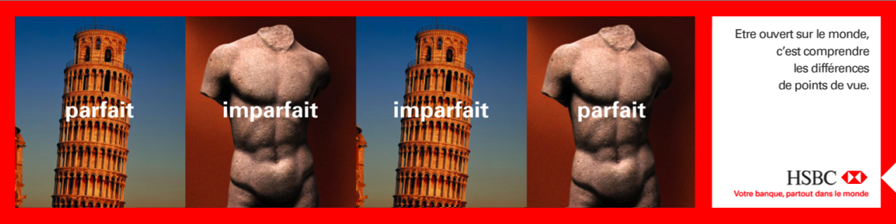
τέλειος - ατελής

Slide 11
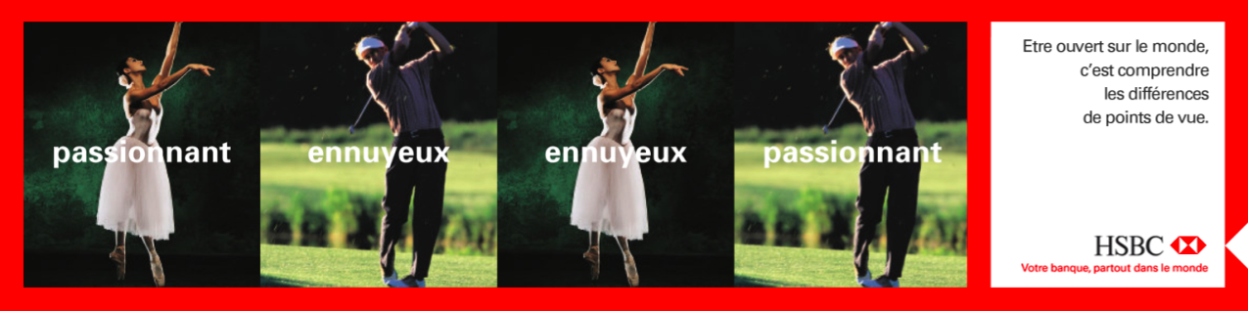
συναρπαστικός - βαρετός

Slide 12
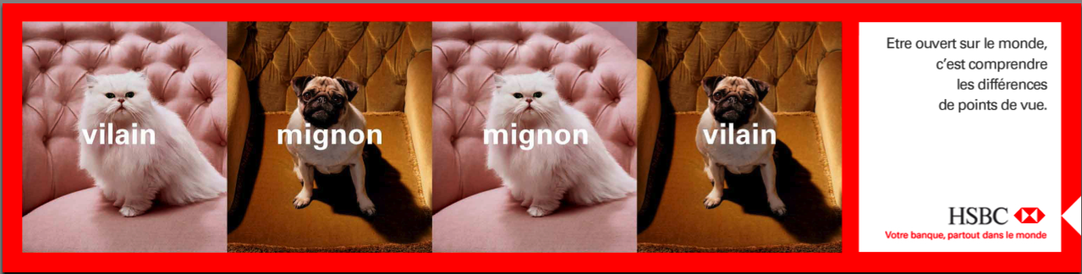
άσχημος - χαριτωμένος

Slide 13
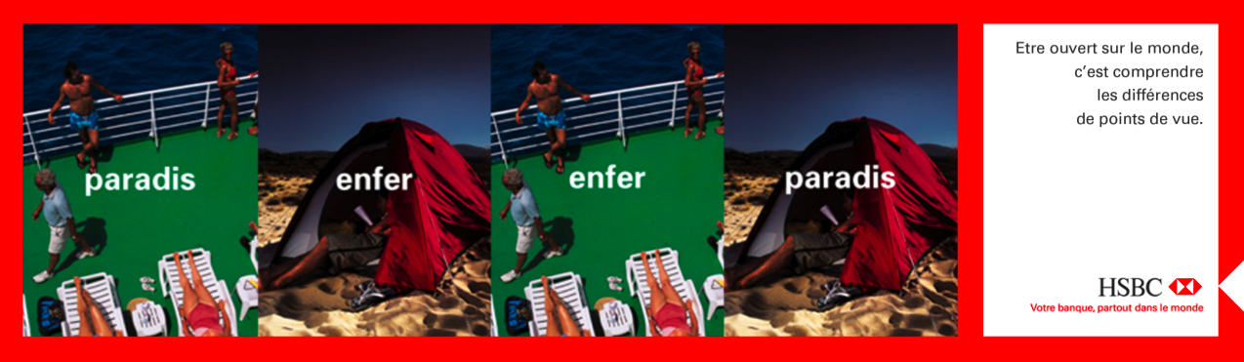
παράδεισος - κόλαση

Slide 14
Ακουστικό Design
1. Οι Θεωρίες της αντίληψης
2. Τα ποιοτικά εργαλειά της περιγραφής του ηχητκού περιβάλλοντος

Slide 15
Ακουστικό Design
Τα ποιοτικά εργαλειά της περιγραφής του ηχητκού περιβάλλοντος
A.
Pascal Amphoux
Περιβάλλον | Milieu | Τοπίο
Αναλυτική ακουή του ηχητικό « Kόsmoυ » | Κοινωνική ακουή του ηχητικό « Κόσμου » | Ακουή ενός ηχητικού τοπίου
B. ο χρόνος, ένας τόπος, το νόημα, οι κοινωνικές πρακτικές
(Jean-François Augoyard)

Slide 16
Perception of sounds to change the attitude of listening
P. Amphoux, CRESSON
« Sonic World »
Sound
Environment
Environmental listening
. Analytic description of sound
. Measurements, textual descriptions, recordings,
…
[analytic attitude – acousticians, researchers, etc…
Sound Milieu
Listening to the milieu
. Living with sounds without listening to them specifically
[everyday attitude of listening]
Soundscape
Listening to the soundscape
. Experimenting and enjoying sounds
[Esthetical attitude of listening]

Slide 17
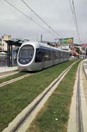
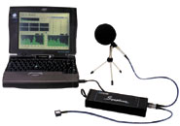
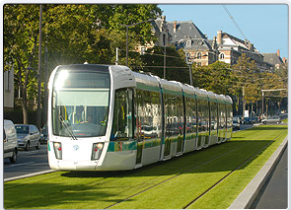
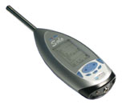
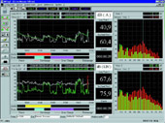
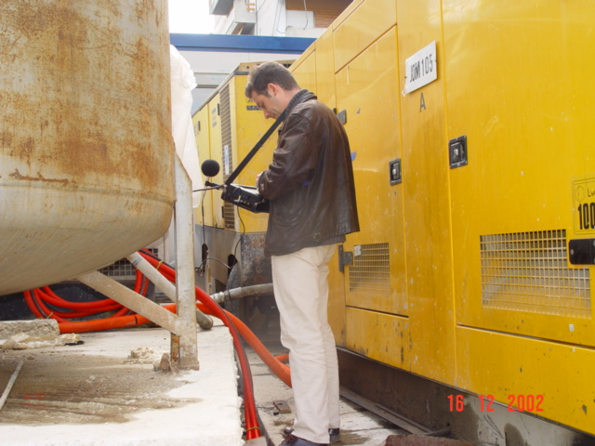
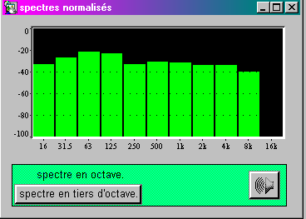
Sound Environment
Environmental listening

Slide 18
Perception of sounds to change the attitude of listening
P. Amphoux, CRESSON
« Sonic World »
Sound
Environment
Environmental listening
. Analytic description of sound
. Measurements, textual descriptions, recordings,
…
[analytic attitude – acousticians, researchers, etc…
Sound Milieu
Listening to the milieu
. Living with sounds without listening to them specifically
[everyday attitude of listening]
Soundscape
Listening to the soundscape
. Experimenting and enjoying sounds
[Esthetical attitude of listening]
Nicolas REMY ⏐ Changing Landscape, Volos, 2011

Slide 19
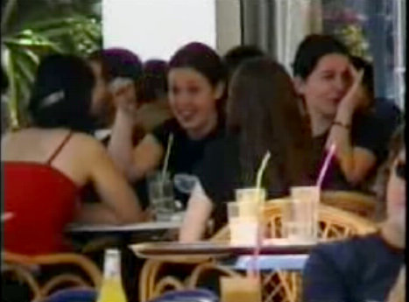
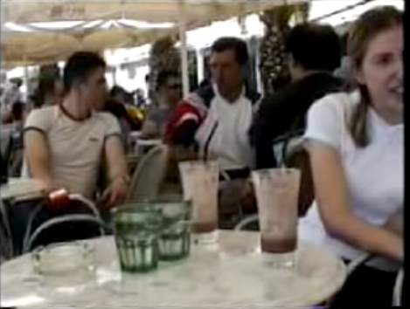
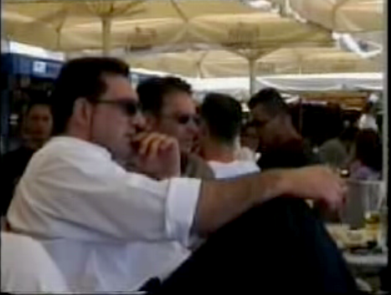
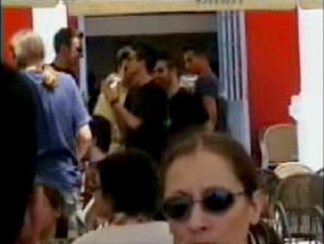
Sound Milieu
Listening to the milieu
E. Paxinou
Interpersonal communication in noise
DEA Ambiances Architecturales et Urbaine, CRESSON : Grenoble.

Slide 20
Perception of sounds to change the attitude of listening
P. Amphoux, CRESSON
« Sonic World »
Sound
Environment
Environmental listening
. Analytic description of sound
. Measurements, textual descriptions, recordings,
…
[analytic attitude – acousticians, researchers, etc…
Sound Milieu
Listening to the milieu
. Living with sounds without listening to them specifically
[everyday attitude of listening]
Soundscape
Listening to the soundscape
. Experimenting and enjoying sounds
[Esthetical attitude of listening]

Slide 21
Soundscapes
Robert Murray Schafer
« The tunning of the world, 1977 »
Definition : An environment of sound (or sonic environment) with emphasis on the way it is perceived and understood by the individual, or by a society. It thus depends on the relationship between the individual and any such environment. The term may refer to actual environments, or to abstract constructions such as musical compositions and tape montages, particularly when considered as an artificial environment.

Slide 22
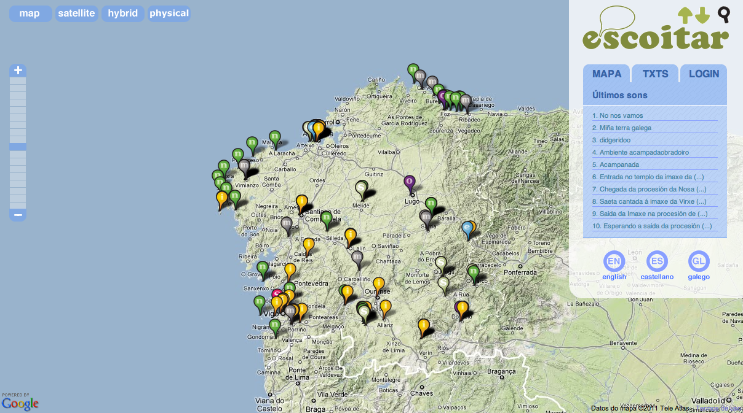
Soundscapes, http://www.escoitar.org

Slide 23
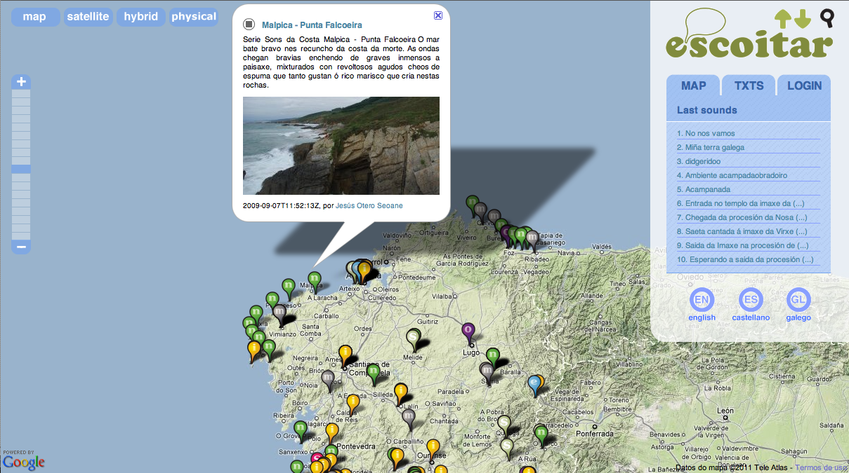
www.europeanacousticheritage.eu

Slide 24
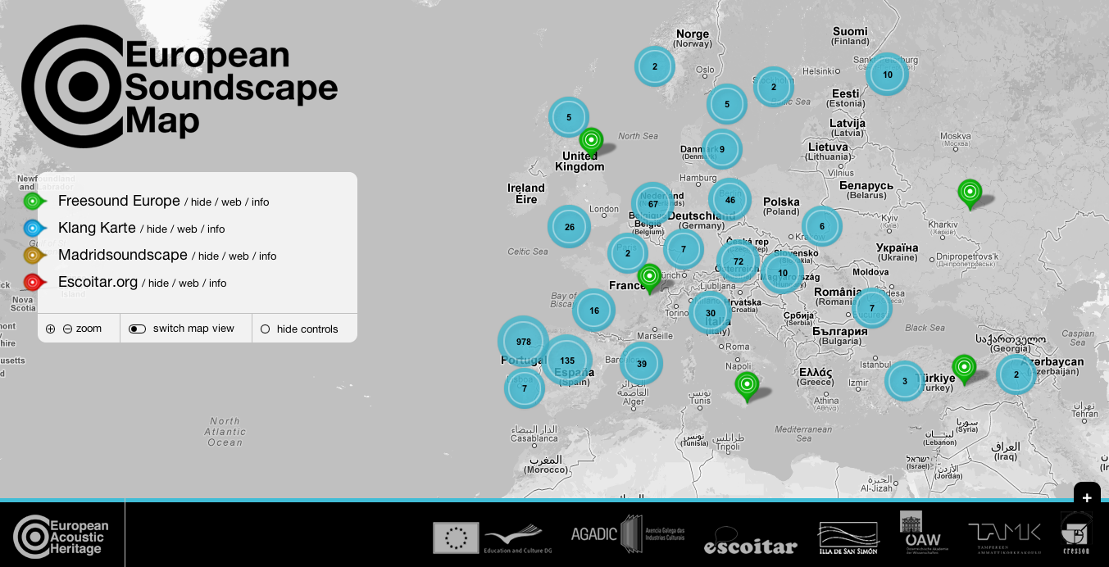
www.europeanacousticheritage.eu

Slide 25
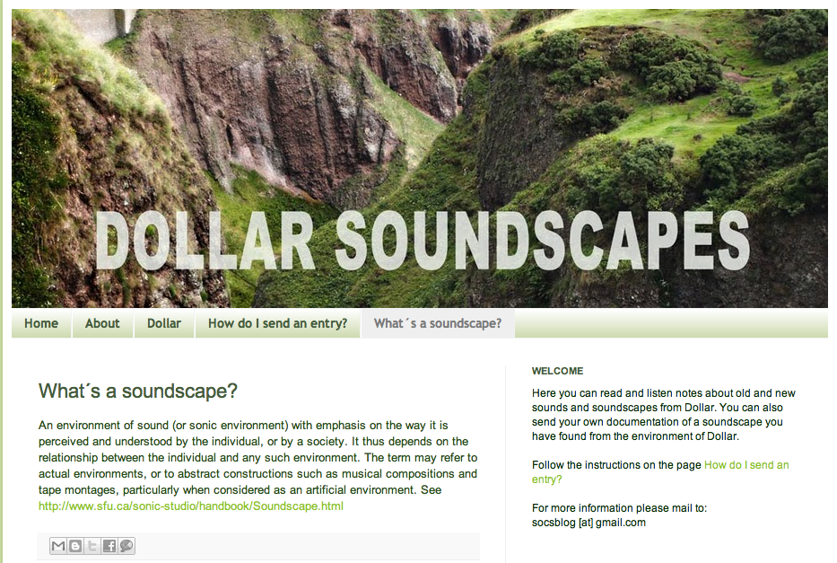
Soundscapes, http://dollarsoundscapes.blogspot.com

Slide 26
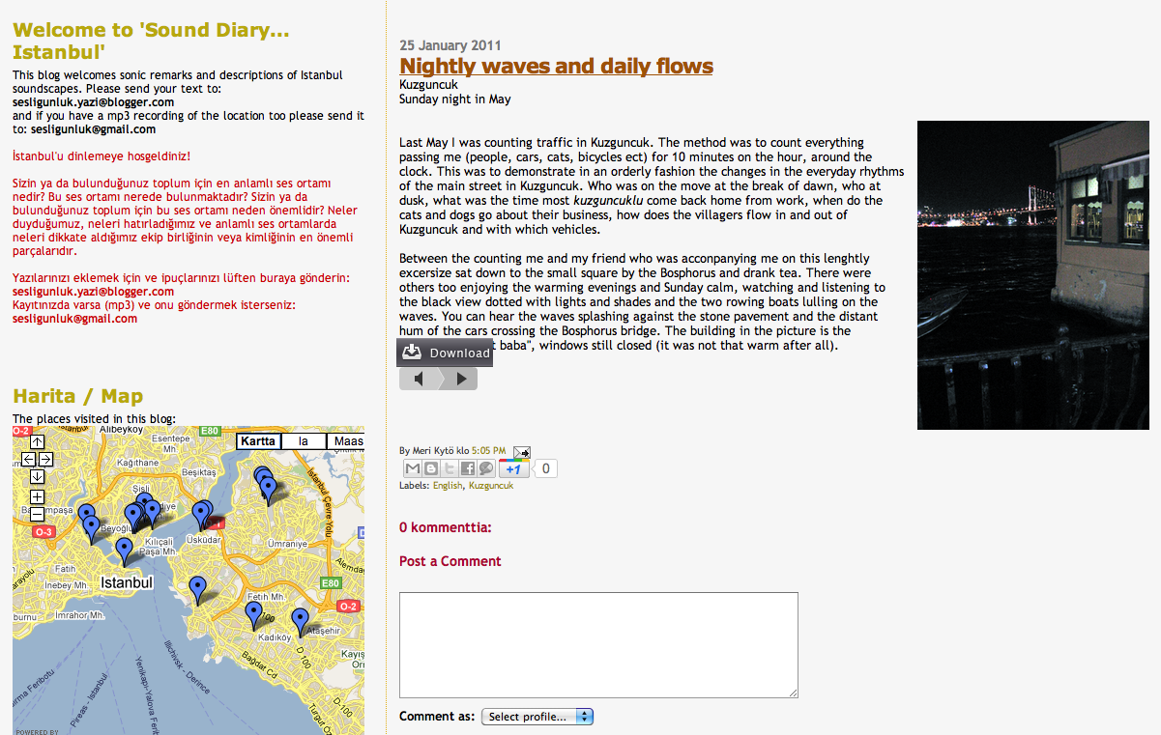
Soundscapes, http://sesligunluk.blogspot.com/2011/01/nightly-waves-and-daily-flows.html

Slide 27
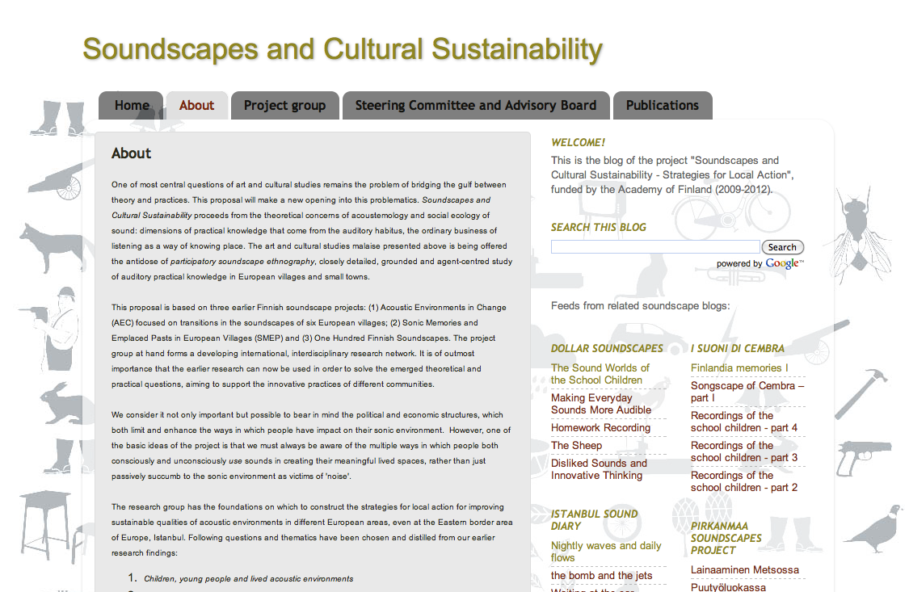
Soundscapes, http://socsproject.blogspot.com/p/about.html

Slide 28
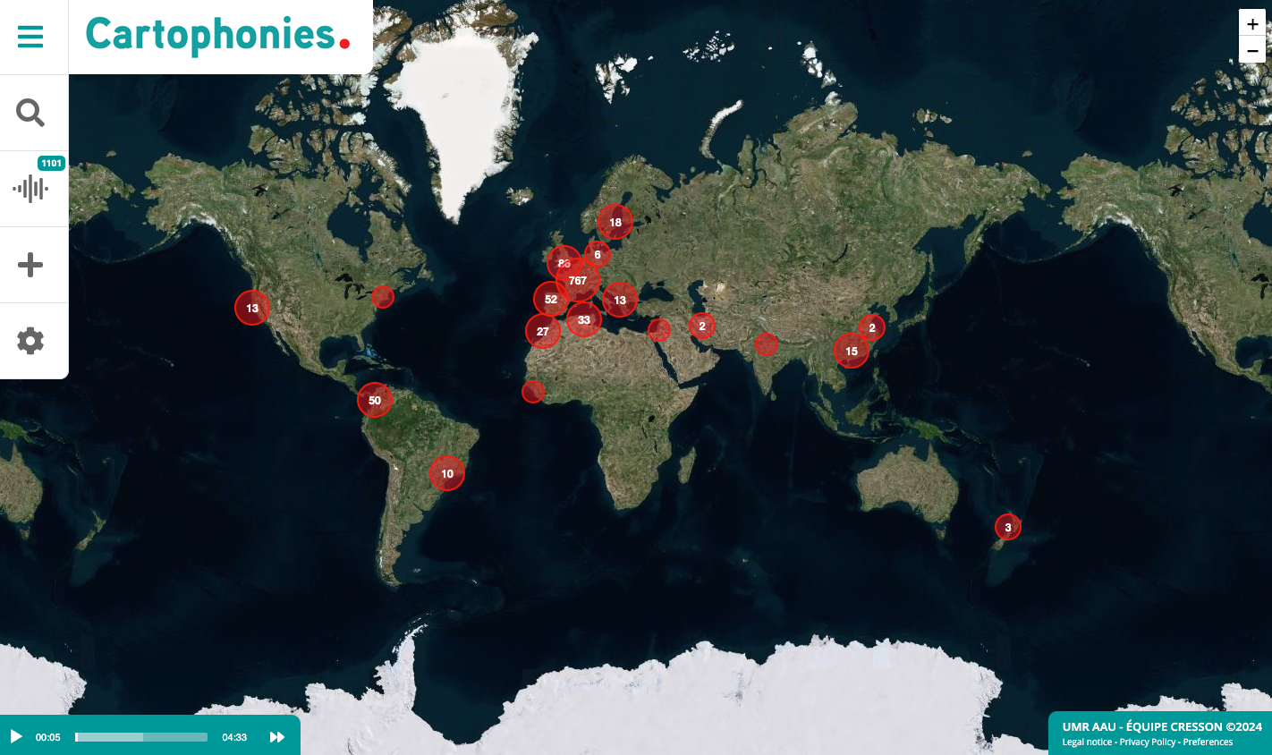
https://www.cartophonies.fr/?lang=en

Slide 29
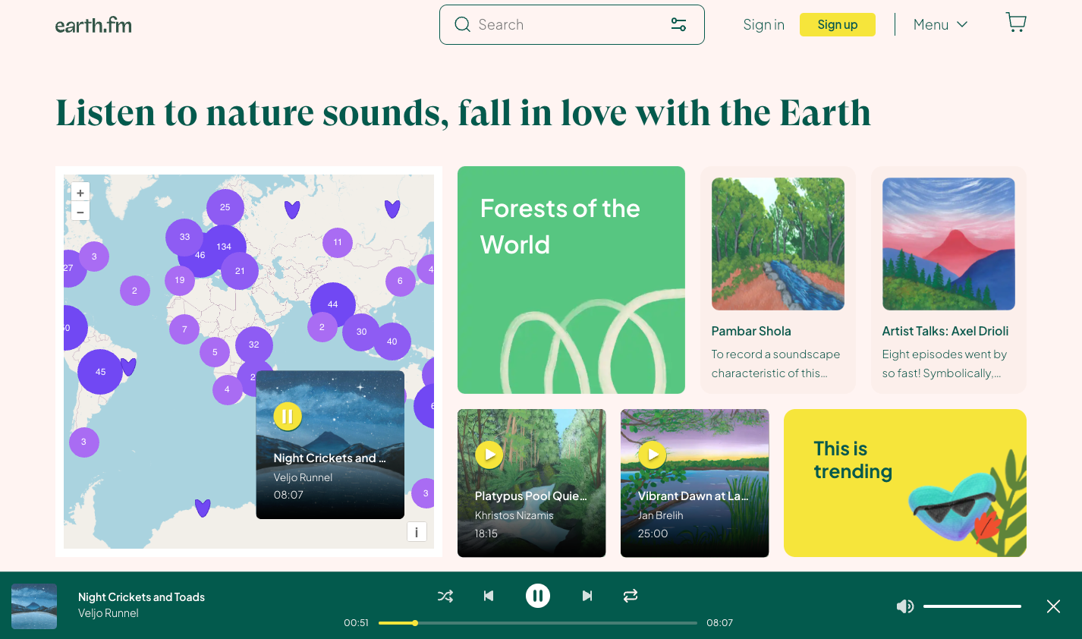
https://earth.fm

Slide 30



Ακουστικό Design
2. Τα ποιοτικά εργαλειά της περιγραφής του ηχητκού περιβάλλοντος
Γ. Sound Object / Sound Effet / Soundscape

Slide 31
Γ. Sound Object – Pierre Shaeffer (1910-1995)
https://www.youtube.com/watch?v=nNHRO_oMcEc

Slide 32
Γ. Soundscape – R. Murray Schafer
http://interact.uoregon.edu/mediaLit/wfae/home/newsletter/

Slide 33
Γ. Sound effect – CRESSON (CNRS- Ecole d’architecture de Grenoble)
(Jean-François Augoyard)
https://aau.archi.fr/cresson/cres-s-o-u-n-d/la-boite-a-effets/

Slide 34
Accelerando
Anamnesis
Anticipation
Asyndeton
Attraction
Blurring
Chain
Chorus
Cocktail
Colouring
Compression
Coupling
Crescendo
Crossfafe
Cut out
Deburau
Decontextualisation
Decrescendo
Delay
Delocalization
Desynchronisation
Dilatation
Distortion
Doppler
Drone
Dullness
Echo
Emergence
Enveloppment
Erasure
Expansion
Fade
Feedback
Filtration
Flange
Flutter Echo
Fuzz
Harmonization
Hyperlocalization
Imitation
Immersion
Incursion
Intrusion
Larsen
Limitation
Lombard
Mask
Metamorphosis
Mixing
Narrowing
Niche
Noise-Gate
Perdition
Phase
Phonomnesis
Phonotonie
Print-Through
Quotation
Rallentendo
Release
Remanence
Repetition
Reprise
Repulsion
Resonance
Reverberation
Rumble
Sharawadji
Suspension
Synchronization
Synecdoche
Tartini
Telephone
Tremolo
Ubiquity
Vibrato
Wave
Wall
Wha-Wha
Wobble
Wow

Slide 35
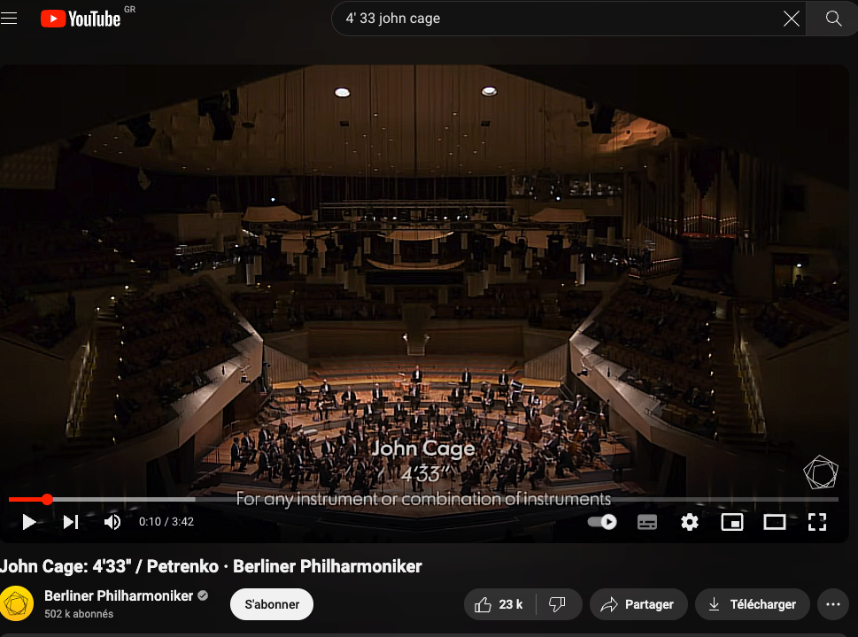

Slide 36
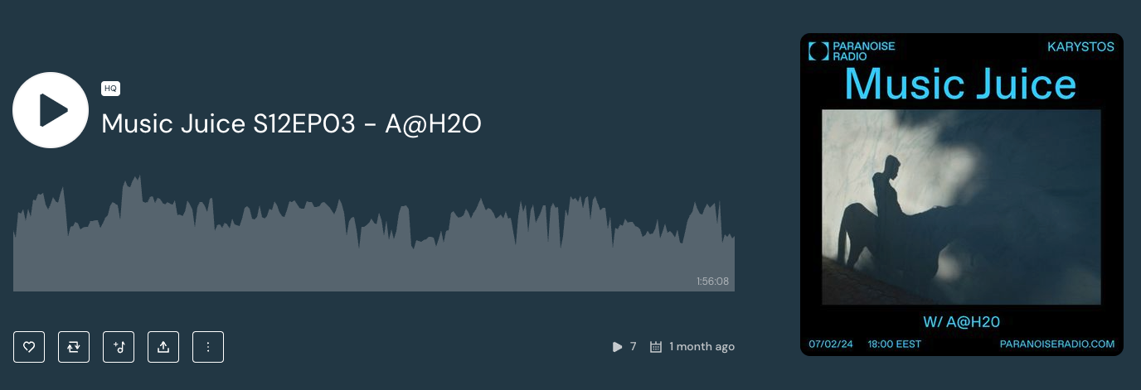
Podcast 01 : My 04’33’’

